Slide 1
MONITORING AND EVALUATION
Examples of charts and data visualisations

Slide 2

Use Built in charts and customise them to your own purposes
Using data from an existing Excel Spreadsheet

Slide 3
Use Built in charts How to Guide
PART ONE

Slide 4
Instructions for using charts
Windows Screenshots

Slide 5
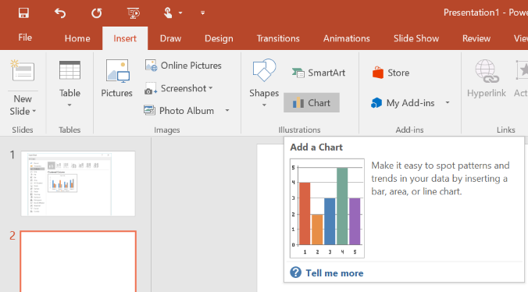
Step 1
Insert a chart
These screenshots may not look the same as your version of PowerPoint

Slide 6
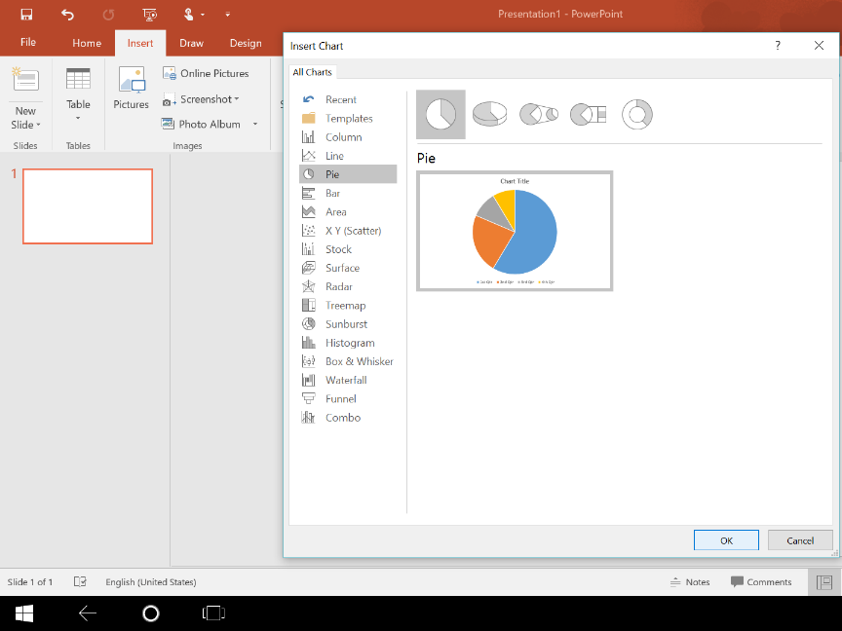
Step 2
Select a Chart to Insert

Slide 7
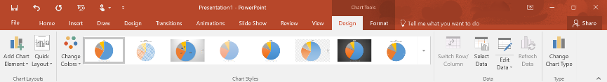
In the Charts Tool Tabs you can edit the:
Layout
Styles
Data
Chart
Edit or replace in Excel
Other
Scatter
Area
Bar
Pie
Line
Column

Slide 8
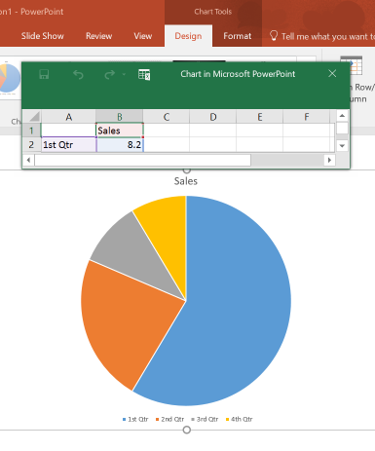
Step 3
Add your data fields to the Excel Spreadsheet

Slide 9
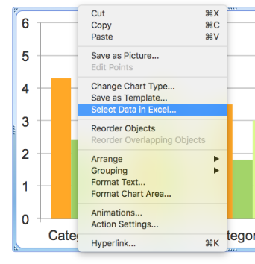
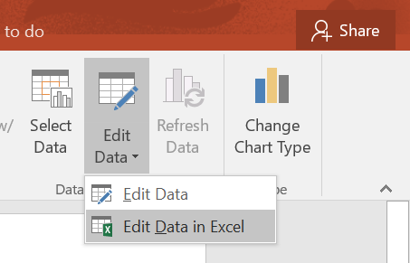
If Excel doesn’t open automatically when you choose a chart you can either right click or click on the icon to edit the data

Slide 10
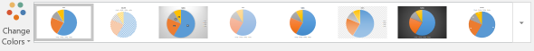
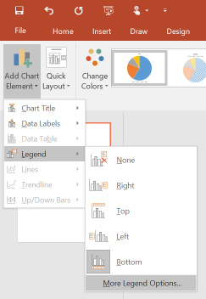
Step 4
Format the chart to clearly display the findings

Slide 11
Instructions for using charts
Mac Screenshots

Slide 12
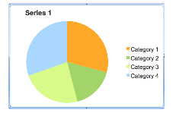
Step 1
Click on Chart area
In the Charts Tool Tabs you can edit the:
Chart
Data
Layout
Styles
Edit or replace in Excel
Other
Scatter
Area
Bar
Pie
Line
Column
In the Chart Layout tab there are options to edit:
Labels
Axes
Analysis

Slide 13
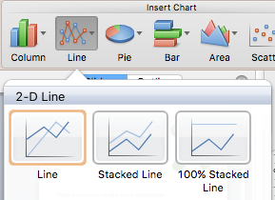
Step 2
Select a Chart to Insert

Slide 14
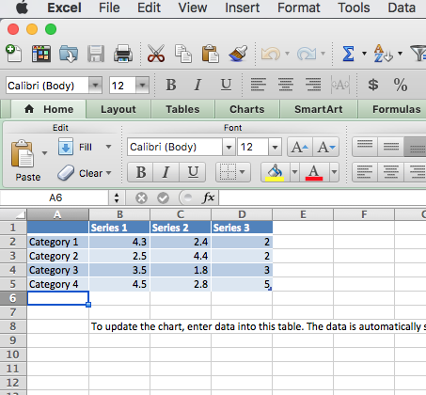
Step 3
Add your data fields to the Excel Spreadsheet

Slide 15

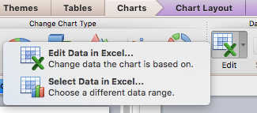
If Excel doesn’t open automatically when you choose a chart you can either right click or click on the icon to edit the data

Slide 16
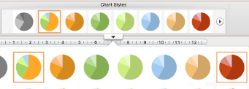
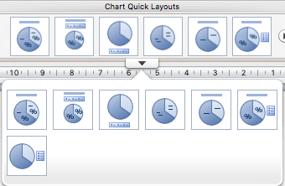
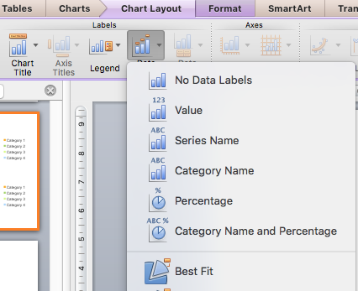
Step 4
Format the chart to clearly display the findings

Slide 17
Use Built in charts EXAMPLES
PART TWO

Slide 18

BUILT IN CHARTS Column Graph

Slide 19

BUILT IN CHARTS Pie Chart

Slide 20

BUILT IN CHARTS Line Graph

Slide 21

BUILT IN CHARTS Other

Slide 22
Build Your own charts to visualise the findings
Use your data with the following templates to

Slide 23
The following are examples of visualising data that are not built in features of PowerPoint
Use these as templates to populate with your own data.

Slide 24
Dashboard
Customise this Dashboard for your own purposes
40%
50%
60%
30%
70%
20%
80%
Category 1
10%
90%
Category 2
0%
Category 3
100%
Dashboard Instructions
Click on the arcs and drag the yellow endpoint to create the percentage scale
Arrow guage: Click on the line and move the endpoint to the focus percentage area
Notes:
Dashboard Instructions
Click on the arcs and drag the yellow endpoint to create the percentage scale
Arrow guage: Click on the line and move the endpoint to the focus percentage area

Slide 25
Icons
Category 1
Example Text
Category 2
Example Text
Category 3
Example Text
https://thenounproject.com is a good resource for icons that may be relevant to the nature of the data
Notes:
https://thenounproject.com is a good resource for icons that may be relevant to the nature of the data

Slide 26
Dashboard & Icons
40%
50%
60%
30%
70%
20%
80%
Category 1
10%
90%
Category 2
0%
Category 3
100%
Category 1
Category 2
Category 3
Notes:
Dashboard Instructions
Click on the arcs and drag the yellow endpoint to create the percentage scale
Arrow guage: Click on the line and move the endpoint to the focus percentage area
https://thenounproject.com is a good resource for icons

Slide 27
Comparative
25%
50%
CATEGORY 1
CATEGORY 1
CATEGORY 1
100%
Explanatory Text
Explanatory Text
Explanatory Text
Explanatory Text Explanatory Text
Explanatory Text
Explanatory Text
Explanatory Text Explanatory Text
Explanatory Text
Explanatory Text
Customise these for your own purposes
Notes:
Visual representation of a comparative percentage scales with explanatory text or analysis of the result.
(Evaluation of monitored data)

Slide 28
Comparative
Explanatory Text Explanatory Text Explanatory Text Explanatory Text
25%
Explanatory Text Explanatory Text Explanatory Text Explanatory Text
50%
Explanatory Text Explanatory Text Explanatory Text Explanatory Text
75%
Explanatory Text Explanatory Text Explanatory Text Explanatory Text
100%
Customise these for your own purposes

