Slide 1
Today’s webinar with Dr Julia Butt from NDRI will be starting at 10am A.W.S.T.
Here are some tips for when the webinar starts.
To use the chat feature in this webinar, press on the purple arrow on the right hand side of the webinar room, and select ‘chat with everyone’. Feel free to use the ‘chat’ box to ask questions if you are having difficulties.
If you are having difficulties with video quality
  Close all other applications running on your computer including email, instant messenger, browsers etc.
  Open this webinar in Google Chrome browser.
If you are having difficulties with sound quality
  Try using headphones for better audio
  Ensure volume is turned up on your computer
  You can dial into the webinar – ask the hosts for information on how to do this
If problems still persist we recommend you logout of this session then log back in.
Please note, this webinar is recorded. It will be made available on the Knowledge Centre website at a later date.

Slide 2
Presenter: Dr Julia Butt
National Drug Research Institute
Kava in Australia
25 June 2019

Slide 3
Acknowledgement of Country
We would like to acknowledge the Traditional Owners of the land we are standing on today, the Whadjuk Noongar people, and pay our respects to Elders past, present and future.

Slide 4
Kava
Kava use among Aboriginal Australians – Understanding the evidence
Julia Butt
Senior Research Fellow
National Drug Research Institute, Curtin University

Slide 5
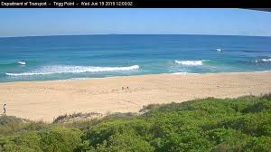


Slide 6
Overview
What is kava
Who uses kava
What are the effects of kava on health
Kava in Australia
  What can the research even tell us…
  Where is it used
  Effects of kava on health
  Effects of kava on community
Kava policy

Slide 7
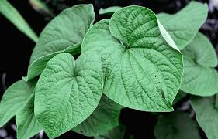
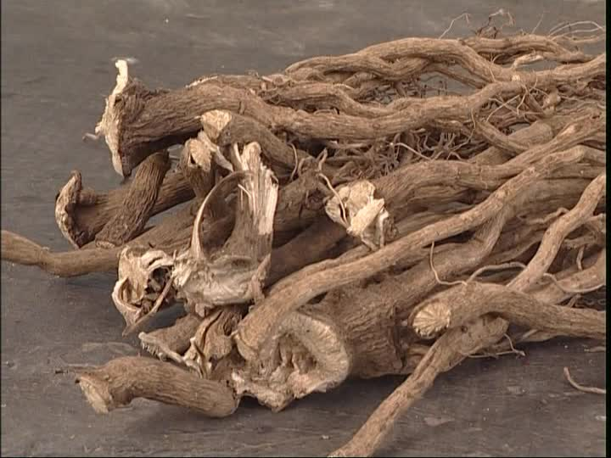
What is kava
A plant, a root, drink
Piper Methysticum Forst F – pepper plant – grows in tropical Pacific countries

Slide 8
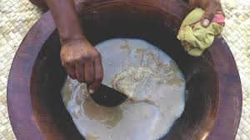
What is kava
Drink is an infusion of kava root and water (or coconut milk)
Non-fermented

Slide 9
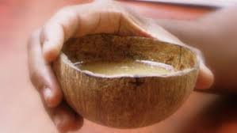
What is Kava
What it feels like:
  Sociability
  Peace
  Positive mood
  Reduced anxiety
  Relaxation
Increased intoxication:
  Sleepiness – leading to deep sleep
  Muscle weakness
  Ataxia
  Sense of unreality and fatigue
  Dilated pupils
  Numb mouth

Slide 10
What is Kava
Psychoactive properties due to kava lactones (kavapyrones)
Absorbed through the gastrointestinal tract
Kava has a dose dependent effect on the CNS
Kava lactone extracts are being used increasingly in Western natural medicine as a treatment for anxiety, depression and insomnia.

Slide 11
Who Uses kava
Pacific Islands: Melanesia, Polynesia, Micronesia
  Ceremonially, socially, medicinally
  General increase in the frequency and quantity of use
Pacific diaspora
Some Arnhem Land communities in the Northern Territory, Australia
Other populations internationally

Slide 12
Why is Kava Use an Issue in Australia?
Manage the competing needs of different populations in Australia
  Aboriginal people in Arnhem Land
  Australians with Pacific heritage
  Consumers of natural medicine
  Economies of Australia’s Pacific neighbours

Slide 13

Health Effects of Kava Use
Challenging area of research
Methodological rigour
Lack of recent Australian data
Small complex populations
Some evidence for benefits

Slide 14

Is Kava Harmful to Health
United Nations (FAO - 2016, WHO - 2007) – Food Standards Australia and New Zealand (2005)
  The overall potential for harm from moderate kava use is low
  Doesn’t mean no potential for harm
  Doesn’t mean heavy use is low harm

Slide 15
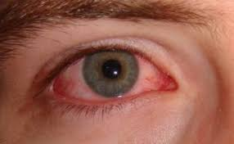
Is Kava Use Harmful to Health?
Short term potential for harm
  Driving
  Accidents
  Nausea
  Eye discomfort
  Toxicity is considered low

Slide 16
Is Kava Use Harmful to Health
Kava dermopathy
Liver functioning
Low body weight
Poor health
Low motivation
Cognitive function
Seizures

Slide 17
Is Kava Use Harmful to Health?
Systematic Review (Rychetnik and Madronio, 2011)
  Causality indicated
    Kava dermopathy
    Raised liver enzymes (GGT)
    Nausea
    Weight loss / Low body weight
  Association indicated - Association hypothesis
    Red eyes Fits, seizures
    Poor health Meliodosis
    Impotence Ischemic Heart Disease
    Raised cholesterol
    Low motivation

Slide 18
Is Kava Use Harmful to Health
Kava dependence?
Drug interactions
Risks associated with practices:
  Production
  Sale
  Consumption

Slide 19
Is Kava Use Harmful to Health
Moderate use put people at a low risk for harm.
There is insufficient evidence to define moderate or heavy kava use.
There is insufficient evidence regarding the health effects of heavy kava use.

Slide 20
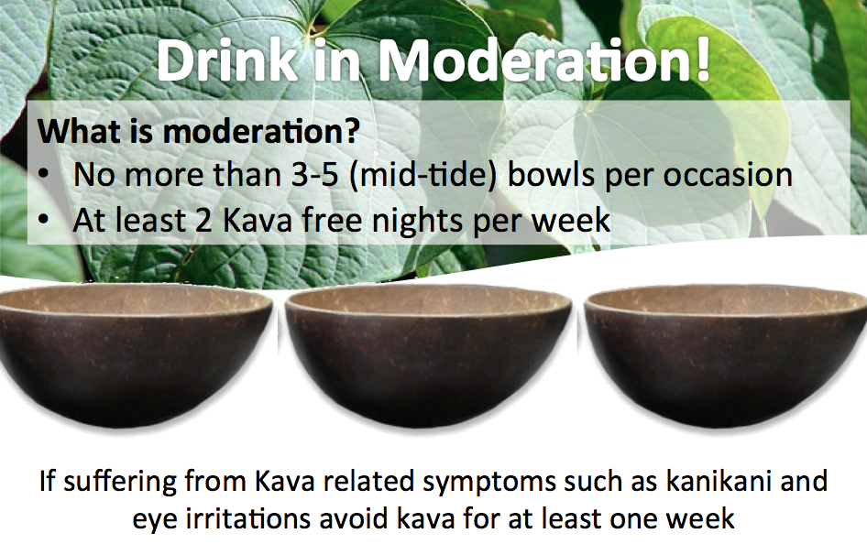
Fijian Ministry of Health and Medical Services

Slide 21
Kava use in Arnhem Land
In Australia kava is used in all states and territories.
Concerns about kava use are limited to communities in Arnhem Land, Northern Territory.
Kava use is not of concern for other Aboriginal or Torres Strait Islander communities.

Slide 22
Kava use in Arnhem Land
Kava is used in around 8 Arnhem Land Communities and has been since 1982.
Kava was introduced in the context of social change.
  Kava was introduced as an alcohol control measure “Fellowship without the harms”
  Kava use was ‘encouraged’; considered safe and socially acceptable

Slide 23
Kava use in Arnhem Land
Understanding the research
  Regulation
  Challenges of research in small communities
  Research before 2007
  Research since 2007…

Slide 24
Kava Policy Milestones
1982 -1990 – Unregulated
1990 – 1993 – Kava Licensing
1993 – 1998 – Regulatory hiatus
2002 – 2007 – Second kava licensing period
2007 – current – Kava import restriction
2019 announcement

Slide 25
Kava use in Arnhem Land
Understanding the research
  Regulation
  Challenges of research in small communities
  Research before 2007
  Research since 2007…

Slide 26
Kava use in Arnhem Land
Extent and pattern of kava use
  In kava using communities until 2002 there was an increasing number of people who drank kava and increasing quantities of kava consumed per person.
  In kava using communities: typically half of all males were using and using at levels consistent with harm.
  More prevalent among males over 30.
  High volumes, long duration

Slide 27
Kava use in Arnhem Land
Kava use does not occur in isolation
  Alcohol
  Cannabis
  Other drugs
Current extent of kava use
  Black market activity
  Anecdotal evidence

Slide 28
Effects of Kava use in Arnhem Land
No systematic evidence for the positive effects
  Reduction in alcohol consumption and related harms
  Increased fellowship
Anecdotal report cannot be ignored
    Beliefs about alcohol and kava
    Keeping people in community

Slide 29
Effects of Kava use in Arnhem Land
Health – prior to 2002
  Kava dermopathy (45% - Clough; 60 - 70% of heavy drinkers - Mathews)
  Elevated liver enzymes (61% people who use Clough)
  Poor overall health (39% heavy drinkers, Mathews)
  Low BMI (32% people who use, Clough)
  Redness of eyes
  Poor motivation

Slide 30
Effects of Kava use in Arnhem Land
Health
  Immune functioning
  Seizures
  Cardio vascular health
Understanding health effects
Recent information - anecdotal

Slide 31
Effects of Kava use in Arnhem Land
Social
  Economic impacts
  Time out-of-role
    Culture
    Health, nutrition, hygiene
    Care for children
    Family
    Community participation
    Workforce participation

Slide 32
Effects of Kava use in Arnhem Land
Community
  (Health effects + Social effects) x prevalence
  Declines in community activites, cultural activities, community cleanliness
  Cash drains
  Clough: More than half males, 20-40% females and 20% available cash then community function is impacted.

Slide 33
Managing Harms
Health promotion
Health screening
Alcohol and other drug workforce – poorly resourced
Lack of evidence
What to do in absence of evidence
  Best practise in AOD
  Recognise individual risk factors
  Recognising the social determinants of health

Slide 34
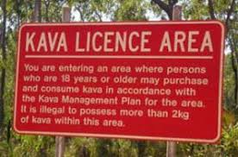
Kava Regulation
Supply reduction measures…

Slide 35
Kava Policy Milestones
1982 -1990 – Unregulated
1990 – 1993 – Kava Licensing
1993 – 1998 – Regulatory hiatus
2002 – 2007 – Second kava licensing period
2007 – current – Kava import restriction
2019 announcement

Slide 36
Kava Regulation
1982 -1990 – Unregulated
  Rapid expansion
  Emergence of a black market
  Communities did use their own strategies to minimise harm
  WA - ban
1990 – 1993 – Kava Licensing
  Response to emerging harms (goal was to reduce consumption, responsible sale of kava)
  Community ownership
  Possession not illegal – black market continued to grow
  Evaluated

Slide 37
Kava Regulation
1993 – 1998 – Regulatory hiatus
  Change in Food Standards act meant NT laws contravened Act – licensing ended
  Licensed sale ceased
  Not accompanied by resourcing for health nor policing
  Black market flourished

Slide 38
Kava Regulation
2002 – 2007 – Second kava licensing period
  National Code of Kava management: Regulate use and to ensure provision for cultural use.
  Licensing in NT: retail licenses in communities
  Positives: cash remained in communities, health advisory group established
  Negatives: Not evaluated… daily consumption limits not appropriate, under age drinking, persistent black market, reliance on income.

Slide 39
Kava Regulation
2007 – current – Kava import restriction
  Health minister Abbot announced restrictions on the importation of kava.
  Allowed incoming passengers up to 2KG kava
  Timing consistent with the NTER and return to paternalistic policy
  Announcement was not made in consultation, communities not prepared
  Limited anecdotal evidence suggests a decrease in kava related harm
2019 announcement
  Scott Morrison announced potential increase to importation restriction
  Community consultation has been sought…

Slide 40
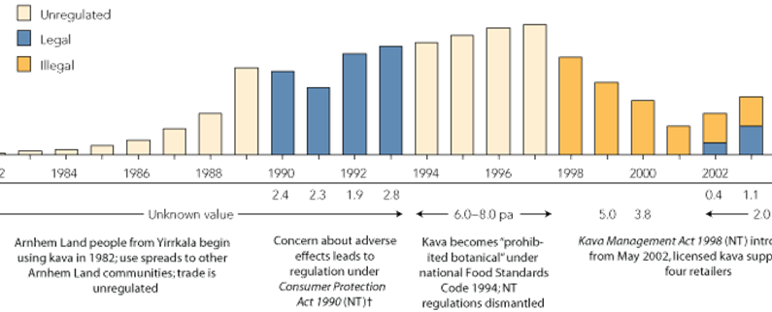
Implications of Policy
Clough et al., 2006

Slide 41
Implications of Policy
Only licensing included community consultation, clear objectives and mechanisms to monitor objectives. Both periods were terminated prior to adjustments being made.
Policy changes were not coordinated supported by increases to health or policing services.
Lack of evaluation is worthy of note.
Policy implementation is an area which can cause harm.

Slide 42
Recognising what we know and what we don’t know
We do know
  Moderate kava use is low risk.
  Kava use can cause individual and community level harms when use is heavy.
  Kava use is part of the picture. It is not the only picture.
  Communities need to be supported to address kava (and other drug) related harm
  Community consultation is required to develop and implement policy.

Slide 43
Recognising what we know and what we don’t know
We don’t know
  Prevalence
  Clearly what harms are. What the mechanisms are for some harms.
  Characteristics of kava use dependence.
  Relationship with alcohol related harm (or other drugs).

Slide 44
Future Directions
Need for research across cultures as well as within.
  Kava dependence
  Safe levels of consumption
  Impacts of chronic heavy consumption
  Prevalence

Slide 45
Future Directions
Collaborative development and implementation of policy
Action and resourcing to prevent black market
Action and resourcing to support health and wellbeing specific to kava
A clearer focus on the social determinants of health

Slide 46
Dr Julia Butt
Senior Research Fellow, NDRI
julia.butt@curtin.edu.au

Slide 47
Dr Julia Butt (NDRI)
Email: julia.butt@curtin.edu.au
Thank you!
Millie (HealthInfoNet)
Ph: (08) 9370 6358
Email: m.harford-mills@ecu.edu.au

