Slide 1
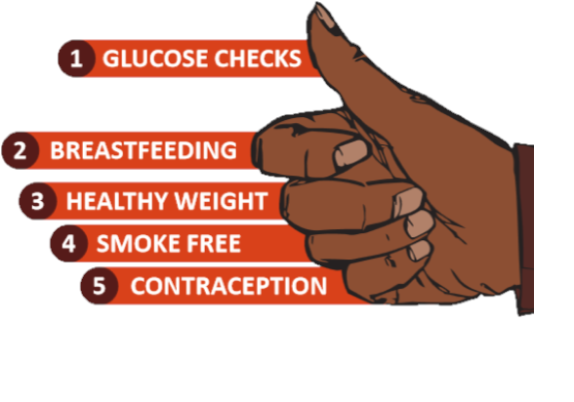
Postpartum Management
The Key Five

Slide 2
Context
1 in 5 pregnancies among Aboriginal mothers in the NT was complicated by hyperglycaemia in 2015¹
Preventing hyperglycaemia improves pregnancy & obstetric outcomes
Offspring exposed to hyperglycaemia in-utero have higher rates of diabetes and overweight
Mothers with previous GDM are at high risk for GDM in future pregnancies, future type 2 diabetes and other cardiometabolic conditions
Ref: 1. NT DoH 2018

Slide 3
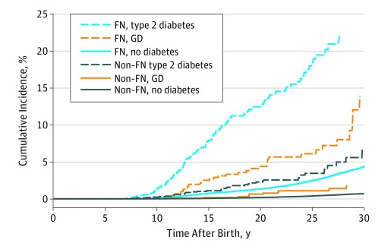
In-utero GDM & T2M exposure & risk of diabetes in offspring – Manitoba, Canada
Ref: JAMA Pediatrics 2018

Slide 4
The importance of the post-partum period
Opportunity to:
Implement strategies to improve offspring health
Optimise “pre-conception” health for the next pregnancy
Maximise mothers’ long-term health

Slide 5

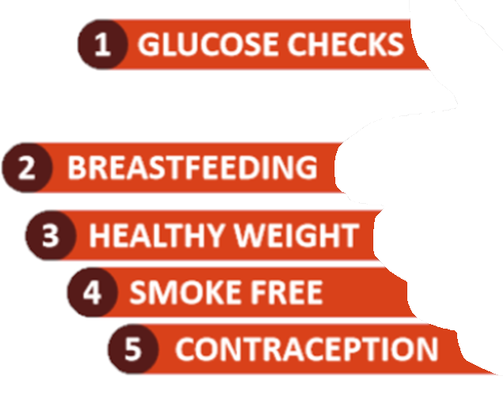

Slide 6
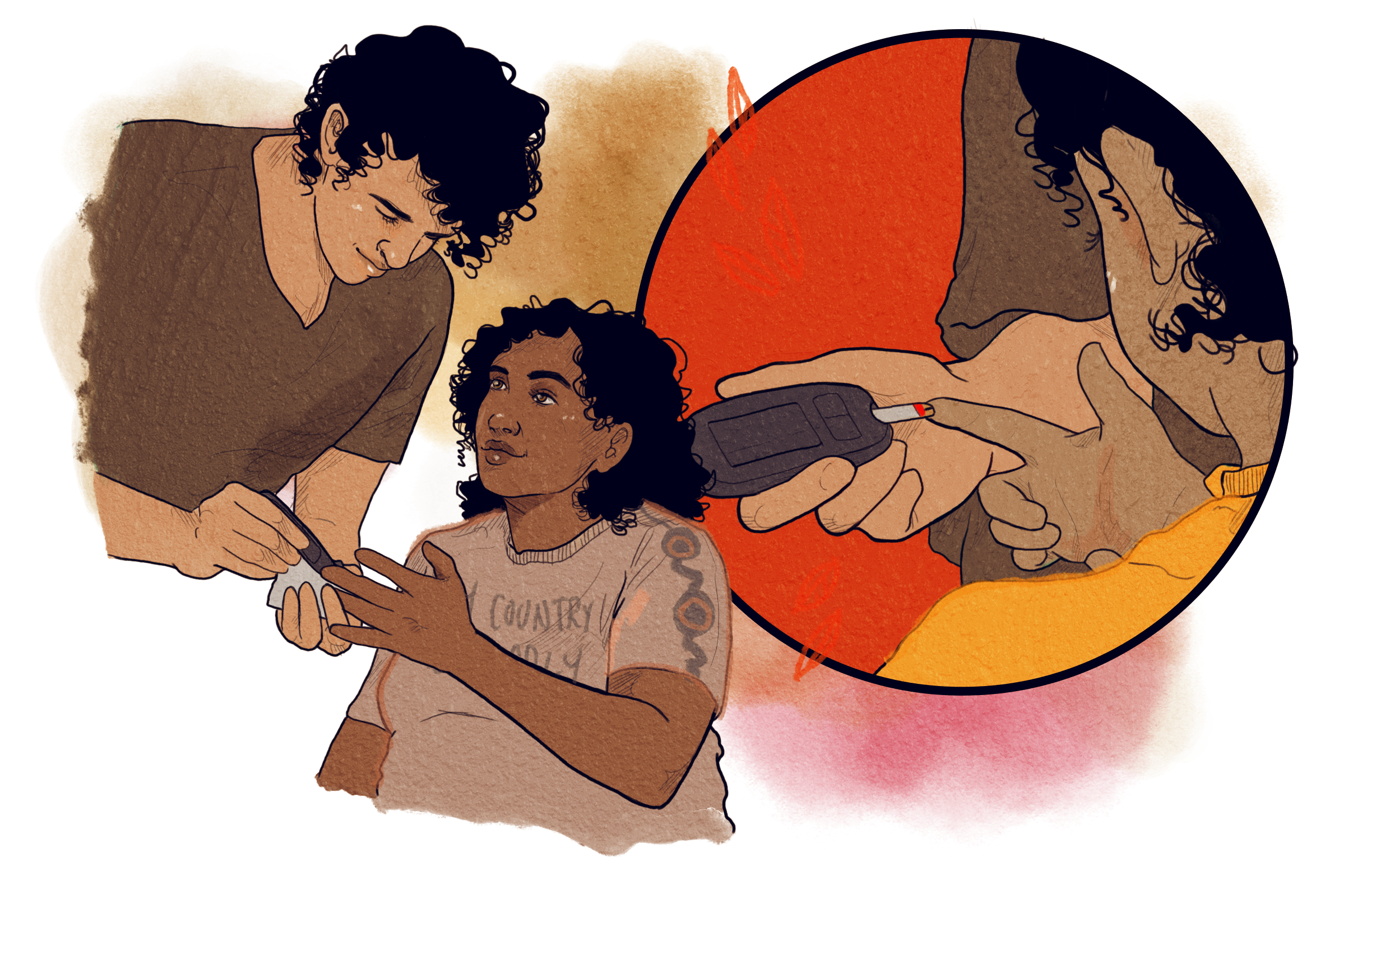
Glucose Checks - GDM
Postpartum glucose check:
First-line - 6-8 week post partum OGTT*
HbA1c at 4 months if OGTT not feasible
Recall for yearly HbA1c and Adult Health Check
Recommend 75 gm OGTT if HbA1c 5.7-6.4% on above
Discuss
Risk of developing T2DM
Early check for DIP in next pregnancy – OGTT at first visit
*OGTT = fasting 75 gram oral glucose tolerance test
CARPA Women’s Business Manual, pp 210-211

Slide 7
OGTT not HbA1c for early checks post-GDM
Women attending at 6-8 weeks postpartum for other postpartum checks and routine child health checks provides an opportunity for an early postpartum glucose check
HbA1c is unreliable before 4 months (and potentially up to one year) postpartum due to changes in Hb turnover
Reflects blood glucose levels of three months prior to test
Level is lower during pregnancy & following peripartum blood loss
Kim C, et al. 2011. Diabetes Care 34:1949-1951.

Slide 8
Importance of glucose checks post-GDM
T2DM risk after GDM
4x higher risk in Indigenous compared with non-Indigenous women
At 7 years postpartum, 42.4% of Indigenous women were diagnosed with T2DM compared with 13.5% of non-Indigenous women
Chamberlain C, et al. 2016. Diabetes Metab Res Rev 32:217-227.

Slide 9
Glucose Checks in T2DM
Review medications:
Reconsider need for insulin if commenced in pregnancy
Usually continue metformin
Other oral diabetes treatments not to be used when breastfeeding
HbA1c at 4 months
Discuss planning next pregnancy and pre-pregnancy checks
CARPA Standard Treatment Manual, p 254; CARPA Women’s Business Manual p 210

Slide 11
Breastfeeding
Benefits to mothers with diabetes in pregnancy and their children
Children – reduction in risk of developing type 2 diabetes and obesity^{1,2}
Mothers – reduced incidence of development of type 2 diabetes³
Encouraging and supporting breastfeeding using a strengths-based approach recommended
Advice on physiology, common problems and management techniques should be appropriate and understandable
1. Met Synd 2003; 2. Am J Clin Nutr 2006; 3. Pub Health Nutr 2005
Notes:
differences in composition compared to formula.
breastfed infants-lower daily caloric intake than formula-fed infants.
early weight gain, is a risk factor for later overweight

Slide 12
Breastfeeding & risk of overweight offspring
Case-control studies from Pima Indian & Native Canadian populations^{1,2}
Meta-analysis 17 studies³
Duration of breastfeeding was inversely associated with risk of overweight
Risk of overweight was reduced by 4% for each month of breastfeeding
Exclusively formula-fed infants were the comparison group
1. Pettitt et al, 1995. 2. Young et al, 2002. 3. Harder et al, 2005

Slide 13
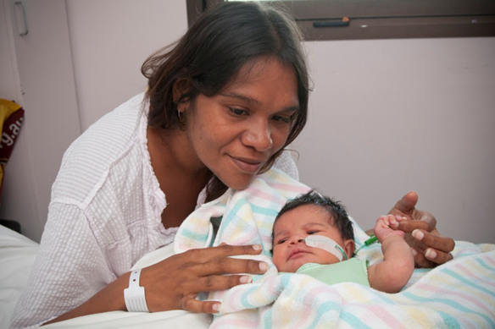
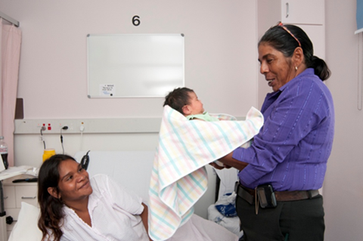
Breastfeeding
Skin to skin contact as soon as possible after birth key to achieving breastfeeding success
Appropriate clinical pathways sought early if milk production delayed
At discharge from hospital, women should receive contact details for remote clinic staff or community health service which can provide continued support
National Breastfeeding Helpline – 1800 686 268

Slide 14
Breastfeeding
NT DIP Clinical Register 2017

Slide 15
Breastfeeding children of mothers with diabetes
Maternal hyperglycaemia is strongly associated with offspring T2D
Breastfeeding is strongly protective
Ref: Halipchuk J et al. Canadian J Diabetes 2018

Slide 16
Breastfeeding
Babies with hypoglycaemia
Increased risk if mother had diabetes in pregnancy
Baby may be ‘sleepier’ leading to breastfeeding difficulties
Important to maintain breastmilk supply if artificial supplementation used
Baby’s blood glucose levels monitored before feeds and management as per hospital protocol
May require admission to a neonatal unit for monitoring and stabilisation

Slide 17
Breastfeeding
Antenatal planning
Expressing colostrum antenatally may be advised at term for some women with diabetes
Not advised for women with high risk for adverse outcomes due to uterine contractions
Expressed colostrum used instead of breast milk substitutes if newborn is hypoglycaemic or has difficulty feeding
High risk women may benefit from planned management strategies in the antenatal period eg. lactation consultant referral

Slide 19

Healthy Weight
Pre-pregnancy BMI & excessive gestational weight gain are independent predictors of pregnancy complications¹
Weight gain between pregnancies increases risk of future GDM²
Weight loss between pregnancies (among overweight/obese women) is associated with reduced risk of future GDM³
Refs: 1. BJOG 2019; 2. Endocrine 2016; 3. Obste Gyn 2011
Notes:
Schwartz N, Nachum Z, Green MS. Risk factors of gestational diabetes mellitus recurrence: a meta-analysis. Endocrine. 2016(3):662.
Ehrlich S, Hedderson M, Feng J, Davenport E, Gunderson E, Ferrara A. Change in body mass index between pregnancies and the risk of gestational diabetes in a second pregnancy. Obstet Gynecol 2011; 117: 1323–1330.

Slide 20
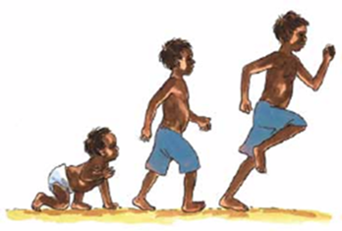
Healthy Weight
PANDORA Results
Higher rates of poor birth outcomes for Indigenous women largely related to T2DM
Preventable & modifiable risks impact outcomes: diabetes, BMI (additive), gestational weight gain, smoking
Figure 2.5 Large for gestational age
OR (95% CI)
Age (+5 years)
0.88 (0.74, 1.04)
Indigenous women
1.15 (0.76, 1.73)
GDM vs CTR
0.67 (0.41, 1.10)
DIP vs CTR
1.70 (0.89, 3.25)
T2DM vs CTR
2.31 (1.32, 4.06)
BMI (+3 kg/m²)
1.32 (1.22, 1.42)
Nulliparous
0.34 (0.22, 0.53)
Smoking
0.58 (0.38, 0.88)
.5
1
2
4
8
16
Maple-Brown et al, International Journal of Epidemiology, 2019. 48(1):307-318.

Slide 21
Healthy Weight
Weight and GDM risk
Weight gain between pregnancies (even 1-2 BMI units) is a strong risk factor for GDM in subsequent pregnancies
Risk factor | Impact on GDM risk
Gain of >10 kg between age 18 years and pregnancy | X 2
Overweight | X 2
Obesity | X 4
BMI >35 | X 8
Notes:
Women who are overweight or obese at their index pregnancy, but who lose weight (approximately 2.0 kg/m2) lower their future risk of GDM by almost 80%.
A BMI unit is around 3kg.

Slide 22
Liver
Skeletal muscle
Healthy Weight
Obesity and Effects on Glucose
Insulin resistance
Increased glucose levels
Increased fatty acids in bloodstream
Increased adipose tissue
Decreased insulin secretion
Pancreatic beta-cell dysfunction
Notes:
Obesity leads to increased glucose levels by a couple of mechanisms. Increased fat tissue causes an increased level of fatty acids in the blood – this in turn has effects on the liver, muscle and pancreas. In the liver and muscle, the high fatty acid levels make these organs less sensitive to the effect of insulin, so glucose will not move into the liver and muscle and instead stays in the bloodstream, causing glucose levels to be high. In the pancreas, the high fatty acid levels cause the beta-cells to not function properly so less insulin is produced, also leading to high glucose levels

Slide 23
Weight is a modifiable risk factor
Weight loss is highly effective for preventing type 2 diabetes¹
Aim for weight loss of 5-10% of body weight – even modest amounts of weight loss are beneficial
Postpartum lifestyle interventions aid weight loss but no trials done to confirm benefit in subsequent pregnancy outcomes²
Lifestyle intervention during pregnancy in high risk individuals can prevent GDM, reduce GWG & reduce c-section rate^{3,4}
Refs: 1. Lancet 2009; 2. Nutr Rev 2018; 3. Diab Care 2016; 4. Cochrane Rev 2017
Notes:
Targeting the postpartum period to promote weight loss: a systematic review and meta-analysis
Jodie M Dodd, Andrea R Deussen, Cecelia M O’Brien, Danielle A J M Schoenaker, Amanda Poprzeczny, Adrienne Gordon, Suzanne Phelan
Nutrition Reviews, Volume 76, Issue 8, August 2018, Pages 639–654,

Slide 24
Healthy Weight
Weight monitoring in pregnancy
Pregnancy is a good motivator / opportunity for women to make healthy lifestyle choices.
Recommended GWG depends on pre-pregnancy BMI – assess and discuss with mum at earliest opportunity, and monitor throughout pregnancy
Weight gain trackers are a useful tool
Pre-pregnancy BMI (kg/m²) | Rate of gain 2nd and 3rd trimester (kg/week) - calculations assume 0.5-2kg weight gain in 1st TM | Recommended range of total weight gain for singleton pregnancies (kg)
<18.5 – underweight | 0.45 | 12.5-18
18.5-24.9 – healthy | 0.45 | 11.5-16
25-29.9 - overweight | 0.28 | 7-11.5
≥ 30 - obese | 0.22 | 5-9

Slide 25
Healthy Weight
Key messages – Preconception through to post-partum
Discuss healthy weight and diabetes risk as appropriate with women of reproductive age – benefits both mother and child
Assess and monitor weight, BMI and gestational weight gain during pregnancy
Encourage women to adopt a healthy diet, regular physical activity and support breastfeeding
Offer follow up support for women who want to lose weight prior to pregnancy or postnatally
Involve partners and families, emphasising that children will adopt eating habits from their parents – therefore mothers adopting healthy habits helps their children get a healthy start to life

Slide 27
Smoke free
48% of Aboriginal mothers in the NT reported smoking before 20 weeks pregnancy in 2015
Of these, only 15% ceased smoking in later pregnancy
Risks of smoking for the mother before and during pregnancy:
Difficulty conceiving
Increased risk of cervical and vulval cancer
Irregular menstrual cycle
Higher risk of problems during pregnancy and labour
Higher risk of miscarriage or ectopic pregnancy
Ref: NT DoH 2018

Slide 28

Smoke free
Risks of smoking for the baby:
Dangerous chemicals transferred in-utero entering foetal lungs and bloodstream, causing complications at and after birth including:
Small for gestational age
Preterm birth
Hypoxia
Notes:
http://www.quitnow.gov.au/internet/quitnow/publishing.nsf/Content/pregnancy-and-quitting#1
https://www.youtube.com/watch?v=fTsxHIo_DWc
https://www.youtube.com/watch?v=dC56tJHupnY
https://www.racgp.org.au/afp/2014/januaryfebruary/smoking-in-pregnant-women/#30
https://www.ranzcog.edu.au/RANZCOG_SITE/media/RANZCOG-MEDIA/Women%27s%20Health/Statement%20and%20guidelines/Clinical-Obstetrics/Women-and-Smoking-(C-Obs-53)-Review-November-2014_1.pdf?ext=.pdf

Slide 29
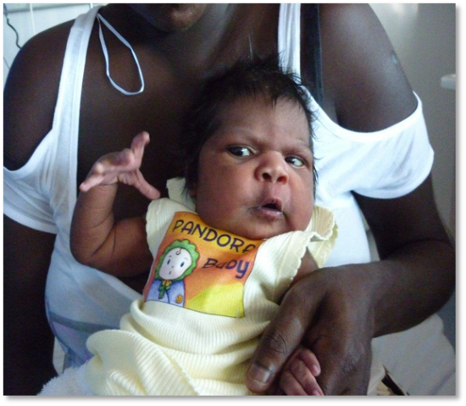
Smoke free
Benefits of quitting smoking for baby:
Lower risk of dying at or soon after birth from Sudden Infant Death Syndrome (SIDS)
More likely to have a healthy weight
Less likely to have complications at and after birth
More likely to leave hospital at the same time as mum
Notes:
http://www.quitnow.gov.au/internet/quitnow/publishing.nsf/Content/pregnancy-and-quitting#1
https://www.youtube.com/watch?v=fTsxHIo_DWc
https://www.youtube.com/watch?v=dC56tJHupnY
https://www.racgp.org.au/afp/2014/januaryfebruary/smoking-in-pregnant-women/#30
https://www.ranzcog.edu.au/RANZCOG_SITE/media/RANZCOG-MEDIA/Women%27s%20Health/Statement%20and%20guidelines/Clinical-Obstetrics/Women-and-Smoking-(C-Obs-53)-Review-November-2014_1.pdf?ext=.pdf

Slide 30
Smoke free
What is available to help quit smoking:
Visit Midwife, AOD nurse or GP for Nicotine Replacement Therapy (NRT)
Call Quit line 137848-Quit for you, quit for two
Visit website Australia.gov.au/quit now
Of the women who stop smoking during pregnancy, 50-70% will resume smoking again in the year post-partum.
Women who give up smoking during pregnancy should receive follow-up support to encourage them to remain smoke free.
Encourage partners and families to also be smoke free
Notes:
http://www.quitnow.gov.au/internet/quitnow/publishing.nsf/Content/pregnancy-and-quitting#1
https://www.youtube.com/watch?v=fTsxHIo_DWc
https://www.youtube.com/watch?v=dC56tJHupnY
https://www.racgp.org.au/afp/2014/januaryfebruary/smoking-in-pregnant-women/#30
https://www.ranzcog.edu.au/RANZCOG_SITE/media/RANZCOG-MEDIA/Women%27s%20Health/Statement%20and%20guidelines/Clinical-Obstetrics/Women-and-Smoking-(C-Obs-53)-Review-November-2014_1.pdf?ext=.pdf

Slide 32
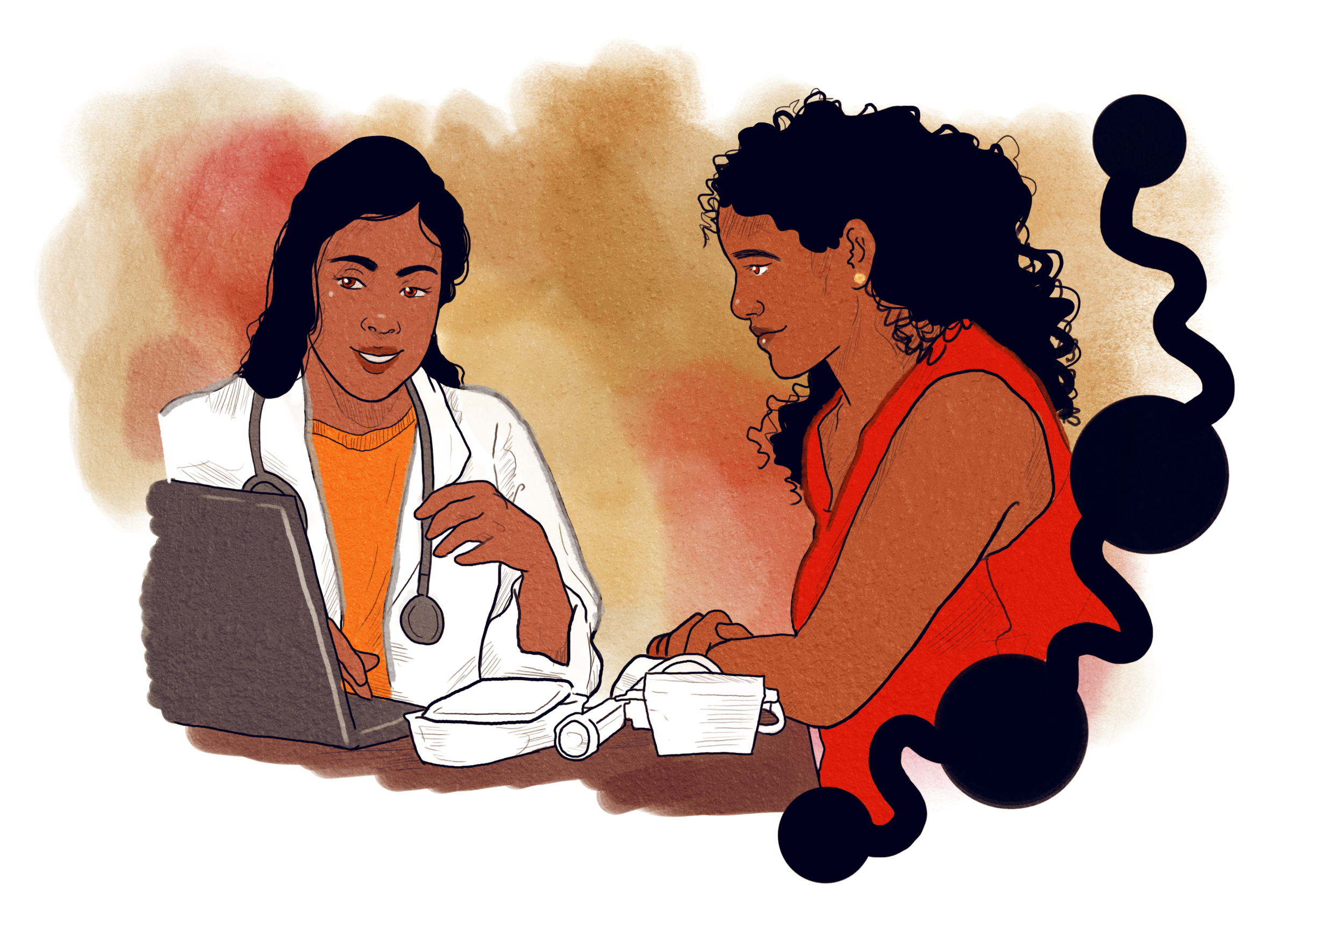
Contraception
50% pregnancies unplanned¹
66% women with diabetes do not recall discussing contraception with their healthcare providers²
53% women with diabetes no documented contraceptive counselling
Delay of pregnancy to improve glycaemic control prevents poor maternal and neonatal outcomes³
1. AIHW, 2015 Mothers and Babies Report 2. Robinson, J Contracept. 2016; 7
3. Schwarz, J Gen Intern Med, 2012, 27(2):
Notes:
From a reproductive perspective, poor glycemic control at the time of conception and during pregnancy increases the chance of adverse pregnancy outcomes including stillbirth, congenital abnormalities, and perinatal mortality

Slide 33
Contraception
Modern contraceptives help women prevent, plan and space pregnancies
Clinics and communities should promote effective contraception for all women at routine check-ups and consultations
Women want effective contraception that is reliable, allows rapid return to fertility when stopped, easy to use and minimal side effects
Women may need time and extra explanation when choosing the most appropriate contraception for them.
CARPA Women’s Business Manual, pp 335-337

Slide 34
Contraception in diabetes
No options contraindicated due to diabetes
Only concern is progestogen-only injectable contraceptives (Depo-Provera) in women WITH complications
Possible negative effect on lipid metabolism
Not an issue with Implanon due to constant release of progesterone
WHO Medical Eligibility Criteria for Contraceptive Use. Geneva: 2015.
Notes:
Progestogen-only subdermal implants containing etonogestrel are suitable for women with diabetes, as per WHO MEC guidelines.¹⁸ Implants release a constant dose of progestogen reducing the potential for metabolic variation and maintaining steady blood-lipid ratios.²⁸

Slide 35
Contraception post-partum
Multiple options to consider
Most important factor is the woman’s preference
Progesterone only (eg. oral or implant) are favoured
Oestrogen-containing options (i.e. COCP) should be avoided in breastfeeding (ok after 6 months)
If not breastfeeding, caution with COCP in early post-partum period due to venous thromboembolism risk (fine after 6 weeks)
IUDs can be inserted within 48h of delivery or after 4 weeks
WHO Medical Eligibility Criteria for Contraceptive Use. Geneva: 2015.
Notes:
COCP – combined oral contraceptive pill

Slide 36
Contraception and pre-conception counselling
Good opportunity to talk about the importance of good AN care and the Key Five!
Talk with woman about:
General health issues, especially if first pregnancy or medical issues
Optimising control of chronic conditions – diabetes, ↑BP, asthma, epilepsy, depression
Encourage healthy weight (BMI 20-25) before getting pregnant
Starting 5 mg folic acid if pre-existing diabetes or BMI >30* and planning pregnancy
Check immunisation status – particularly rubella
Advise and assist to cease smoking
*Queensland Clinical Guidelines, 2015. Obesity in Pregnancy.
Notes:
Obesity is associated with higher risk of neural tube defects (OR 1.7 for obese, 3.11 for severely obese), with obese women being less likely to have folate in their diet, as well as having lower serum folate levels even when controlled for low dietary intake. (from UK Green Top Guideline)

Slide 37
Email: ntdippartnership@menzies.edu.au
Artist & funding acknowledgement: A number of illustrations in this presentation were created by digital artist Charlotte Allingham, a young Wiradjuri woman living in inner Naarm (Melbourne). We would like to acknowledge Monash Centre for Health Research and Implementation (MCHRI) and HealthLAB (Menzies) for their contribution developing the illustrations and Victorian Assisted Reproductive Treatment Authority (VARTA) for their financial contributions to the illustrations

