Slide 1


Scabies & Crusted Scabies Management

Slide 2
Notice
Disclaimer
Information contained in this presentation, including texts, graphics and images, is intended for educational purposes only, and should not be substituted for medical advice from a doctor or healthcare provider.
All due care has been taken to ensure the accuracy of the content at the time of development of this resource.

Slide 3
Overview
Skin
Function
Importance of healthy skin
Scabies
Background
Description
Detection
Transmission
Treatment
Scabies Free Zone
General Points
Crusted Scabies
Overview
Description
Detection
Grading Crusted Scabies
Treatment
Ongoing management
General Points
Discussion
Resources

Slide 4
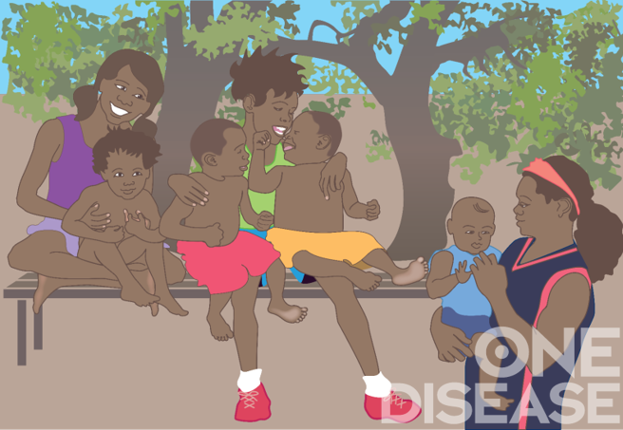
Skin
Function
Your skin is your body's largest and fastest-growing organ. Skin is your body's coat, and it helps to protect you. It helps you stay warm when it's cold, and cool when it's hot.
Your skin keeps all your insides in, from your heart and lungs to your blood and muscles.
And, unless it's cut or damaged, it keeps stuff out, including germs.
You also feel things through the nerves in your skin.
Notes:
Is your epidermis showing? Don't worry, it should be. Your epidermis is the top part of your skin, and your skin is your body's largest and fastest-growing organ. Skin is your body’s protective coat. It protects you. It helps you stay warm when it's cold, and cool when it's hot. Your skin keeps all your insides in, from your heart and lungs to your blood and muscles. And unless it's cut or damaged, it keeps stuff out, including germs. You also feel things through the nerves in your skin.

Slide 5
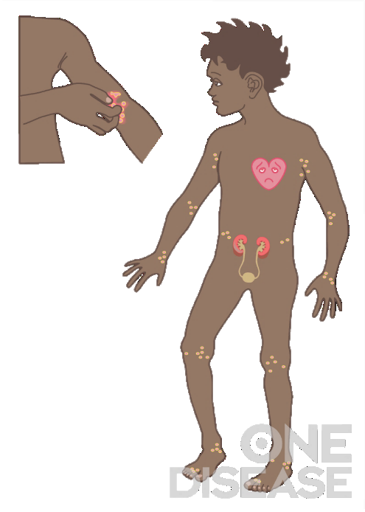
Skin
Importance of healthy skin
Many skin conditions are preventable or easily treated with regular skin checks and early treatment.
Early treatment is important to help prevent serious life long health problems.
Breaks in skin from cuts, sores or itchy scabies means the protective coat is damaged and germs can get in.
Germs can make you sick and your kidneys and heart sick too.
Notes:
As the largest organ of the body, the skin is visible to everyone. Skin infections are unsightly, painful and the ongoing inflammation associated with skin infections contributes to general poor health.

Slide 6
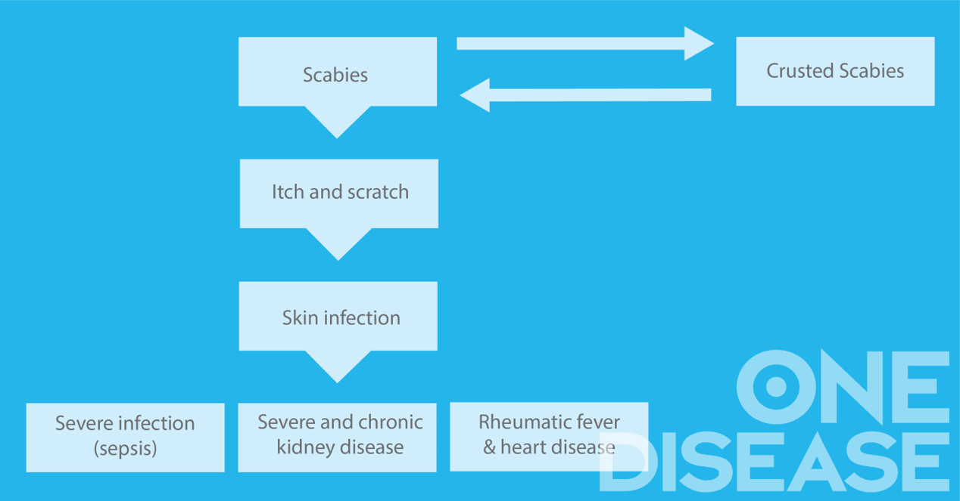

Skin
Notes:
Scratching scabies and breaking the skin can lead to bacterial skin infections which are usually caused by Staphylococcus aureus and Group A Streptococcus (GAS).
These infections can result in inflammation of the heart or kidney resulting in Acute Rheumatic fever (ARF) and acute post-streptococcal glomerulonephritis (APSGN) which can lead to long term consequences of chronic heart and kidney disease.

Slide 7
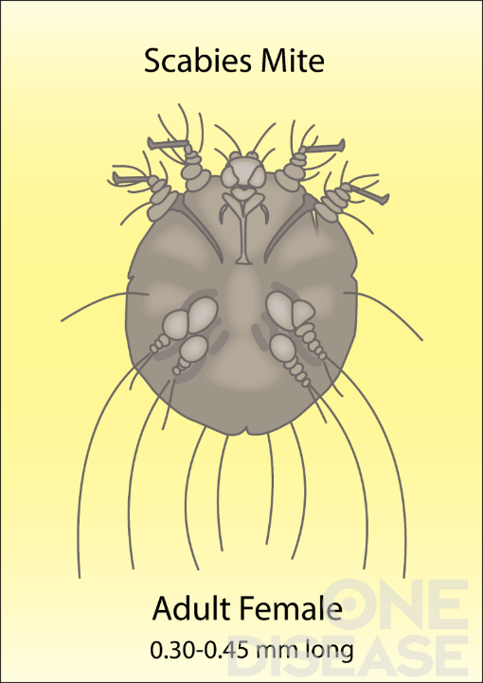
Scabies
Background
Scabies is a contagious skin condition caused by the scabies mite (Sarcoptes scabiei var. hominis).
Scabies can be found in many areas of Australia and other countries.
Scabies is listed as a Category A neglected tropical disease by the World Health Organisation.
The burden of disease from scabies is high and it presents a significant public health concern in the Northern Australia area.
Notes:
Scabies is a contagious skin condition caused by the scabies mite (Sarcoptes scabiei var. hominis). This is not the same scabies mite that can infest pets. Scabies mites on dogs are different and cannot reproduce on humans
Scabies can be found in many areas of Australia and other countries.
Scabies is listed as a Category A neglected tropical disease because it has been identified by several countries as a public health priority that doesn’t yet have an effective control strategy in place.
Scabies mites are transmitted between humans.
Scabies do not live in the mud or dirt, but mud or dirt can lead to skin infection.
Even if you shower every day and have a tidy house you can still get scabies, it is not related to poor hygiene. Scabies is shared between people from prolonged skin to skin contact. ( like sleeping in the same bed or long cuddles)
Soap and detergent are good to use to prevent skin infections, but do not kill scabies.

Slide 8
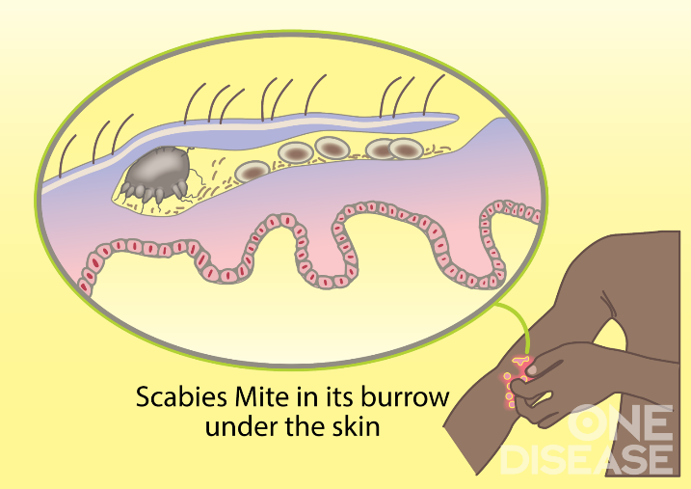
Scabies
Description
Scabies live, feed, reproduce, and lay their eggs in burrows in the top layer of skin.
Scabies usually involves around 10 to 15 mites.
Mites cannot live off the human body. Will only survive 3-8 days off a human body.
Notes:
Scabies is caused by the mite Sarcoptes Scabiei and is characterised by intense itch, papules, diffuse rash in some cases and often, secondary sores from scratching skin.
The mite is 0.3-0.5mm in length, reproduces on the skin and burrows in the outermost layer of skin to lay its eggs.
Scabies burrows are created when female mites tunnel just under the surface of the skin. It is this burrowing into the skin that triggers the body’s immune response to cause itch in an effort to mechanically remove the mite from the body. The itch results from the inflammatory response to mite excreta and other components.
After creating a burrow, each female lays 2-3 eggs every day in the skin. The burrow tracks of the mite can sometimes be seen on the skin. They may appear as tiny raised or discoloured lines.
Mites cannot live off the human body. Will only survive 3-8 days .
Majority of cases have 10-15 mites on the entire body.

Slide 9
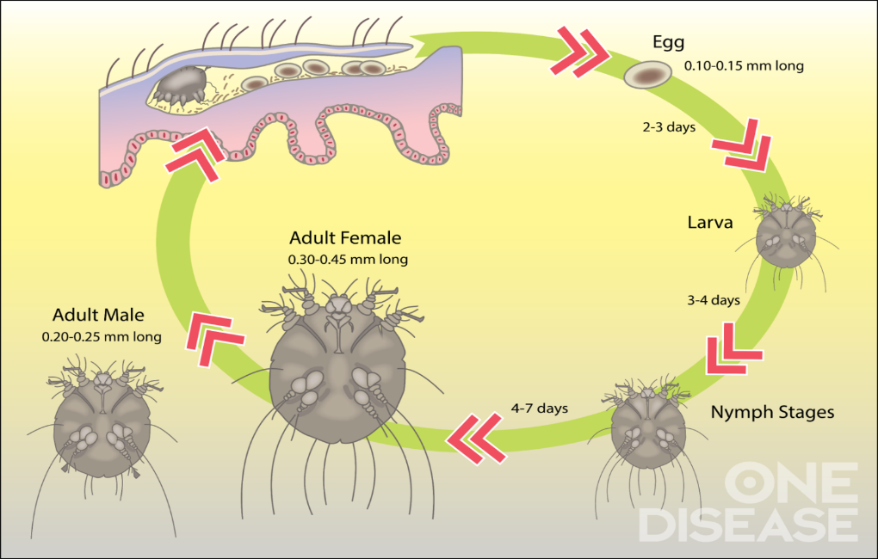
Scabies
Understanding the Life cycle of the scabies mite for treatment
Notes:
Once the female scabies mite has laid her eggs under the top layer of the skin they will hatch in about 2-3 days and develop into adult mites in approximately 1 week.

Slide 10
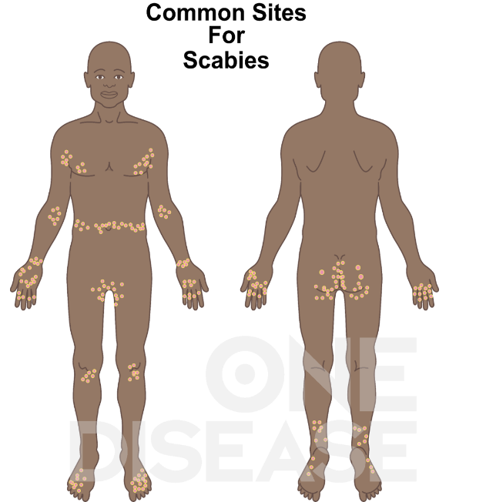
Scabies
Description
Distribution of scabies on the body includes areas of folded skin for burrowing. For example:
Webs between fingers & toes
Wrists
Axilla (under the arms)
Elbows
Knee areas
Buttocks & genitals
Notes:
Even though there might only be 10-15 mites on a person’s body, they may develop rash and itch all over their body. This is a list of the usual areas where rash, itching and papules (bumps from the body’s reaction to the mites) can occur.

Slide 11
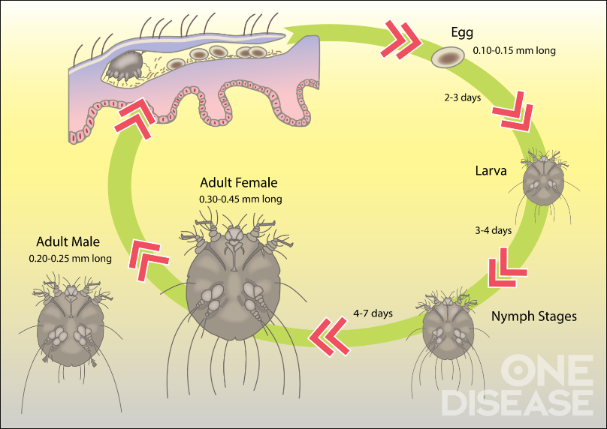
Scabies
1. Life cycle of scabies mite
2. Scabies mites lay eggs in burrows in the skin
Notes:
This slide reinforces information from previous slides about the life cycle of the scabies mite, its action on the skin and where it is found.

Slide 12
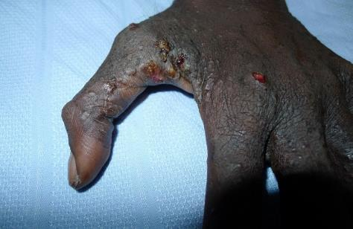
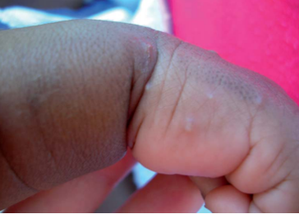
Scabies
Detection
Look for:
Blisters or burrows in the folds of skin
Pimple like bumps (papules)
Itch (particularly at night) & when you scratch the skin can become infected
Rash and bumps on the skin
Close contact with someone who has scabies
Secondary Infection
Scabies with infected sores from scratching
Papules
Notes:
Detection (what to look for)
Some signs that it may be a case of scabies include:
Itching and scratching particularly at night.
Other family members with scabies
Anyone in family or community with crusted scabies
Check skin: look for scratches and sores between fingers on wrist, elbows, knees, ankles, under arms, around groin and buttock.
Babies often have blisters and pustules on palms of hands, soles of feet.
Reference: CARPA Standard Treatment Manual, 7th Edition.
Images source: Currie, B., Menzies School of Health Research.

Slide 13
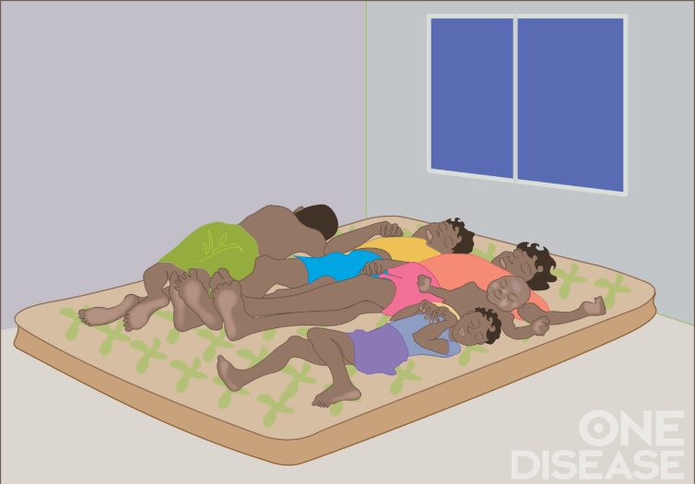
Scabies
Transmission
Close, prolonged skin-to-skin contact such as:
Sharing a bed with somebody
Holding a child for a long time
Overcrowded housing
Scabies mites are rarely transmitted from freshly contaminated clothes or bedclothes
Notes:
Scabies is spread from person to person by prolonged direct physical contact. Contact must be prolonged; a quick handshake or hug will not spread it. Sharing a bed with someone or holding a baby for a long time can spread scabies as this is prolonged skin-to-skin contact. The scabies mite can survive approximately 3 to 8 days off the human body depending on environmental conditions.

Slide 14
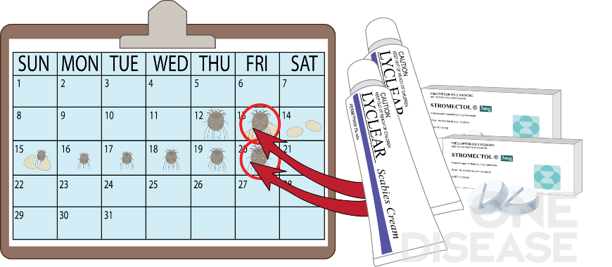
Scabies
Treatment
Treatment of scabies requires 2 doses for you and all close contacts:
Life cycle of scabies mite shows the first dose will kill adult mites but not eggs
The second dose, one week later, will kill newly hatched eggs
Notes:
Remember the life cycle of the scabies mite? It takes about 7-10 days for scabies mite eggs to hatch and grow into adult mites. This is very important for the medications which kill scabies mites. The first dose of scabies medicine will kill the adults scabies mites but cannot kill the eggs until they have hatched. A second dose of scabies medicine, one week after the first will kill mites which have hatched before they can lay eggs again.

Slide 15
Scabies
Treatment – treat entire household on the same day
Lyclear (5% permethrin) topical, leave on for 8-24 hours
Ivermectin (prescribed by doctors)
Benzyl Benzoate (usually used for Crusted Scabies) topical, leave on for 24 hours.
NONE OF THESE KILL SCABIES EGGS SO THEY NEED TO BE USED TWICE – ONE WEEK APART
After final treatment – recalls for follow up treatment
Notes:
CARPA Standard Treatment Manual (7th Edition) recommends the health clinic:
In clinic do whole-body application of thin layer of permethrin 5% cream
Repeat treatment in 1 week
Treat all close contacts with permethrin 5% cream
Household members
Other people with close physical contact (e.g holding infected child)
Tell person itching may last for 2 or more weeks after treatment
Encourage hand washing and short finger nails
Creams (for clinic staff)
Permethrin (Lyclear) applied all over body apart from mouth, nose and eyes and left on for 8-24 hours will kill scabies mites (but not the unhatched eggs)
Benzyl Benzoate left on for 24 hours will kill scabies mites (but not the unhatched eggs). It can also be used for ‘difficult to treat’ simple scabies.
Ivermectin will kill scabies mites (but not the unhatched eggs)
Please note that Ivermectin needs to be prescribed by a Doctor
ALL OF THESE MEDICATIONS NEED 2 DOSES. THEY NEED TO BE GIVEN APPROXIMATELY 7 DAYS APART AS THE EGGS WILL HATCH WITHIN 3-4 DAYS AND POTENTIALLY REPRODUCE IN 7 DAYS. If treatment is left longer more eggs may have been produced and the scabies lifecycle starts again.
Treatment for scabies involves (CARPA STM 7th Edition):
The application of Lyclear Scabies Cream twice, 7 days apart, at the same time, for everyone in the household.
Lyclear contains the ingredient permethrin, which belongs to a group of medicines called pyrethroids which kill mites such as scabies.
The Lyclear cream is not ovicidal, it won’t kill scabies eggs.
The first application of Lyclear will kill all the adult mites but not the eggs, which will hatch and become adults during the following 7 days.
This is why the cream must be applied twice, 7 days apart. The second application will kill all the new adult mites that have hatched.
Recall
Follow up by returning to clinic three (3) weeks after treatment has completed (CARPA STM 7th Edition).

Slide 16
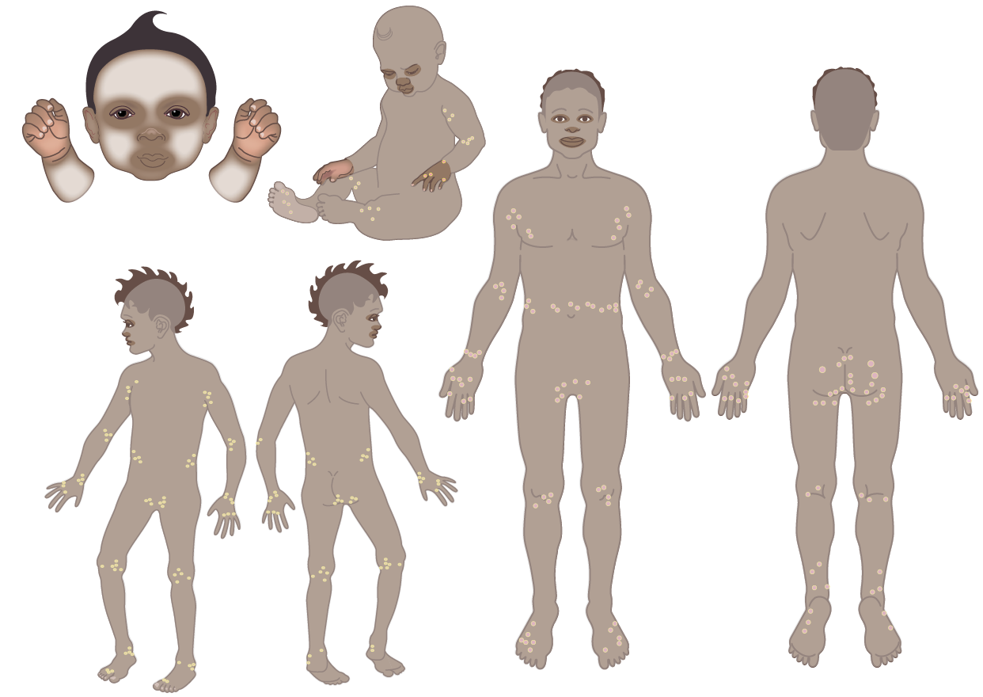
Scabies
Applying scabies creams/lotions
When applying creams or lotions (Permethrin or Benzyl Benzoate), make sure to apply to the whole body from head to toe.
Make sure the cream goes everywhere including:
Between fingers and toes
On the face (avoid the eyes, nostrils and mouth) and scalp
Under trimmed fingernails
Soles of the feet
Bottom and groin
Avoid the hands for babies who may put their hands in their mouths.
Notes:
Applying scabies creams or lotions
Put on clean, dry skin
Start with head including scalp and face — avoid eyes, lips, mouth
If hair very thick or infestation very bad — may need to shave head.
Always get permission from person/carer
Work carefully down whole body. Always include:
Between fingers and toes, soles of feet, under nails
Body creases — behind ears, under jaw, neck, armpits, groin, bottom, under breasts
Joints and joints creases — elbows, knees, heels
Advise to put on hands again after washing, put on child's hands again before bed

Slide 17
Scabies
Treatment
Create scabies free zones using:
HEAT – temperatures above 50C will kill mites
If it is a very hot day, a black plastic bag in the sun should kill mites
Hot water washing machine or a hot clothes dryer for >20 minutes
ISOLATION – more than 72 hours OFF the body
If the mites can’t find a human, they’ll die after 3-8 days
This means any clothes, shoes, blankets can be bagged up and any mites on them will be dead in 3-8 days
Notes:
When there has been a case of scabies in a house or residential facility, items that have been in contact may have scabies mites on them. The mites need to be killed so that they don’t reinfest people. There are two ways that are effective in killing the mites on household items like clothes, sheets, blankets and shoes.
Heat (above 50 degrees Celsius for >20 minutes) will kill mites. If a washing machine that can heat water or a hot clothes dryer is available, this the easiest option. If these are not available, another option is isolating the items for 3-8 days. Isolation can be achieved by putting items like clothing, shoes and bed sheets etc in a plastic bag and not using them for 3-8 days. In this time, the mites will die as they will not have had contact with a human host.

Slide 18

Scabies
Notes:
Scabies free zones
Creating scabies free zones is an important part of treatment and long-term prevention of scabies transmission.
Scabies free zones involves removing scabies at the individual (person) level, household and family group level, community level and regional level.

Slide 19
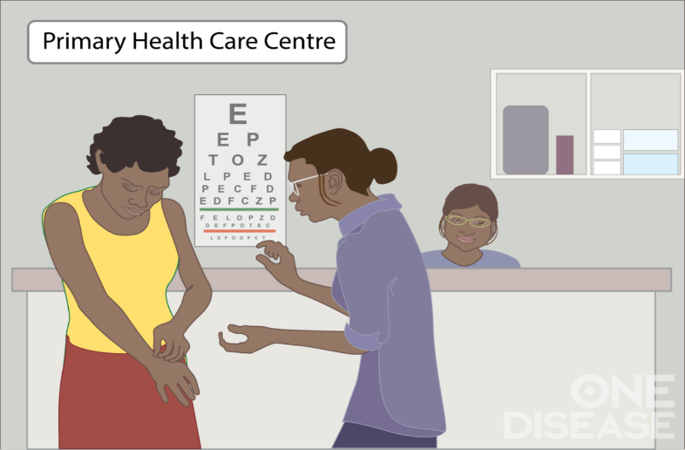

Scabies
Scabies free zone: Individual level (Person)
If you think you have scabies or skin problems, go to the clinic
If it is scabies, treatment will require 2 doses for you and all close contacts, one week apart.
Notes:
Treating an Individual/Person with Scabies (Advice for Community Clinic)
To make a scabies free zone at an individual (person) level, ensure two doses of scabies medicine, one week apart. It is very important to treat the household contacts at the same time so the person does not get scabies again from their household contacts.

Slide 20
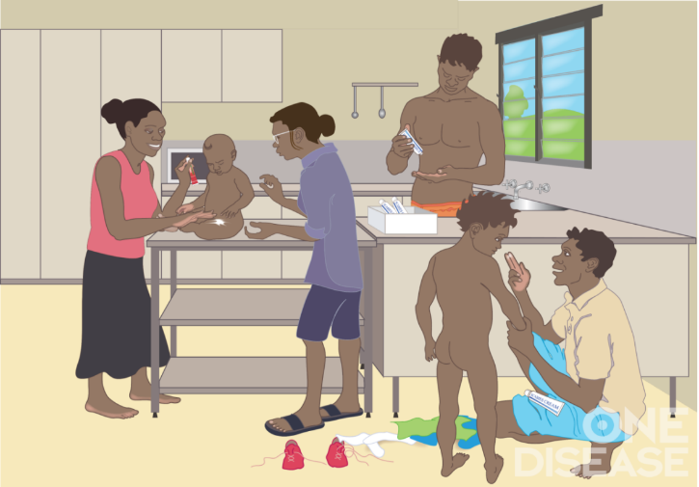
Scabies
Scabies free zone: Household and Family Group
Everyone in the house has treatment together to stop the transmission of scabies
Work with families to create and maintain a Scabies Free Zone in household places and spaces.
Clothes and bedding can go in a plastic bag for 3-8 days. This will kill the mites.
Notes:
Treating a Household/ Facility with Scabies (Advice for Community Clinic)
Simultaneous treatment of all household members, followed by treatment of those with active scabies 1 week later
Remember that scabies die off the body after 3-8 days
If there is a Crusted Scabies client and they are in hospital (or there is no Crusted Scabies) then the mites will die in the house after 3-8 days
There is no need to put mattresses in the sun. The sun does not kill scabies mites, only high heat and isolation from humans for 3-8 days. If putting mattresses outside causes the family shame, mattresses can be covered with a plastic mattress protector.
If there is no washing machine or no HOT water, bag clothes/blankets for 3-8 days

Slide 21
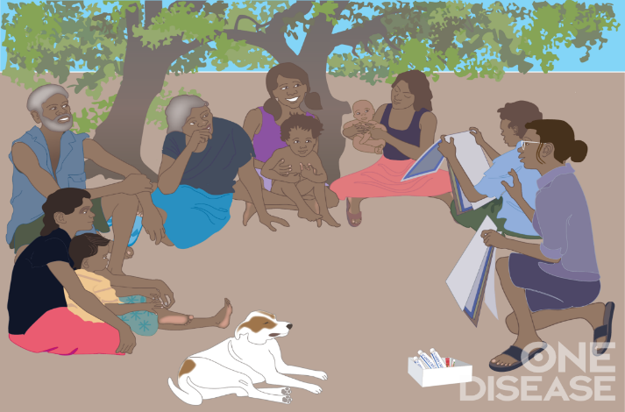
Scabies
Scabies free zone: Community level
If many households in the community have scabies, consider a community wide Healthy Skin Day.
Possible measures include:
Health education
Screening and treatment
With/without general clean-up of households and community spaces
Don’t forget:
Community involvement
Inter-agency collaboration
Notes:
Creating a Community Scabies Free Zones (Advice for Community Clinic)
Education and support are vital to empowering your community to manage scabies. Information on how to run scabies health promotion campaigns can be found at www.onedisease.org/resources-1. Refer to One Disease, 2017, Managing Households with Recurrent Scabies, 2nd Ed., Darwin Northern Territory.

Slide 22
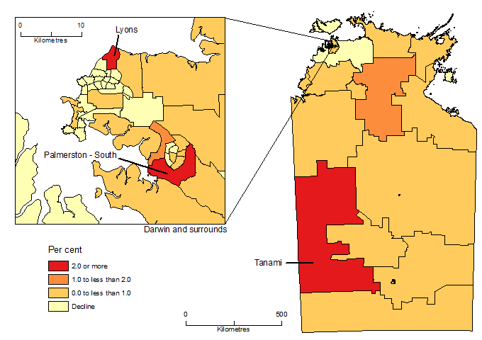
Scabies
Scabies free zone: Regional Level
Coordinating the development of Scabies Free Zone across a Region requires:
Being clear about the boundaries of the region (e.g. State region, Shire area, health service region, etc)
Engaging multiple groups or communities within the region
Inter-agency collaboration
Notes:
Creating a scabies free zone at a regional level requires cooperation between agencies, services and communities and must include community engagement.
Map source: https://www.abs.gov.au/AUSSTATS/abs@.nsf/Latestproducts/3218.0Main%20Features502017-18?opendocument&tabname=Summary&prodno=3218.0&issue=2017-18&num=&view=

Slide 23
Scabies
General points:
Scabies mites do not live in dirt or dust.
Scabies is not a zoonotic condition-Scabies mites that come from dogs are different to human scabies mites. Scabies mites from dogs cannot reproduce in humans.
Scabies is not a disease of poor hygiene.
Scabies mites do not fly or jump.
Scabies burrow into the skin.
Reasons for recurrent scabies infections are complex and a case management approach is needed to break the cycle.
Notes:
General scabies points to remember

Slide 24
Crusted Scabies
Overview
In January 2016 Crusted Scabies was made a notifiable disease under the Notifiable Diseases Act NT.
Crusted Scabies is notified via laboratory following detection of Sarcoptes scabiei mites on skin scrapings.
An Infectious Disease physician must have reviewed the patient in order to meet the case definition.
A confirmed case of Crusted Scabies will elicit a Public Health response. This includes contact tracing and treatment of household and close contacts and creating a scabies free zone.
Notes:
Some people may know Crusted Scabies by its previous name, Norwegian Scabies. In the Northern Territory, Crusted Scabies is a notifiable disease.
Under the Notifiable Diseases Act NT, crusted scabies is notifiable via laboratory or a doctor following detection of scabies mites on skin scrapings
An IFD physician or Dermatologist must have reviewed the patient in order to meet the case definition
A confirmed case of Crusted Scabies will elicit a public health response initiated by the centre for disease control (CDC) and often completed by the community health centre. This includes contact tracing and treatment of household and close contacts.
Crusted Scabies is only notifiable in the Northern Territory.
Only confirmed cases should be notified/reported to the Centre for Disease Control or Public Health Unit.
A confirmed case requires laboratory suggestive evidence (this means mites and/or eggs have been identified by a laboratory from a skin scraping) AND clinical evidence (clinical evidence means visible skin abnormalities consistent with crusted scabies and must include verification by an infectious diseases physician or a dermatologist).

Slide 25
Crusted Scabies
Description – Is it Scabies or Crusted Scabies?
Scabies:
Scabies numbers – 10-15 mites
Itchy
Not highly contagious
Can be treated in clinic
With correct treatment it will get better
Crusted Scabies:
Scabies numbers – hundreds to thousands of mites
May not be itchy
Highly contagious
Requires long treatment in hospital
With correct treatment it will get better
Notes:
There are some important differences between scabies and Crusted Scabies which are listed on this slide.

Slide 26
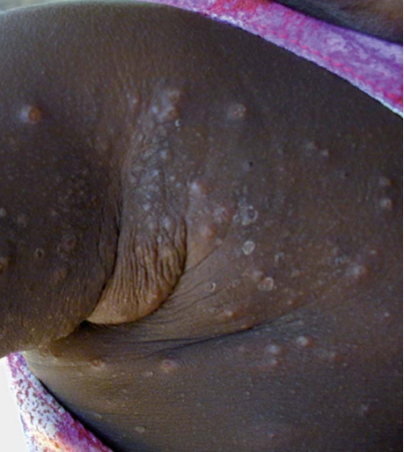
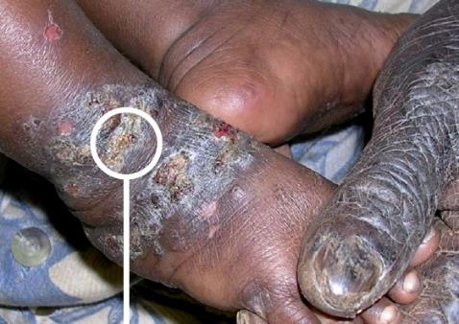
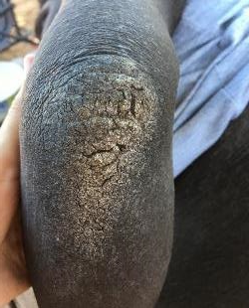
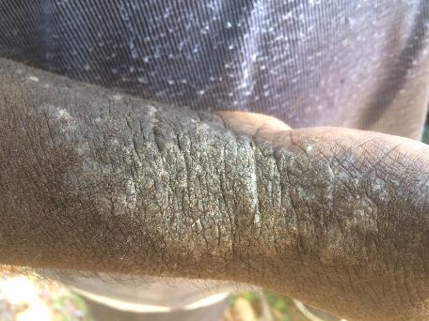
Crusted Scabies
2. Scabies
4. Crusted Scabies
1. Scabies
3. Crusted Scabies
Notes:
These images indicate the important visible differences between scabies and Crusted Scabies.
Scabies
Scabies that have become infected (they look crusted because secondary infection has caused sores which have scabbed but this is not Crusted Scabies)
Crusted Scabies
Crusted Scabies
Images source: 1. One Disease, 2. Currie, B., Menzies School of Health Research, 3. One Disease, 4. One Disease

Slide 27
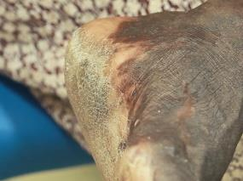
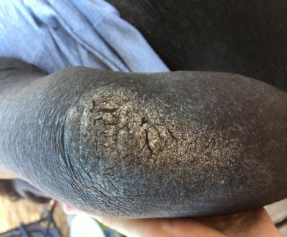
Crusted Scabies
Description
Immune response does not control mite proliferation.
Crusted Scabies is highly infectious and causes outbreaks of scabies throughout households and communities.
Thick, scaly cream-coloured skin.
Sometimes no itch.
With or without depigmentation.
Can lead to secondary skin sepsis.
Transmitted via skin to skin contact and from environment because of the number of mites.
Mites can live up to 3-8 days off the skin.
Notes:
Crusted Scabies, previously known as Norwegian Scabies, is a hyper-infestation of scabies. It is believed that in some people, the body’s immune response does not trigger when the scabies mite burrows under the skin (indicated by the abundance of mites and often a lack of itch in those with crusted scabies) and left untreated and with no immune response launch, the mite reproduces out of control, resulting in up to millions of mites on the one person.
The proliferation of mites causes hyperkeratosis or thickened, scaly skin to form which is made up of dead skin cells, dead mites, live mites, eggs and faeces. As these crusts form, they begin to flake away from the body, shedding with it, live mites into the environment which can infest a human if they come in contact with that fomite (or infested environment) such as a chair or a bed they had been in. This thickened skin can then crack, allowing bacteria to enter the blood stream and can lead to secondary sepsis.
Images sourced: One Disease

Slide 28
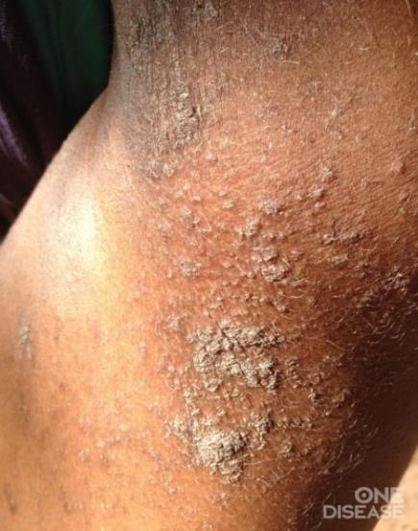
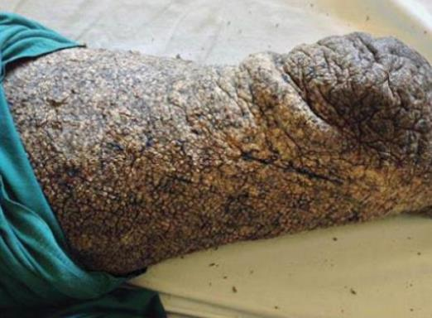
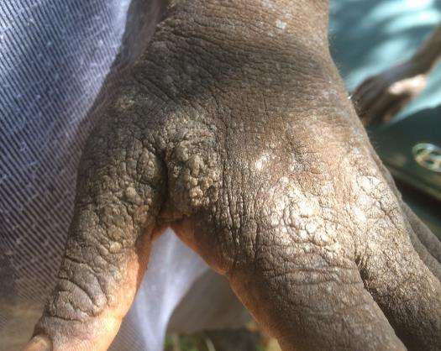
Crusted Scabies
Images of different grades of Crusted Scabies
Notes:
All of these pictures are of crusted scabies. The pictures demonstrate different grades of Crusted Scabies.
Grade indicates severity of condition and required treatment.
Images sourced: One Disease & Currie, B., Menzies School of Health Research.

Slide 29
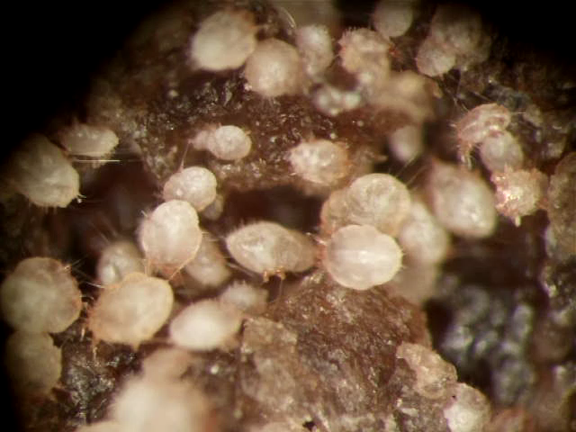
Crusted Scabies
Notes:
This is a video of a flake of skin from somebody with crusted scabies that has been placed under the microscope and demonstrates why it is so contagious. The large light coloured mites are adult female mites, the smaller grey mites are adult male mites and the small pale mites are young mites.
Media source: Holt, D., Menzies School of Health Research.

Slide 30
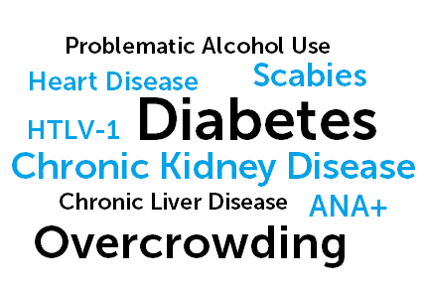
Crusted Scabies
People at risk
Those with other health conditions like heart disease, kidney disease and diabetes.
Those with immunodeficiency.
Notes:
People who develop CS are generally unwell and have existing chronic conditions. People who develop Crusted Scabies have reduced immune function so those with comorbidities such as kidney disease, diabetes, heart disease, HTLV-1 and people that have had transplants who are exposed to scabies are at higher risk of developing Crusted Scabies. This is important information because as long as the person has these comorbidities and/or immunosuppression, they will be susceptible to developing Crusted Scabies even if their Crusted Scabies is treated. People who have had Crusted Scabies before may develop it again in the future. There will be more on this in a few slides.

Slide 31
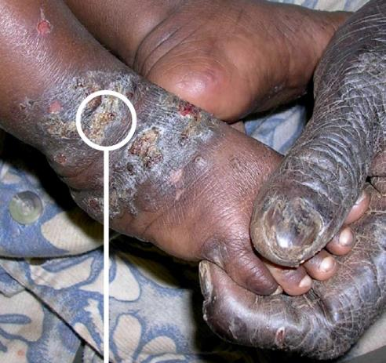
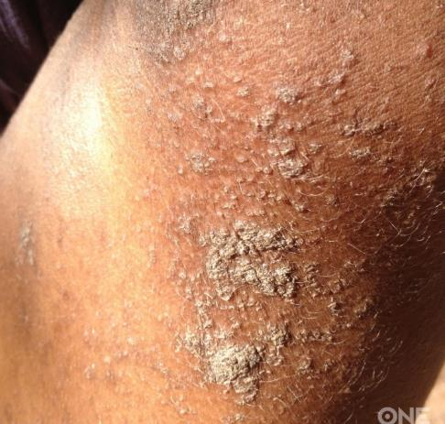
Crusted Scabies
Detection (for clinic staff)
Many cases of scabies are misdiagnosed as Crusted Scabies.
Crusted sores occur with scabies from scratching and secondary infections.
Crusted sores - secondary infection from scratching
Crusted scabies
Notes:
It can be very difficult sometimes to see the difference between scabies, scabies with infected sores and Crusted Scabies. Remember that scabies with crusted sores from secondary infection is a different diagnosis to Crusted Scabies.
Image source: Menzies School of Health Research & One Disease.

Slide 32
Crusted Scabies
Detection (for clinic staff)
Skin scrapings:
Take from the part of the body where there is the most crusting
If you think it might be tinea, take two separate scrapings with two separate pathology forms
Diagnosis:
Call local hospital Infectious Disease team/ Dermatologist for opinion
Gain consent from client and send photos to expert
If scrapings are positive, Crusted Scabies more likely to be diagnosed
Notes:
In January 2016 in the NT, Crusted Scabies was made a notifiable disease under the Notifiable Diseases Act. This means that a suspected case of CS should have skin scrapings taken and be discussed with an Infectious Disease physician or a dermatologist. If the skin scraping is positive, the lab will notify CDC who will then follow up the case. They will conduct the contact tracing and ensure the treatment of the CS client’s contacts. All cases of suspected CS should have skin scrapings taken from the most crusted area of their body and a pathology request stating that scabies is suspected.
Keep in mind, if you are unsure if the person has CS; you should request testing for tinea AND scabies, get two samples and identify each individually as this allows the lab to verify scabies much sooner. It can take 28 days to verify some fungal elements and if together in the one test, the scabies verification will take this long also.

Slide 33

Crusted Scabies
Skin Scraping Procedure (for clinic staff)
Notes:
This is a video which helps explain how to take a skin scraping when Crusted Scabies is suspected.
Media source: One Disease www.onedisease.org/resources-1

Slide 34
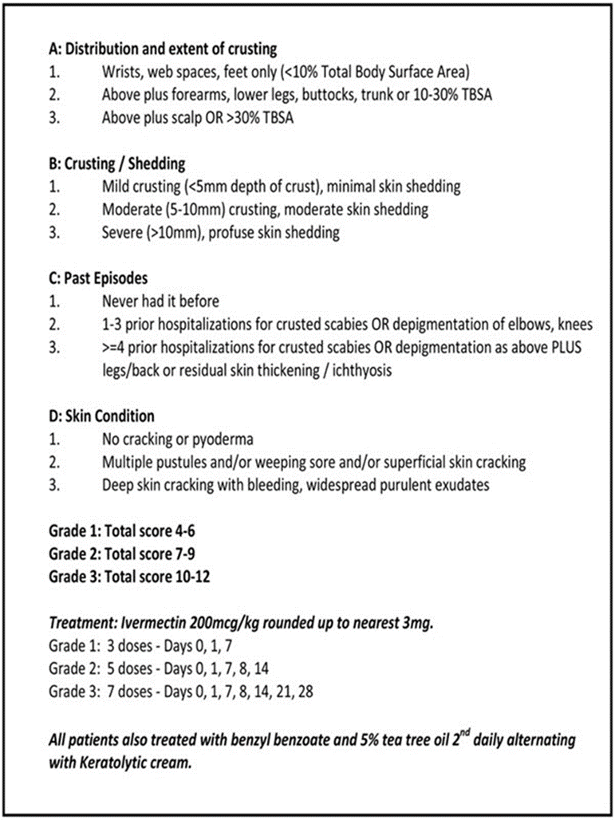
Crusted Scabies
Grading Crusted Scabies
The ‘Crusted Scabies grading system and acute treatment protocol’ was developed by experts at Royal Darwin Hospital (Davis et al, 2013).
Grading the severity of Crusted Scabies ensures correct diagnosis and medical treatment.
Grade may be 1, 2 or 3 depending on severity.
Notes:
This is the full checklist for grading Crusted Scabies, developed by specialist infectious diseases physicians. Crusted Scabies is graded according to factors such as the amount of the body affected, the thickness of crusted skin, the number of times a person has previously had crusted scabies. Grades are from 1 to 3, indicative of severity and treatment duration typically reflects the grade. All cases are recommended to be hospitalised, however with very committed care and close supervision, a grade 1 case can be treated in community. See the latest CARPA Standard Treatment Manual for guidance on community treatment, https://www.remotephcmanuals.com.au/
.

Slide 35
Crusted Scabies
Treatment
Treatment for Crusted Scabies is guided by grading system developed by Infectious Disease Specialists.
Grading based on how much of the body is affected by crusting, how thick the crusting is, how much skin is shedding, past episodes and general skin condition like if it is cracked or not.
Grade | Typical tx duration | Topical treatment | Oral treatment
1 | 7 days | 2nd daily scabicidal and keratolytic | Ivermectin days 0, 1, 7
2 | 14 days | 2nd daily scabicidal and keratolytic | Ivermectin days 0, 1, 7, 8, 14
3 | 28 days | 2nd daily scabicidal and keratolytic | Ivermectin days 0, 1, 7, 8, 14, 21, 27
Notes:
Treatment of crusted scabies depends on grade. Treatment is often provided while the person is in a hospital isolation room with full contact precautions. Infectious Disease Physicians alongside Infection Control Units will decide during the treatment process when a person no longer needs to be in an isolation room.
Treatment will almost always involve concurrent use of oral Ivermectin with alternating days of topical scabicide and urea & lactic acid cream.
Topical scabicidal agents used are Benzyl Benzoate 95% (Benzemul) sometimes mixed with Tea Tree Oil 5% or, Permethrin Cream (Lyclear)
Keratolytic agent used is a topical cream with 10% urea, 5% lactic acid (Calmurid or Dermadrate)
The topical agents are used in conjunction with Ivermectin.
As the table shows, the more severe the grading is, the longer the treatment regime will be.
On the advice of a Infectious Disease physician, once the skin is no longer crusted they may cease treatment.

Slide 36

Crusted Scabies
Treatment: In hospital
Notes:
This hospital patient education tool is available in six languages: English, Arrente, Luritja, Pitjanjatjara, Walpiri and Yolngu Matha. It can be found at: www.onedisease.org/resources-1
Media source: iTalk Studios & One Disease

Slide 37
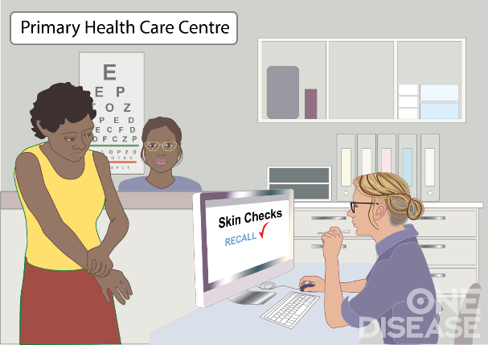
Crusted Scabies
Ongoing management
People who have been treated for Crusted Scabies need ongoing surveillance to prevent recurrences
Ongoing management of scabies includes:
Education/awareness, self check, seek treatment early
Staff awareness
Communication with regular/community health care providers
A Care Plan that ensures regular review of skin
Maintaining scabies free zones
Notes:
Communication between the treatment hospital (when a person with crusted scabies is an inpatient) and their regular health clinic along the journey help to facilitate the person with crusted scabies return to a scabies free zone. Once a person has had Crusted Scabies their close contacts also need to be treated to ensure that the person is returning from hospital to a scabies free zone.
People that have had Crusted Scabies will always be at risk of it developing again if they are exposed to scabies. This is why it is very important that people who have been treated for Crusted Scabies be placed on a long-term recall or care plan for monitoring scabies symptoms and treating these early if they arise. If not monitored or treated, a simple case of scabies may develop again into Crusted Scabies.
Long term care plans should include considerations for:
Education for everyone (including the person with crusted scabies) about ways to prevent Crusted Scabies and seeking treatment early are important for avoiding recurrences.
Regular skin checks to monitor symptoms
Providing prophylactic medications to person who had Crusted Scabies
If they, or their close contacts get a case of scabies they, and all contacts should be treated as soon as possible with a scabicide (like Lyclear or Benzyl Benzoate) Always be mindful that treatment requires 2 doses.
Remember:
Early treatment can prevent them from having a recurrence of Crusted Scabies and probable hospitalisation.
An easy way to ensure regular skin checks is to implement recalls in the health care providers clinical information system (CIS).
Additional measures such as Healthy Skin Weeks & wide spread education that promote awareness of maintaining scabies free zones are valuable.

Slide 38
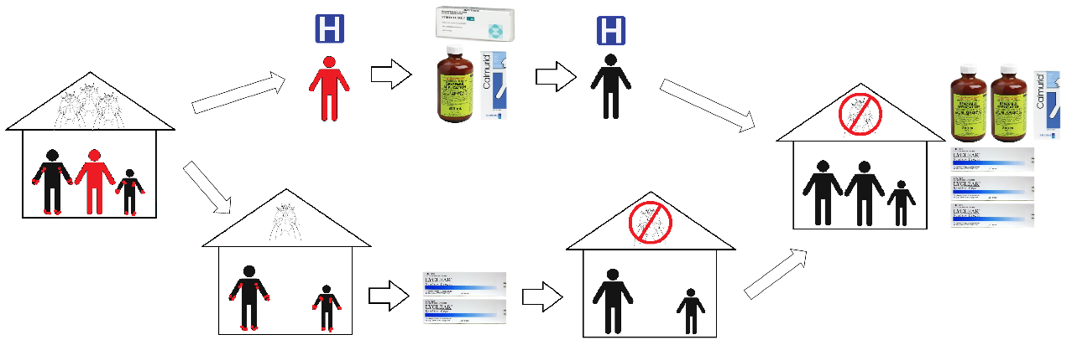
Crusted Scabies
Notes:
This diagram shows the red figure has a diagnosis of Crusted scabies. The family members (the other figures) have simple scabies. The house is infested with scabies mites because the person with Crusted Scabies was shedding lots of mites.
The person with Crusted scabies goes into hospital for treatment with oral medication and lotions. The length of stay may be many weeks.
Meanwhile, at home all close contacts are treated with Permethrin or other scabies medicine on day 1 and again a week later. Bedding and clothes are washed in hot water or bagged and sealed for 3 to 8 days. Together, this means the scabies mites in the household have been killed.
When the person is discharged from hospital, they return home to a scabies free zone with the knowledge to prevent Crusted scabies by treating simple scabies early. The person with Crusted Scabies is on a long term care plan with the clinic where they receive ongoing skin checks for scabies.
Image source: One Disease

Slide 39
Crusted Scabies
General points:
Crusted Scabies is a notifiable condition in the Northern Territory
Crusted Scabies is diagnosed by laboratory scrapings and involvement by an infectious diseases physician
Crusted Scabies is highly infectious and may contribute to cases of household scabies recurrence
People with comorbidities and/or immunosuppression are at higher risk of developing Crusted Scabies
Crusted Scabies often needs treatment in hospital
People who have been treated for Crusted Scabies need to be on long-term management care plans to prevent recurrence and rehospitalisation
Notes:
General crusted scabies points to remember

Slide 40
Discussion
Discussion: Example scenario
5 year old presented 3 times in the last 4 months with extensive scabies and skin sores
LAB given each time, Lyclear provided each time
Household appears to be doing good job cleaning house and treating family members with Lyclear
Discuss what reasons there may be for cases of recurrent scabies.
Notes:
This is a common case study in many communities. When a young person has had multiple recurrences of scabies, it is important to brainstorm why this might be occurring.
Did the whole family/ household get treated? Is everyone using topical scabies medicine (or oral scabies medicine) and putting the cream all over their body? Did everybody leave the cream on overnight?
Did they complete their treatment (2 doses, I week apart)?
Is there someone they have contact with who has Crusted Scabies?
Remember: don’t expect people to know everything about scabies, share your knowledge!
Considerations
Children with three or more presentations of scabies in <2 months is considered an indicator for further household surveillance and management.
It is important to investigate in cases of recurrent scabies, the possibility of undetected Crusted Scabies in the household.
Close contacts of people with Crusted Scabies can exhibit severe scabies rashes due to exposure to many mites.
Time spent on individual early case management of children and households with persistent scabies can lead to improved health outcomes, interruption of mite transmission, and reduced workload for clinics in the long run.
For more details, see One Disease, 2017, Managing Households with Recurrent Scabies, 2nd Edition, www.onedisease.org/resources-1
Additional considerations:
People who have Crusted Scabies might not have engaged with health services about their skin because of the shame/embarrassment they feel
They may have complex social, cultural, physical or mental conditions which can impact on how willing they are to accept treatment and understanding of the importance of being successfully treated for scabies
Polite and sensitive conversation is crucial - your own culture of health seeking behaviour may be very different to another’s but that does not mean anybody’s culture is right or wrong

Slide 41
Resources
CARPA Standard Treatment Manual
https://www.remotephcmanuals.com.au/
One Disease Resources
www.onedisease.org/resources-1
https://www.onedisease.org/faq
Telethon Kids Institute National Healthy Skin Guideline
https://infectiousdiseases.telethonkids.org.au/our-research/skin-guidelines/
Remote Area Health Corps
https://www.rahc.com.au/
Notes:
For clinical guidance regarding diagnosis and management of scabies in community, see the latest edition of the CARPA Standard Treatment Manual.
For general scabies and Crusted Scabies resources and patient education tools, see the One Disease resources webpage and One Disease Frequently Asked Questions webpage.
For clinical guidelines regarding many skin conditions, see the Telethon Kids Institute National Healthy Skin Guideline.
For the Crusted Scabies online eLearning module, see the Remote Area Health Corps website.

