Slide 1
Summary of Aboriginal and Torres Strait Islander health status - selected topics 2020

Slide 2
Introduction
Nationally, there has been a shift away from the deficit approach (focusing on the negative differences between Aboriginal and Torres Strait Islander people and non-Indigenous people) to focus on strength-based approaches to understanding and
interpreting measures of health and wellness ^{[4]}. The Summary of Aboriginal and Torres Strait Islander health status – selected topics 2020 aims to deliver the most important and up to date information about Aboriginal and Torres Strait Islander health while also limiting comparisons with other Australians.
The HealthInfoNet has prepared this Summary as part of our contribution to support those who work in the Aboriginal and Torres Strait Islander health sector. Key health topics are summarised in plain language and an infographic style to enable readers to digest data easily and quickly.

Slide 3
Statistical terms
Hospitalisation refers to a period of hospital care for a person admitted to hospital. Hospitalisation rates are calculated as the total number of such periods of care divided by the total number of the population of interest. The rate is usually written per 1,000. Unless indicated, rates of hospitalisations provided in this Summary are excluding dialysis separations – these are the regular hospitalisations required by kidney disease patients for dialysis treatment.
Incidence is the number of new cases of a disease or condition during a time period, the incidence rate is the number divided by the population of interest.
Median is the middle number in a range where 50% fall below and 50% fall above.
Prevalence is the proportion of people living with a disease or condition in a given time period.
Rates are one way of looking at how common a disease or condition is in a population. A rate is calculated by taking the number of cases and dividing it by the population at risk, for a specific time period. A specific type of rate, called an age- standardised rate (or an age-adjusted rate), allows for comparison between populations that have different age profiles. These are different from crude rates. Unless stated otherwise, rates presented in this Summary are age-standardised.
Survival is the likelihood of a person being alive for a given period of time after being diagnosed with a disease or condition.

Slide 4
National surveys
Most of the information presented in this Summary is drawn from government reports, particularly those produced by the Australian Bureau of Statistics (ABS), the Australian Institute of Health and Welfare (AIHW), the Australian Health Ministers’ Advisory Council (AHMAC) and the Steering Committee for the Review of Government Service Provision (SCRGSP). Data in these reports come from:
national health surveys
hospitals and other government agencies (including the birth and death registration systems).
It’s important to note that data presented from national health surveys were generally calculated from responses by people aged 15 years and over. For children aged 14 years and under, a parent or guardian of a child generally provided responses on behalf of the child.
2012-13 Australian Aboriginal and Torres Strait Islander Health Survey | 2012-13 AATSIHS
2014-15 National Aboriginal and Torres Strait Islander Social Survey | 2014-15 NATSISS
2018-19 National Aboriginal and Torres Strait Islander Health Survey | 2018-19 NATSIHS
2019 National Drug Strategy Household Survey | 2019 NDSHS

Slide 5






Aboriginal and Torres Strait Islander population
PAPUA NEW GUINEA
Number of Aboriginal and Torres Strait Islander people
Proportion of state or territory that identify as Aboriginal and/ or Torres Strait Islander (%)
TORRES STRAIT
NT
78,596
32%
MAINLAND AUSTRALIA
QLD
241,082
4.7%
WA
109,138
4.1%
SA
45,926
2.6%
NSW
286,553
3.5%
ACT
8,414
2%
National estimates, 2020
VIC
63,615
1%
864,206
3.4% of the Australian population ^{[1, 2]}
30,604
5.7%
TAS
ABS, 2020 ^{[1]}

Slide 6
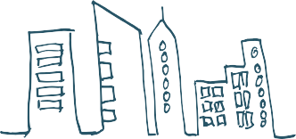

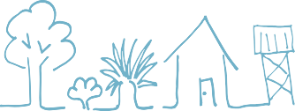
Aboriginal and Torres Strait Islander population
The Aboriginal and Torres Strait Islander population is much younger overall than the non-Indigenous population ^{[1, 2]}. 1/3 of the Aboriginal and Torres Strait Islander population was aged <16 years. Just over 5% of Aboriginal and Torres Strait Islander people were aged 65 years+.
More detailed information about the Aboriginal and Torres Strait Islander population can be found in the 2016 Census ^{[3]}.
37%
44
91%
₅%
Aboriginal
Major cities
₄%
Torres Strait Islander
%
Regional areas
Both Aboriginal and
Torres Strait Islander
19%
Remote and very remote areas ^{[3]}
32% of the total Aboriginal and Torres Strait Islander population were located in the regions
of Brisbane, NSW Central and North Coast and Sydney-Wollongong ^{[4]}.

Slide 7


Social and cultural determinants of health
among Aboriginal and Torres Strait Islander people
Education
In 2020 ^{[3]}:
There were 240,180 school students who identified as Aboriginal and/or Torres Strait Islander The retention rate₁ for secondary students was 60%
Highest retention rates were found in the ACT (99%) and SA (75%), while lowest the rates were found in the NT (36%) and NSW and WA (both 56%).
Aboriginal and Torres Strait Islander students at, or above the national minimum standard, 2019 ^{[4]}
 | Year 3 | Year 5 | Year 7 | Year 9
Reading | 83% | 78% | 78% | 72%
Writing | 85% | 73% | 65% | 53%
Numeracy | 81% | 80% | 76% | 84%

Slide 8



Social and cultural determinants of health
among Aboriginal and Torres Strait Islander people
The 2016 Australian Census reported for Aboriginal and Torres Strait Islander people ^{[5]}:
47% 37%
15,395
were studying at university
aged 20-24 years had completed year 12
aged 15 years+ had completed vocational or tertiary studies

Slide 9



Social and cultural determinants of health
among Aboriginal and Torres Strait Islander people
Employment and income
The 2016 Australian Census reported for Aboriginal and Torres Strait Islander people ^{[5]}:
70% 53% 47%
aged 15 to 24 years were either in full or part time employment, education or training
reported a householdweekly income₂
aged 15-64 years were employed
of $150-$799

Slide 10
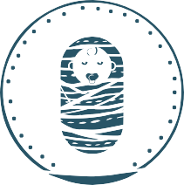
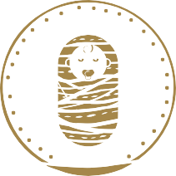



Births and pregnancy
among Aboriginal and Torres Strait Islander people
There were 21,925 births₁ registered in Australia where one or both parents were Aboriginal and/or Torres Strait Islander in 2019, representing for 7.2% of all births registered for that year ^{[1]}.
11,145 10,780
boys girls
Aboriginal and/or Torres Strait Islander status of parents for births registered
45% 30% 25%
mother only father only both parents

Slide 11


Births and pregnancy
among Aboriginal and Torres Strait Islander people
Babies
Low birthweight (LBW) is a birthweight of less than 2,500 grams ^{[2]}. Babies with LBW are at greater risk of health problems and death ^{[3]}.
For babies born to Aboriginal and Torres Strait Islander mothers in 2018 ^{[4]}:
12%
Average weight of 3,214 grams
of babies were of LBW

Slide 12

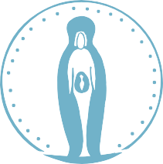
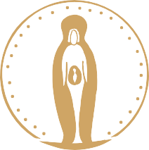
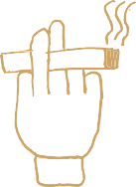
Births and pregnancy
among Aboriginal and Torres Strait Islander people
Mothers
Antenatal (pre-birth) care from health professionals during pregnancy supports positive health outcomes for mother and child, especially when provided during the first trimester (12 weeks) of pregnancy ^{[5, 6]}.
For Aboriginal and Torres Strait Islander mothers who gave
birth in 2019 ^{[1]}:
median age was 26 years
59% were aged 20-29 years
11% were teenagers
In 2018, 66%
The total fertility rate₂ was
of pregnant women attended antenatal care in their first trimester of pregnancy ^{[4]}.
2,316births
per 1,000 women
Smoking while pregnant is known to be a major factor in babies having LBW ^{[8]}. In 2018, 2 out of 5 mothers reported smoking during pregnancy ^{[1]}.

Slide 13
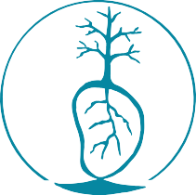
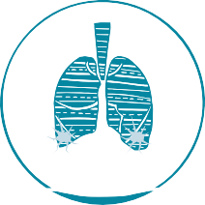

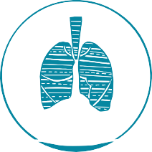
Deaths
among Aboriginal and Torres Strait Islander people
In 2019, there were 3,787 deaths₁ registered for Aboriginal and/or Torres Strait Islander people ^{[1]}.
This accounts for 2.2% of all deaths in Australia for 2019. Deaths from avoidable causes₂
accounted for 61% of all deaths in the five-year period 2014-2018 ^{[2]}.
Leading causes of death:
Chronic lower respiratory disease
Ischaemic heart disease
Lung and related cancers
_{ABS} [3]
Diabetes
In 2019 ^{[1]}:
The rate of deaths for people of all ages was 439 per 100,000
The median age at death was 60.4 years
The rate of deaths for babies 12 months or younger was 5.8 per 1,000

Slide 14




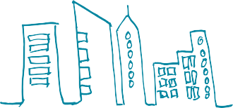
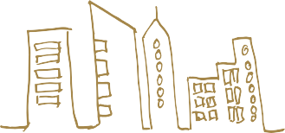

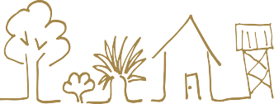
Deaths
among Aboriginal and Torres Strait Islander people
The life expectancy for Aboriginal and Torres Strait Islander people born in 2015-2017 was ^{[4]}:
71.6 years
75.6 years
males
females
Life expectancy varied considerably by remoteness:
males
females
72.1 years
76.5 years
in major cities
65.9 years
in remote and very remote areas
in major cities
69.6 years
in remote and very remote areas

Slide 15




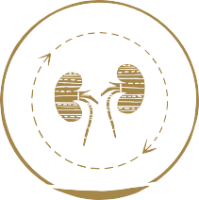

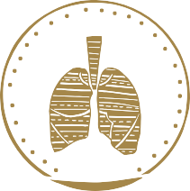
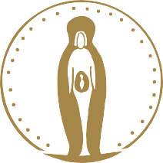

Hospitalisations
among Aboriginal and Torres Strait Islander people
In 2018-19 there were ^{[7]}:
558,553 hospitalisations
4.9% of all hospitalisations
92%
4.3%
57% 43%
Female Male
Aboriginal people
Torres Strait Islander people
4.2% both Aboriginal and Torres Strait Islander.
A key factor in the higher rates of hospitalisation for Aboriginal and Torres Strait Islander people is dialysis treatment for kidney disease, which involves repeat admissions for the same patients.
Leading causes of Aboriginal and Torres Strait Islander hospitalisation in 2018-19 ^{[7]}:
47% 6.7%
5.4%
5.2%
5.0%
Dialysis
Injuries
Respiratory conditions
Pregnancy and birth
Digestive conditions

Slide 16
Hospitalisations
among Aboriginal and Torres Strait Islander people
Potentially preventable hospitalisations among Aboriginal and Torres Strait Islander people in 2018-19
Potentially preventable hospitalisations: 75 per 1,000
The highest rates for potentially preventable hospitalisations were for:
Chronic conditions 36
Acute conditions 29
Vaccine-preventable conditions 11
per 1,000

Slide 17
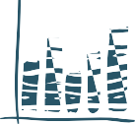




Cardiovascular health
among Aboriginal and Torres Strait Islander people
Prevalence
The National Aboriginal and Torres Strait Islander Health Survey (NATSIHS) 2018-19 ^{[4]} reported:
5.5%
CVD was slightly higher among males than females
26%
5.2%
The prevalence of CVD increased with age
among those aged 55 years +
of adults had CVD
5.4%
4.9%
Non remote areas
Remote areas

Slide 18

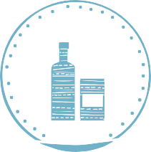
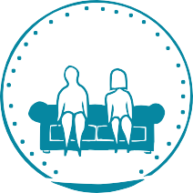

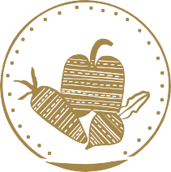



Cardiovascular health
among Aboriginal and Torres Strait Islander people
Risk factors
Risk factors for CVD include ^{[5-7]}:
Smoking
Drinking alcohol at risky levels
Lack of physical activity
Unhealthy weight
Depression and social isolation
Unhealthy diet
High blood pressure
High cholesterol

Slide 19


Cardiovascular health
among Aboriginal and Torres Strait Islander people
Hospitalisations
16,124 hospitalisations for CVD in 2018-19 ^{[8]}
5.4% of all Aboriginal and Torres Strait Islander hospitalisations
Although rates of CVD are highest among older people, CVD is recognised as having a substantial impact on younger Aboriginal and Torres Strait Islander people.
22 in every 1,000
2015-17 rate of hospitalisations for for CVD in Aboriginal and Torres Strait Islander people aged 35-44 ^{[9]}.
Deaths
About one quarter of all deaths were caused by CVD in 2014-2018 ^{[9]}.
23%
IHD was the leading cause of deaths in 2019 ^{[10]}.
The rates of deaths due to IHD increased with age, however, concerningly, it was the leading cause of death among the 35-44 year age group and the fourth leading cause of death among the 25-34 year age group in 2019 ^{[10]}.
145
85
per 100,000

Slide 20



Cardiovascular health
among Aboriginal and Torres Strait Islander people
Acute rheumatic fever (ARF) and rheumatic heart disease (RHD)
ARF and RHD are preventable health problems that affect many Aboriginal and Torres Strait Islander people and communities ^{[11]}. RHD occurs when ARF, a sickness caused by the germ Streptococcus, leads to permanent damage to the heart valves. Risk factors for ARF include overcrowding and poor sanitation ^{[11, 12]}.
In NSW, Qld, WA, SA and the NT, from 2015 to 2017₁, there were ^{[13]}:
1,265
Episodes of ARF
More than half of these episodes were in people aged under 15 years
Nearly
60 of episodes were in the NT
%
730
The rate for females was about double the rate for males ^{[13]}.
x2
New diagnoses of RHD
A roadmap for ending RHD in Australia by 2031 was released in 2020 ^{[11]}.

Slide 21




Cancer
among Aboriginal and Torres Strait Islander people
Incidence and prevalence
In the 2018-19 NATSIHS ^{[3]}, 1.3% of Aboriginal and Torres Strait Islander people reported having neoplasms (includes both cancerous and non-cancerous tumours).
1.2% 1.1%
men women
prevalence increased with age
5.3% of people 55 yrs+
In 2011-2015, 6,925 new cases of cancer were diagnosed, an average of 1,385 new cases per year ^{[4]}.

Slide 22
Cancer
among Aboriginal and Torres Strait Islander people
New cases of the most common cancers:
0 200 400 600
800
1000
1200
Lung Breast Bowel Prostate Head & Neck
Uterus Liver
1,040
810
613
575
469
238
234
AIHW ^{[4]}

Slide 23






Cancer
among Aboriginal and Torres Strait Islander people
Risk factors
Different types of cancer have different risk factors and sometimes cancers can develop for no known reason^{[5]}. Risk factors for the common types of cancer include ^{[6]}:
Smoking and passive smoking
Alcohol consumption
Being overweight or obese
Infectious diseases
Family history
Environmental factors and radiation
Poor diet
The high incidence of some types of cancer among Aboriginal and Torres Strait Islander people can be partly explained by the higher level of risk factors, most notably tobacco use ^{[7]}. This is the main contributing factor to the high incidence of lung cancer.

Slide 24

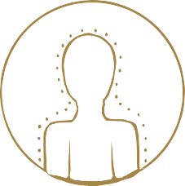
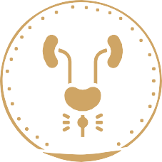
Cancer
among Aboriginal and Torres Strait Islander people
Survival
For the period 2006-2015, the likelihood of surviving five years after a cancer diagnosis was 51% ^{[4]}.
54%
48%
women men
The relative survival rates for males was lower than for females.
The highest observed survival rates were found in prostate cancer, while lung cancer had the lowest ^{[4]}.
89%
11%
Prostate cancer
Lung cancer

Slide 25





Cancer
among Aboriginal and Torres Strait Islander people
Hospitalisations
In 2018-19, there were 9,357 hospitalisations for cancer, representing 3.1% of all admissions ^{[8]}. In 2015-17, there were 24,871 cancer-related hospitalisations ^{[4]}.
Of these, 10,323 were for cancer as the principal diagnosis, at a rate of 12 per 1,000
10 14
women men
46%
in regional locations
36%
in cities
per 1,000
17%
in remote and very remote

Slide 26

Cancer
among Aboriginal and Torres Strait Islander people
Deaths
There were 3,340 deaths due to cancer in 2014-2018, at a rate of 221 per 100,000 ^{[4]}
1,762males
1,578females
Cancers of the trachea, bronchus and lung combined were the fourth highest overall cause of death in 2019 ^{[9]}.
Number of deaths for selected cancers 2014-2018 ^{[4]}:
0 200
Lung Bowel
Blood and lymphatic
Liver Pancreas Head & Neck
Breast
400 600 800 1000
879
253
250
231
211
208
193
AIHW ^{[4]}

Slide 27






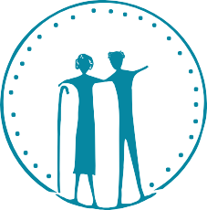
Diabetes
among Aboriginal and Torres Strait Islander people
Incidence and prevalence
In the 2018-19 NATSIHS 7.9% of people self-reported diabetes ^{[3]}:
₇%
8.2% 7.6%
females males
12%
remote areas
non-remote areas
WA and the NT had the highest levels of diabetes (both 11%)
Diabetes increased with age;
35% of people 55 years + had diabetes

Slide 28







Diabetes
among Aboriginal and Torres Strait Islander people
When high glucose levels (a pre-cursor to diabetes) were included with self-reported diabetes, the prevalence increased to 13% of adults ^{[4]}
14% 13%
females males
19%
12%
remote areas
non-remote areas
In 2018, the incidence rate for type 1 diabetes was 13 per 100,000 ^{[5,6].}
9.8 16
women men
per 100,000
In 2017-18, there were 1,715 new cases of GDM among Aboriginal and Torres Strait Islander women aged 15-49 years ^{[6]}.

Slide 29

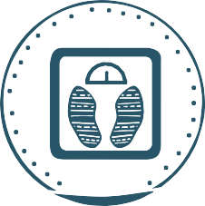
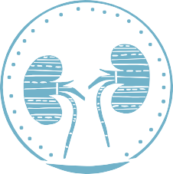
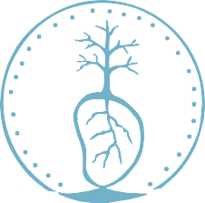
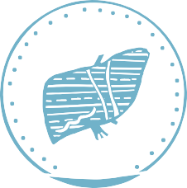
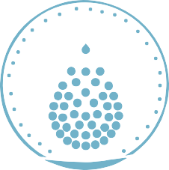
Diabetes
among Aboriginal and Torres Strait Islander people
Risk factors
Risk factors for diabetes include ^{[7]}:
Smoking
Obesity
Other chronic conditions such as kidney disease, cardiovascular disease, liver disease and anaemia.

Slide 30


Diabetes
among Aboriginal and Torres Strait Islander people
Hospitalisations
Hospital services are usually required to treat the advanced stages of complications of diabetes or acute episodes ^{[2]}.
In 2015-17 ^{[4]}:
There were 6,504 hospitalisations for diabetes:
Crude rate of 4.1
per 1,000
In 2017-18 ^{[8]}:
There were 1,016 hospitalisations for type 1 diabetes as a main diagnosis
The crude rate as a main or additional diagnosis was
3.7
3.7
3.8
per 1,000
females
males
1.8x higher for those living in remote and very remote areas than for those living in major cities

Slide 31

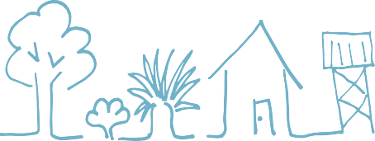



Diabetes
among Aboriginal and Torres Strait Islander people
There were 2,504 hospitalisations for type 2 diabetes as a main diagnosis
The crude rate as a main or additional diagnosis was
85
99
71
per 1,000
females
males
2.3x higher for those living in remote and very remote areas (8.4 per 1,000 ) than for those living in major cities (3.6 per 1,000)
In 2017-18, there were 589 hospitalisations for diabetes as the main diagnosis during pregnancy ^{[9]}.
The rate was more than 5x higher for those living in remote and very remote areas (119 per 1,000 ) than for those living in major cities (22 per 1,000).

Slide 32


Diabetes
among Aboriginal and Torres Strait Islander people
Deaths
Diabetes was the third leading cause of death for Aboriginal and Torres Strait Islander people in 2019 ^{[10]}.
239 deaths, 7%of all deaths
Qld recorded the highest number of deaths due to diabetes as an underlying cause
136 103
females
males
Fifth leading cause of death
Third leading cause of death

Slide 33







Kidney health
among Aboriginal and Torres Strait Islander people
Incidence and prevalence
For the 2012-13 AATSIHS, 18% of Aboriginal and Torres Strait Islander adults had biomedical signs of CKD^{[4]}.
For the 2018-19 NATSIHS, 1.8% of Aboriginal and Torres Strait Islander people reported kidney disease as a long-term health condition ^{[3]}.
1.9% 0.4%
2.3% 1.2%
Females Males
Aboriginal people
Prevalence increased with age
Torres Strait Islander people
7.6%
3.4%
in remote areas
1.4%
in non-remote areas
for people aged 55 years +
For 2014-2018, the incidence rate of ESKD for Aboriginal and Torres Strait Islander people was ^{(Derived from [5-7]):}
603
per 1,000,000 population

Slide 34
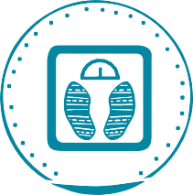



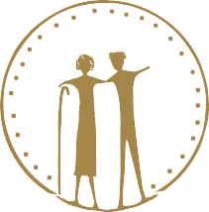
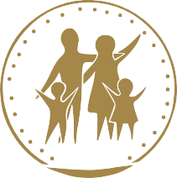

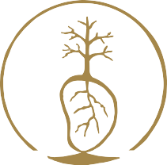
Kidney health
among Aboriginal and Torres Strait Islander people
Risk factors
Risk factors for kidney disease which can be changed include:
Being overweight or obese
High blood pressure
High blood glucose (sugar)
Smoking
Risk factors for Aboriginal and Torres Strait Islander people that cannot be changed or controlled include:
Age (30yrs+)
Family history of CKD
Acute kidney injury
Vascular disease

Slide 35





Kidney health
among Aboriginal and Torres Strait Islander people
Hospitalisations
In 2017-18, the crude rate of CKD hospitalisation was 33per 1,000 ^{[2]}
CKD:
39 27
per 1,000 ^{[2]}
Females Males
ESKD:
2016-18
In 2018-19, there were 242,274 hospitalisations for ESKD ^{[9]}.
316
241
per 1,000 ^{[9]}
Females
Males
In 2016-18, the rate for people living in in remote and very remote locations was 5 times higher than for those living in major cities ^{[9]}.

Slide 36
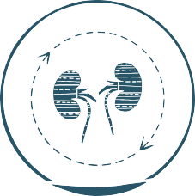
Kidney health
among Aboriginal and Torres Strait Islander people
Dialysis:
Dialysis is the most common reason Aboriginal and Torres Strait Islander people are hospitalised ^{[14]}.
In 2017-18, the rate of hospitalisation for regular dialysis was 284 per 1,000 ^{[2]}
In 2019, 378 people commenced dialysis, up from 322 in 2018 ^{[15]}.
Kidney transplants: In 2019, there were 55 transplant operations^{[15]}.

Slide 37


Kidney health
among Aboriginal and Torres Strait Islander people
Deaths
In 2019, there were 83 deaths due to disease of the urinary system
(including disorders of the bladder and urethra, as well as disease of the kidneys and ureters)
It was the 8th underlying cause of death for women and the 14th underlying cause of death for men ^{[16]}.
For 2016-2018, the crude death rate for CKD as an underlying or associated cause of death was
72 deaths
80 64
Females Males
per 100,000
per 100,000 ^{[2]}
In 2018, 217 Aboriginal and Torres Strait Islander people who were receiving dialysis died ^{[17]}. The most common causes of death for the dialysis patients were CVD (64 deaths) and withdrawal from treatment (51 deaths).

Slide 38


Sexual transmitted infections
among Aboriginal and Torres Strait Islander people
Incidence and prevalence of some notifiable₁ STIs
In 2018, there were ^{[2]}:
6,897 notifications of chlamydia
1,242
4,439 notifications of gonorrhoea 717
791 notifications of syphilis
101
per 100,000
Young people are particularly vulnerable to bacterial STIs ^{[3]}.
chlamydia 21 years
gonorrhoea 22 years
27 years
median age of diagnoses in 2017
syphilis

Slide 39


Sexual transmitted infections
among Aboriginal and Torres Strait Islander people
In 2017, people aged 15-29 years accounted for 82% of chlamydia notifications in the Aboriginal and Torres Strait Islander population.
In 2017 ^{[3]}:
Females 2x more likely to be diagnosed with chlamydia than males. Females 1.2x more likely to be diagnosed with gonorrhoea than males. Syphilis notifications were 50% for males and females
In 2017, Qld (45%) and the NT (35%) accounted for 80% of the syphilis notifications from all jurisdictions, with WA having the next highest reported notifications (9.2%) ^{[3]}.

Slide 40

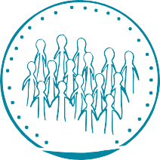

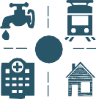
Environmental health
among Aboriginal and Torres Strait Islander people
Overcrowding
In 2016:
In 2018-19:
Overcrowding was highest in the NT (51%)
and lowest in the ACT (8%) ^{[1].}
18% of Aboriginal and Torres Strait Islander people
were living in an overcrowded house^{[6].}
Infrastructure
In 2018-19 ^{[1]}:
94% of households in major cities reported functioning facilities for washing people, bedding and clothes, preparing/storing food and sewerage.
33% of Aboriginal and Torres Strait Islander
households reported major structural issues,
compared with 26% in 2014-15. Households with major structural issues
increased with remoteness.
80% of Aboriginal and Torres Strait Islander households reported living in housing of an acceptable₁ standard.

Slide 41


Environmental health
among Aboriginal and Torres Strait Islander people
Hospitalisations for diseases related to environmental health
influenza and pneumonia 9.2 4.6
acute upper respiratory infections asthma
intestinal infectious diseases 9.0
per 100,000
2.7
bacterial diseases 8.0
1.8
scabies
2018-19 ^{[1]}
Deaths related to poor environmental health
40 44
per 100,000
females males
2014-18 ^{[1]}

Slide 42





Social and emotional wellbeing
(including mental health) among Aboriginal and Torres Strait Islander people
Prevalence Psychological distress
In the 2018-19 NATSIHS, 31% of Aboriginal and Torres Strait Islander respondents aged 18 years and over reported high or very high levels of psychological distress ^{[6]}.
31% 23%
Aboriginal Torres Strait Islander
More women reported high or very high levels of psychological distress compared with men.
35% 26%
Women Men

Slide 43




Social and emotional wellbeing
(including mental health) among Aboriginal and Torres Strait Islander people
Mental health conditions
In the 2018-19 NATSIHS:
25% of Aboriginal and 17% of Torres Strait Islander people aged two years and over were reported as having a mental and/or behavioural condition.
17% 13%
Anxiety was the most Depression was the second common mental health condition most common mental health condition
Mental health conditions were more likely to be reported by people living in non-remote areas compared with remote areas [6].
9.8 remote areas 28
% %
non-remote areas

Slide 44
Social and emotional wellbeing
(including mental health) among Aboriginal and Torres Strait Islander people
Hospitalisations
In 2018-19 ^{[7]}:
There were 23,700 hospitalisations of Aboriginal and Torres Strait Islander people for
mental and behavioural disorders.
8.0
%
of all hospitalisations
Intentional self-harm¹ was responsible for
0.5%
2,980 hospitalisations.
of all hospitalisations

Slide 45


Social and emotional wellbeing
(including mental health) among Aboriginal and Torres Strait Islander people
Deaths
In 2019, 195 people died from intentional self-harm (suicide) ^{[8]}.
Suicide was the fifth leading cause of death overall in 2019 for Aboriginal and Torres Strait islander people.
Between 2015-2019:
The rate of suicide deaths increased from
21 25
per 100,000
in 2010-2014
per 100,000
in 2015-2019
Suicide was
x3 more likely to be a cause of death for men as for women
WA consistently records the highest death rates for suicide.

Slide 46


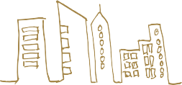
Alcohol use
among Aboriginal and Torres Strait Islander people
Alcohol use among Aboriginal and Torres Strait Islander people 2018-19
The following information was self-reported in the 2018-19 NATSIHS ^{[4]}:
Abstinence (no consumption of alcohol) in the last 12 months
26% 23%
of Aboriginal of Torres Strait Islander
people aged 18 years or older had not drunk alcohol or had not done so for more than 12 months
The proportion of people who were abstinent was highest for people aged 55 years and older.
43%
19%
The proportion of people who were abstinent was higher for people living in remote and very remote areas than non-remote areas

Slide 47


Alcohol use
among Aboriginal and Torres Strait Islander people
Short-term risk (no more than four drinks on a single occasion)
54% of people reported exceeding the short-term risk guideline₁
Men were 1.5x more likely to exceed the guideline when compared with women
65% 43%
men women
Young people (18-24) were more likely to exceed the guideline.
65%
aged 18-24 years

Slide 48




Alcohol use
among Aboriginal and Torres Strait Islander people
Lifetime risk (no more than two standard drinks on a single day)
20% 24%
of Aboriginal of Torres Strait Islander people reported exceeding the guideline for lifetime risk₁
Men were three times more likely to exceed the guideline for lifetime risk compared with women
30% 10%
men women
17%
21%
The proportion of people exceeding the guideline for lifetime risk was higher for people living in non-remote areas compared with remote areas

Slide 49




Alcohol use
among Aboriginal and Torres Strait Islander people
Hospitalisations
In 2016-18 ^{[5]}, the alcohol-related hospitalisation rate was 7.6 per 1,000
6.8 8.4
per 1,000
females males
Deaths
For 2014-2018 ^{[5]}, the rate of deaths due to alcohol use was 2.9 times higher for males
than for females.
11 31
per 100,000
females males
The main cause of alcohol-related deaths was alcoholic liver disease.

Slide 50














Alcohol use
among Aboriginal and Torres Strait Islander people
The good news between 2010 and 2019 there was a decline (from 32% to 19%) in the proportion of Aboriginal and Torres Strait Islander people aged 14 years and older exceeding the 2009 alcohol guidelines for lifetime risk ^{[6]}.
32% 19%
in 2010 in 2019
In 2018-19, 90% of mothers of Aboriginal and Torres Strait Islander children
(aged 0-3 years) had not drunk alcohol during their pregnancy ^{[7]}.

Slide 51



Illicit drug use
among Aboriginal and Torres Strait Islander people
Prevalence
In the 2019 National Drug Strategy Household Survey (NDSHS)^{[8]}:
23%
77%
of people aged 14 years + reported they had used illicit drugs in the previous 12 months
of people aged 14 years + had never used illicit drugs or had not done so in the past 12 months

Slide 52







Illicit drug use
among Aboriginal and Torres Strait Islander people
In the 2018-19 NATSIHS ^{[7]}, people aged 15 years + reported specific drug use over the previous 12 months:
24% had used cannabis (marijuana)
had used other drugs¹ such
%
had used amphetamines
3.3 (ice or speed)
%
%reported taking ecstasy or
_{5.9} as heroin, cocaine, petrol
and kava
3.3 designer drugs
reported illicit use of
_{3.8} analgesics and sedatives
(sleeping pills)
%
Illicit drug use was 1.8 times higher among males than females ^{[7]}:
In 2018-19, the most common principal drugs of concern that Aboriginal and Torres Strait Islander people sought treatment for were
amphetamines, cannabis and heroin ^{[9]}.
37% 21%
males females

Slide 53





Illicit drug use
among Aboriginal and Torres Strait Islander people
Hospitalisations
The top two reasons for drug-related hospitalisations among Aboriginal and Torres Strait Islander people in 2018-19 were mental and behavioural disorders (crude rate of 4.7 per 1,000) and poisoning (crude rate of 3 per 1,000) ^{[10]}.
The most common drugs to cause mental and behavioural disorders requiring hospitalisation in 2016-18 were:
2.1 1
amphetamines ² and cannabis
per 1,000 ^{[7]}
Hospitalisation rates due to drug use were higher in major cities than in inner and outer regional areas, and remote and very remote areas ^{[10]}.
9.2 6.6 4.3
per 1,000

Slide 54

Illicit drug use
among Aboriginal and Torres Strait Islander people
Deaths
For the period 2014-2018:
Rates of drug induced deaths were 1.5 times higher for males than for females ^{[10]}
The highest rate of drug-induced deaths for Aboriginal and Torres Strait Islander people was recorded in SA
20
per 100,000

Slide 55






Illicit drug use
among Aboriginal and Torres Strait Islander people
Volatile substance use
Volatile substance use (VSU) involves sniffing inhalants - substances that give off fumes such as petrol, paint, glue or deodorants ^{[11]}. Sniffing can have serious short and long-term health effects, including a condition known as sudden sniffing death which causes the heart to stop within minutes ^{[12]}.
In the 2014-15 NATSISS, 0.7% of Aboriginal and Torres Strait Islander people aged 15 years and over reported using petrol and other inhalants in the 12 months prior to the survey ^{[13]}.
Rates of hospitalisation caused by VSU for 2016-18 ^{[10]}:
Toxic effect of organic solvents (e.g petrol) 0.04
Accidental poisoning from organic solvents 0.02
per 1,000
Mental/behavioural disorders from use of volatile substances 0.05
Overall, the number of people using volatile substances is small but the issue of VSU is still a problem in some communities ^{[14]}. One study reported a 95% reduction of VSU between 2006 and 2018, attributed to the replacement of regular unleaded petrol with low aromatic fuel (LAF).

Slide 56




Tobacco use
among Aboriginal and Torres Strait Islander people
Smoking among Aboriginal and Torres Strait Islander people
In the 2018-19 NATSIHS ^{[2]}:
37
%
39% 36%
men of women
of people aged 15 years+ reported they were current daily smokers
The age-group with the highest proportion of current daily smokers was 35-44 years
47%
49% te areas
remo
People living in remote areas reported a higher proportion of current daily smokers than those living in non-remote areas
35%non-remote areas

Slide 57
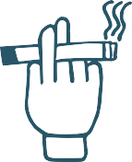

Tobacco use
among Aboriginal and Torres Strait Islander people
Passive smoking among Aboriginal and Torres Strait Islander people
%
₅₇ of Aboriginal and Torres Strait
Islander children aged 0-14
years lived in households with a daily smoker.
For those children living with a daily smoker,
%
₁₃ were living in households where
people smoked indoors ^{[3]}.

Slide 58











Tobacco use
among Aboriginal and Torres Strait Islander people
The good news is the proportion of young people starting to smoke has decreased, which will result in improved health outcomes over time.
Daily smoking rates reduced between 2012-13 and 2018-19 among ^{[2]}:
15-17 year olds
decreasing from 18% to
9.7 %
18-24 year olds
decreasing from 42% to
3 6 %
25-34 year olds
decreasing from 52% to
4 4 %
In 2017, 70% of Aboriginal and Torres
The proportion of Aboriginal and Torres Strait
Strait Islander students (aged 12-17 years)
Islander mothers who reported smoking
had never smoked tobacco, a significant increase from 49% in 2005 ^{[4]}.
during pregnancy has decreased from
52% in 2009 to 44% in 2018 ^{[5]}.

