Slide 1
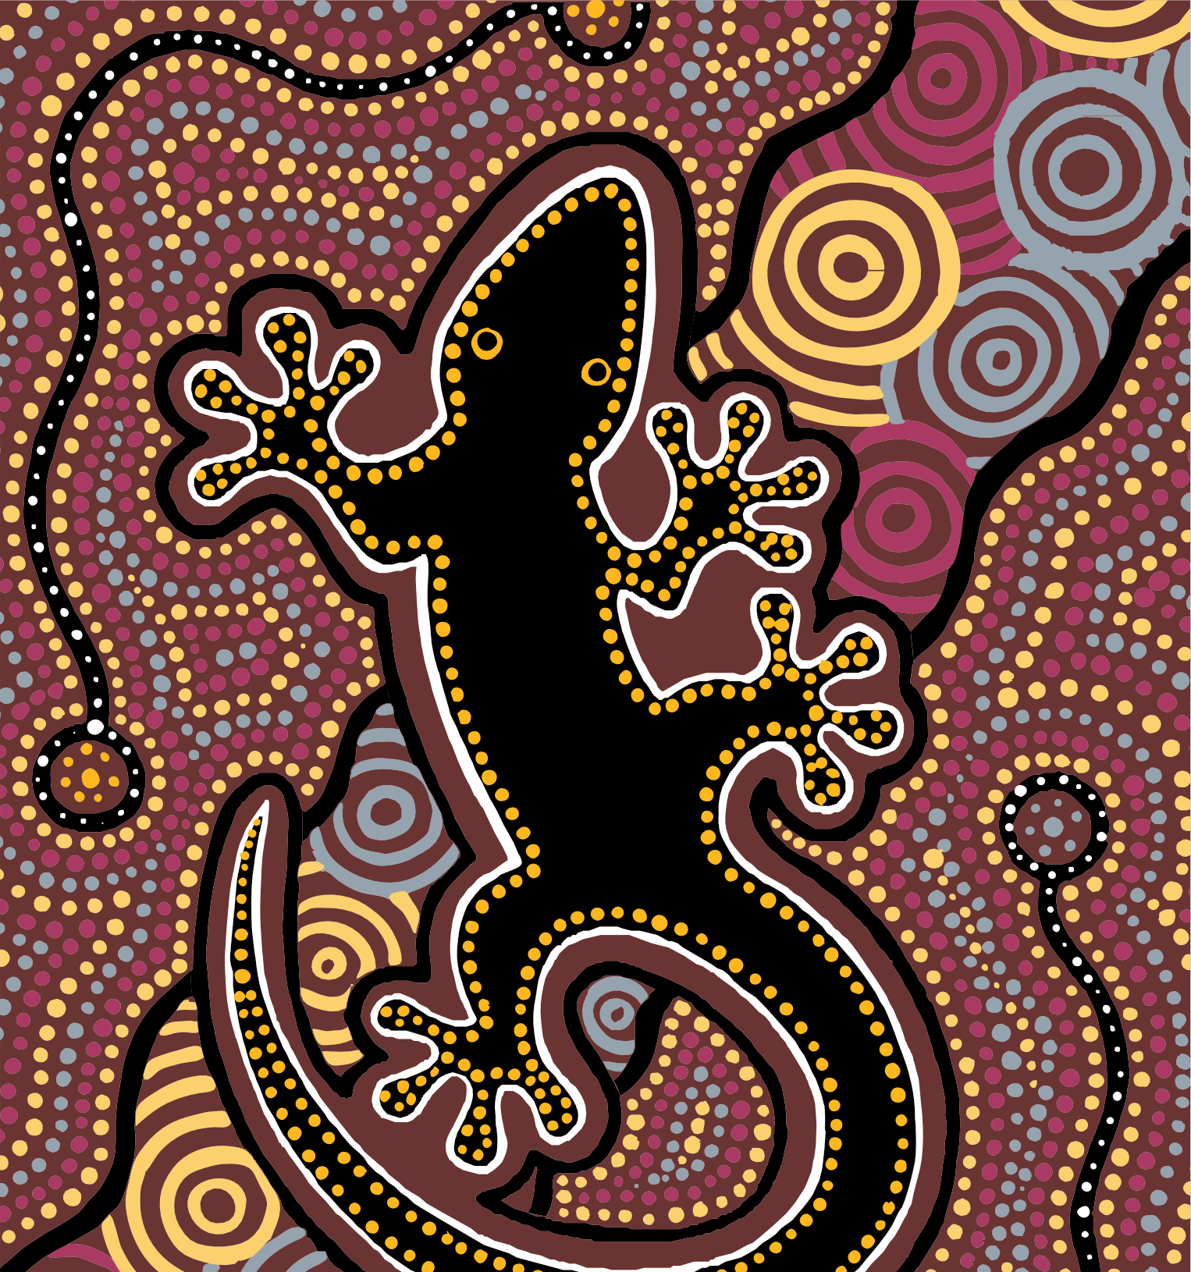



Summary of Aboriginal and
Torres Strait Islander health status
- selected topics 2021

Slide 2
Introduction
Aboriginal and Torres Strait Islander people have lived on their traditional lands across Australia, including the Torres Strait Islands, for many thousands of years ^{[1]}. Before colonisation, Aboriginal and Torres Strait Islander people lived in family and community groups, and moved across the land following seasonal changes. The Aboriginal and Torres Strait Islander concept of health is not just about the individual person, but a whole-of-life view that includes the social, emotional and cultural wellbeing of the community ^{[2]}.
There are distinctive ethnic and cultural differences between Aboriginal societies and between Torres Strait Islander societies, each having their own languages and traditions ^{[3]}. Despite their differences, Aboriginal and Torres Strait Islander people have had many similar experiences of colonisation that have led to negative outcomes on their quality of life and their health ^{[1,4]}.
It is evident that ongoing marginalisation, separation from culture and land, food and resource insecurity, intergenerational trauma, disconnection from culture and family, racism, systemic discrimination and poverty have resulted in poorer physical and mental health for many Aboriginal and Torres Strait Islander people, and an increase in chronic conditions ^{[5,6]}.
Nationally, there has been a shift away from the deficit approach (focusing on the negative differences between Aboriginal and Torres Strait Islander people and non-Indigenous people) to focus on strength based approaches to understanding and interpreting measures of health and wellness ^{[7]}. The Summary of Aboriginal and Torres Strait Islander health status – selected
topics 2021 (Summary) aims to deliver the most important and up to date information about Aboriginal and Torres Strait Islander health while also limiting comparisons with other Australians.

Slide 3
Introduction
The HealthInfoNet has prepared this Summary as part of our contribution to support those who work in the Aboriginal and Torres Strait Islander health sector. Key health topics are summarised in plain language and an infographic style to enable readers to absorb data easily and quickly.
The accuracy of the identification of Aboriginal and Torres Strait Islander people in health data collections varies across the country.
Information about hospitalisations is generally considered to be accurate for all jurisdictions: New South Wales (NSW), Victoria (Vic), Queensland (Qld), Western Australia (WA), South Australia (SA), Tasmania (Tas), the Australian Capital Territory (ACT) and the Northern Territory (NT), however in some jurisdictions private hospital data are not included. Other statistical information is only considered to be sufficient and complete for certain jurisdictions, for example data about deaths are usually only provided for NSW, Qld, WA, SA and the NT. Please refer to the sources for full details on the statistical information presented here.
If you want more information about the health and wellbeing of Aboriginal and Torres Strait Islander people, you can:
read our latest Overview ^{[8]} for a more comprehensive health status update
read one of our health topic reviews (healthinfonet.ecu.edu.au/reviews)
visit our website (healthinfonet.ecu.edu.au).
In 2021, the HealthInfoNet undertook a nation-wide consultation to develop policy and practice guidelines for the work of the HealthInfoNet. The focus of the consultation review is on best practice in data sovereignty and governance. Implementation of the outcomes of the review will be commenced in 2022.

Slide 4
Statistical terms
Burden of disease (and injury) is the quantified impact of a disease or injury on a population using the disability- adjusted life year measure.
Disability-adjusted life year (DALY) is a year of healthy life lost, either through premature death or living with a disability due to illness or injury.
Fatal burden is the burden of dying prematurely from a disease or injury as measured by years of life lost. It offers a way to compare the impact of different diseases, conditions or injuries on a population. See non-fatal burden.
Hospitalisation refers to a period of hospital care for a person admitted to hospital. Hospitalisation rates are calculated as the total number of such periods of care divided by the total number of the population of interest. The rate is usually written per 1,000. Unless indicated, rates of hospitalisations provided in this Summary are excluding dialysis separations – these are the regular hospitalisations required by kidney disease patients for dialysis treatment.
Incidence is the number of new cases of a disease or condition during a time period, the incidence rate is the number divided by the population of interest.
Median is the middle number in a range where 50% fall below and 50% fall above.
Maternal mortality refers to pregnancy-related deaths occurring to women during pregnancy, or up to 42 days after delivery.

Slide 5
Statistical terms
Maternal mortality ratio is the number of maternal deaths divided by the number of confinements (expressed in 100,000s).
Non-fatal burden is the burden from living with ill health, as measured by years lived with disability.
Prevalence is the proportion of people living with a disease or condition in a given time period.
Rates are one way of looking at how common a disease or condition is in a population. A rate is calculated by taking the number of cases and dividing it by the population at risk, for a specific time period. A specific type of rate, called an age- standardised rate (or an age-adjusted rate), allows for comparison between populations that have different age profiles. These are different from crude rates. Unless stated otherwise, rates presented in this Summary are age-standardised.
Survival is statistically measured as the likelihood of a person being alive for a given period of time after being diagnosed with a disease or condition. Data about survival are provided for NSW, Vic, Qld, WA and the NT.
Years lived with disability measures the years of what could have been a healthy life that were instead spent in states of less than full health. Years lived with disability represent non-fatal burden.
Years of life lost measures years of life lost due to premature death, defined as dying before the ideal lifespan (based on the lowest observed death rates from multiple countries). Years of life lost represent fatal burden.

Slide 6
Sources of information
Most of the information presented in this Summary is sourced from government reports, particularly those produced by the Australian Bureau of Statistics (ABS), the Australian Institute of Health and Welfare (AIHW), the Australian Health Ministers’ Advisory Council (AHMAC) and the Steering Committee for the Review of Government Service Provision (SCRGSP). Data in these reports come from national health surveys, hospitals and other government agencies (including the birth and death registration systems).
It is important to note that data presented from national health surveys were generally calculated from responses by people aged 15 years and over. For children aged 14 years and under, a parent or guardian of a child generally provided responses on behalf of the child.
Surveys that have informed in this Summary
2012-13 Australian Aboriginal and Torres Strait Islander Health Survey | 2012-13 AATSIHS
2014-15 National Aboriginal and Torres Strait Islander Social Survey | 2014-15 NATSISS
2018-19 National Aboriginal and Torres Strait Islander Health Survey | 2018-19 NATSIHS
2019 National Drug Strategy Household Survey | 2019 NDSHS

Slide 7
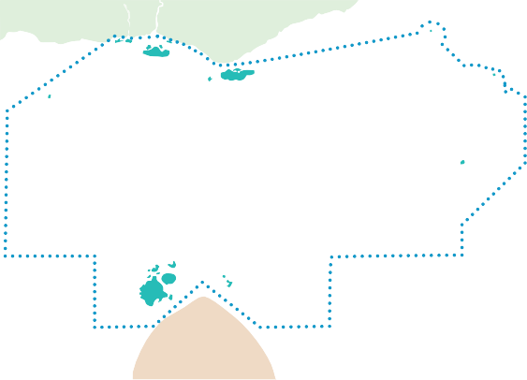







Aboriginal and Torres Strait Islander population
PAPUA NEW GUINEA
Number of Aboriginal and Torres Strait Islander people
Proportion of state or territory population that identify as Aboriginal and/or Torres Strait Islander
TORRES STRAIT
NT
79,571
32%
MAINLAND AUSTRALIA
QLD
246,323
4.7%
WA
111,370
4.2%
SA
46,889
2.6%
NSW
292,147
3.6%
ACT
8,653
2.0%
National estimates, 2021
881,593
3.4% of the Australian population ^{[1, 2]}
VIC
65,209
1.0%
31,148
5.8%
TAS
ABS, 2021 ^{[1]}, ABS, 2019 ^{[2]}

Slide 8
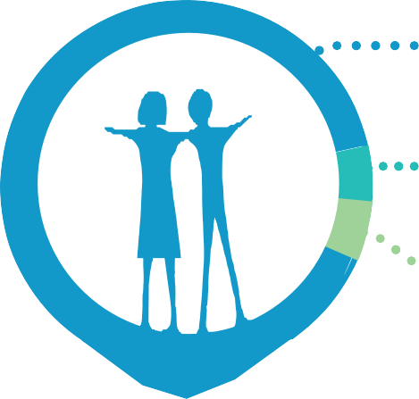


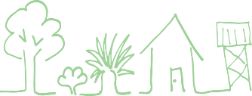
Aboriginal and Torres Strait Islander population
The Aboriginal and Torres Strait Islander population is much younger overall than the non-Indigenous population ^{[1, 2]}.
In 2021, it was estimated that 1/3 of the Aboriginal and Torres Strait Islander population was aged <15 years and just over 5%
of Aboriginal and Torres Strait Islander people were aged 65 years+ ^{[2]}.
More detailed information about the Aboriginal and Torres Strait Islander population can be found in the 2016 Census ^{[3]}.
91%
The ABS estimated that of the population of 881,593 in 2021:
₅%
Aboriginal
38%
44%
18%
lived in major cities
₄%
Torres Strait Islander
lived in inner/outer regional areas
both Aboriginal and
Torres Strait Islander
lived in remote/very remote areas ^{[2]}
32% of the total Aboriginal and Torres Strait Islander population were located in the regions
of Brisbane, NSW Central and North Coast and Sydney-Wollongong ^{[2]}.

Slide 9






Determinants of health
among Aboriginal and Torres Strait Islander people
Factors known as the ‘determinants of health’ impact the health and wellness of individuals ^{[1]}.
Social determinants of health are the conditions in which people are born, grow, work, live, and age, and include ^{[2]}:
employment education income access to health care
Education
In 2020 ^{[3]}:
There were 240,180 school students who identified as Aboriginal and/or Torres Strait Islander. The retention rate₁ for secondary students was 60%.
Highest retention rates were in the ACT (99%) and SA (75%), while lowest were in the NT (36%) and NSW and WA (both 56%).

Slide 10



Determinants of health
among Aboriginal and Torres Strait Islander people
Aboriginal and Torres Strait Islander students at, or above the national minimum standard, 2021 ^{[4]}:
 | Year 3 | Year 5 | Year 7 | Year 9
Reading | 84% | 78% | 75% | 66%
Writing | 84% | 73% | 65% | 52%
Spelling | 74% | 77% | 79% | 73%
Grammar and punctuation | 77% | 73% | 62% | 60%
Numeracy | 81% | 76% | 71% | 79%
The 2016 Australian Census reported for Aboriginal and Torres Strait Islander people ^{[5]}:
47% 37%
15,395
were studying at university
aged 20-24 years had completed year 12
aged 15 years+ had completed vocational or tertiary studies

Slide 11



Determinants of health
among Aboriginal and Torres Strait Islander people
Employment and income
The 2016 Australian Census reported for Aboriginal and Torres Strait Islander people ^{[5]}:
70% 53% 47%
aged 15 to 24 years were either in full or part-time employment, education or training
reported a householdweekly income₂
aged 15-64 years were employed
of $150-$799
Students who started school in year 7/8 and continued through to year 12.
This is based on equivalised household income, which is a special calculation that allows for the comparison of incomes of different types of households.

Slide 12
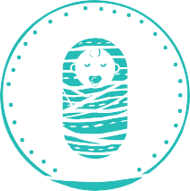
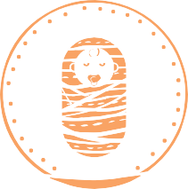





Births and pregnancy
among Aboriginal and Torres Strait Islander people
In 2020, there were 22,016 births₁ registered in Australia where one or both parents were Aboriginal and/or Torres Strait Islander, this represented 7.5% of all births registered ^{[1]}:
11,390 10,626
males females
Aboriginal and/or Torres Strait Islander status of parents for births registered as Indigenous:
44% 31% 25%
mother only father only both parents
Babies
Low birthweight (LBW) is a birthweight of less than 2,500 grams ^{[2]}. Babies with LBW are at greater risk of health problems and death ^{[3]}. For babies born to Aboriginal and Torres Strait Islander mothers in 2019 ^{[4]}:
3,211 grams average weight
12% were of LBW

Slide 13

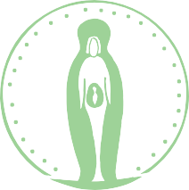
Births and pregnancy
among Aboriginal and Torres Strait Islander people
Mothers
Antenatal (pre-birth) care from health professionals during pregnancy supports positive health outcomes for mother and child, especially when provided during the first trimester (less than 14 weeks) of pregnancy ^{[5, 6]}.
In 2019, 67%of pregnant women attended their first antenatal care appointment during their first trimester of pregnancy ^{[4]}.
For Aboriginal and Torres Strait Islander mothers who gave birth in
2020 ^{[1]}:
the median age was 26.3 years
58% were aged 20-29 years
10% were teenagers aged 15-19 years.
2.3
The total fertility rate₂ was:
per 1,000
women
babies

Slide 14


Births and pregnancy
among Aboriginal and Torres Strait Islander people
There have been improvements in birth and pregnancy outcomes for Aboriginal and Torres Strait Islander mothers and babies, with evidence of:
an increase in the proportion of mothers attending antenatal care in the first trimester
a decrease in the rate of mothers smoking during pregnancy
a decrease in the proportion of babies born small for gestational age ^{[4]}.
Likely to be underestimated as Indigenous status is not always identified, and there may be a delay in birth registrations.
The total fertility rate is the number of children born to 1,000 women at the current level and age pattern of fertility.

Slide 15
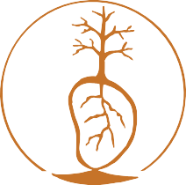
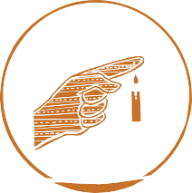
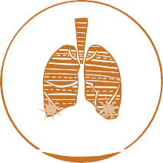

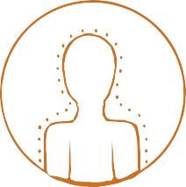



Deaths
among Aboriginal and Torres Strait Islander people
In 2020, there were 4,063 deaths₁ registered for Aboriginal and/or Torres Strait Islander people ^{[1]}. This accounts for 2.5% of all deaths in Australia for 2020.
11% 7.4% 6.8%
5.8%
lung and related cancers
Leading causes of death₂ in 2020 ^{[2]}:
ischaemic heart disease diabetes
chronic lower
respiratory disease
In 2020 ^{[1]} the median age at death was 61.0 years:
58.8 years
63.8 years
males females
The rate of deaths for babies 12 months or younger was 5.4 per 1,000 live births.
For 2012-2019, the maternal mortality ratio was 18 deaths per 100,000 women who gave birth ^{[3]}.
The life expectancy for Aboriginal and Torres Strait
71.6 years 75.6 years
Islander people born in 2015-2017 was ^{[4]}:
males
females

Slide 16
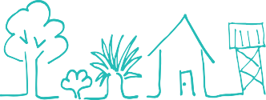

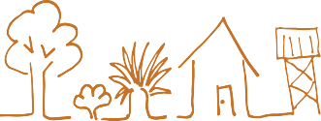
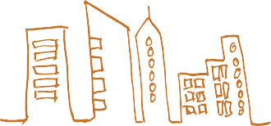
Deaths
among Aboriginal and Torres Strait Islander people
Life expectancy was lower for people living in remote and very remote areas than those living in major cities:
Males:
72.1 years
65.9 years
remote and very remote areas.
69.6 years
major cities
Females:
76.5 years
major cities
remote and very remote areas.
Deaths from avoidable causes₃ accounted for 61% of all deaths in the five-year period 2014-2018 ^{[5]}.
In July 2020, a new national agreement on Closing the gap was endorsed by Aboriginal and Torres Strait Islander leaders. Specific outcomes, targets and monitoring measures were set for life expectancy; deaths; leading causes of death; and potentially avoidable deaths ^{[5]}.
The ABS notes that the actual number of deaths may be slightly higher because of inaccurate data or delays in registration.
In 2020, leading causes of death only included data from NSW, Qld, WA, SA and the NT (3,611 deaths).
Deaths that could have been prevented with timely and effective health care, including early detection and effective treatment ^{[5]}.

Slide 17





Hospitalisations
among Aboriginal and Torres Strait Islander people
Hospital statistics provide some information about the health of a population and give governments information on how well the health system is managing ^{[1]}. However, they provide only a part of the overall picture of health because:
they only report on conditions that are serious enough to require hospitalisation
depending on where they live, not everyone has access to hospitals
different hospitals may have different admission policies and procedures for illnesses
the statistics relate to events of hospitalisation rather than to individual patients, i.e. one person may be hospitalised several times in the time period ^{[2-5]}.
In 2019-20 there were ^{[6]}:
581,163 hospitalisations identified as Aboriginal and/or Torres Strait Islander 5.2% of all hospitalisations
43% 57%
males females
92%
Aboriginal people
4.1%
Torres Strait Islander people
4.3%
both Aboriginal and Torres Strait Islander people

Slide 18
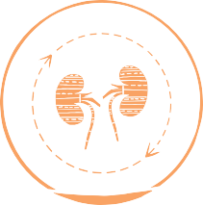

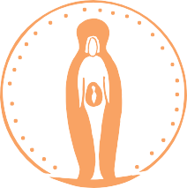
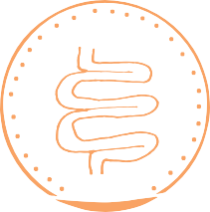
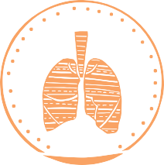
Hospitalisations
among Aboriginal and Torres Strait Islander people
A key factor in the high rates of hospitalisation for Aboriginal and Torres Strait Islander people is dialysis treatment for kidney disease, which involves repeat admissions for the same patients ^{[2]}.
Leading causes of Aboriginal and Torres Strait Islander hospitalisation in 2019-20 ^{[6]}:
48% 6.7%
5.2%
4.9%
4.9%
mostly care involving dialysis
injuries
pregnancy and birth
digestive conditions
respiratory conditions

Slide 19
Hospitalisations
among Aboriginal and Torres Strait Islander people
Potentially preventable hospitalisations
Potentially preventable hospitalisations are those that could have been avoided with preventative care actions and early disease management ^{[7]}. They can be used as a way to measure how easily people can access primary health or community care and how effective it is ^{[8]}. These hospitalisations are calculated for chronic conditions (such as diabetes), acute conditions and conditions that can be prevented with vaccinations.
In 2019-20, the rate of potentially preventable hospitalisations was 72 per 1,000^{[6]}.
The highest rates for potentially preventable hospitalisations were for:
chronic conditions
35
(includes 7.2 for diabetes complications)
acute conditions
29
per 1,000
vaccine-preventable conditions 9.9

Slide 20
Burden of disease
among Aboriginal and Torres Strait Islander people
In 2021, key findings for Aboriginal and Torres Strait Islander people were released for
Australia’s National Burden of Disease study ^{[1]}.
The reference year for this study was 2018.
Burden of disease studies have been undertaken in Australia for more than 20 years by the Australian Institute of Health and Welfare (AIHW) ^{[2]}. These studies measure the impact of diseases and injuries on a group of people in terms of:
the number of years of healthy life lost through living with illness, and
the number of years of life lost through dying prematurely ^{[1]}.
When added together, these measures are called total burden.
The findings from the burden of disease analysis are useful to people who plan health services because they highlight which diseases and injuries are having the most impact on a population.
This Summary presents information₁ about the impact that selected diseases and risk factors have on total burden among Aboriginal and Torres Strait Islander people.

Slide 21









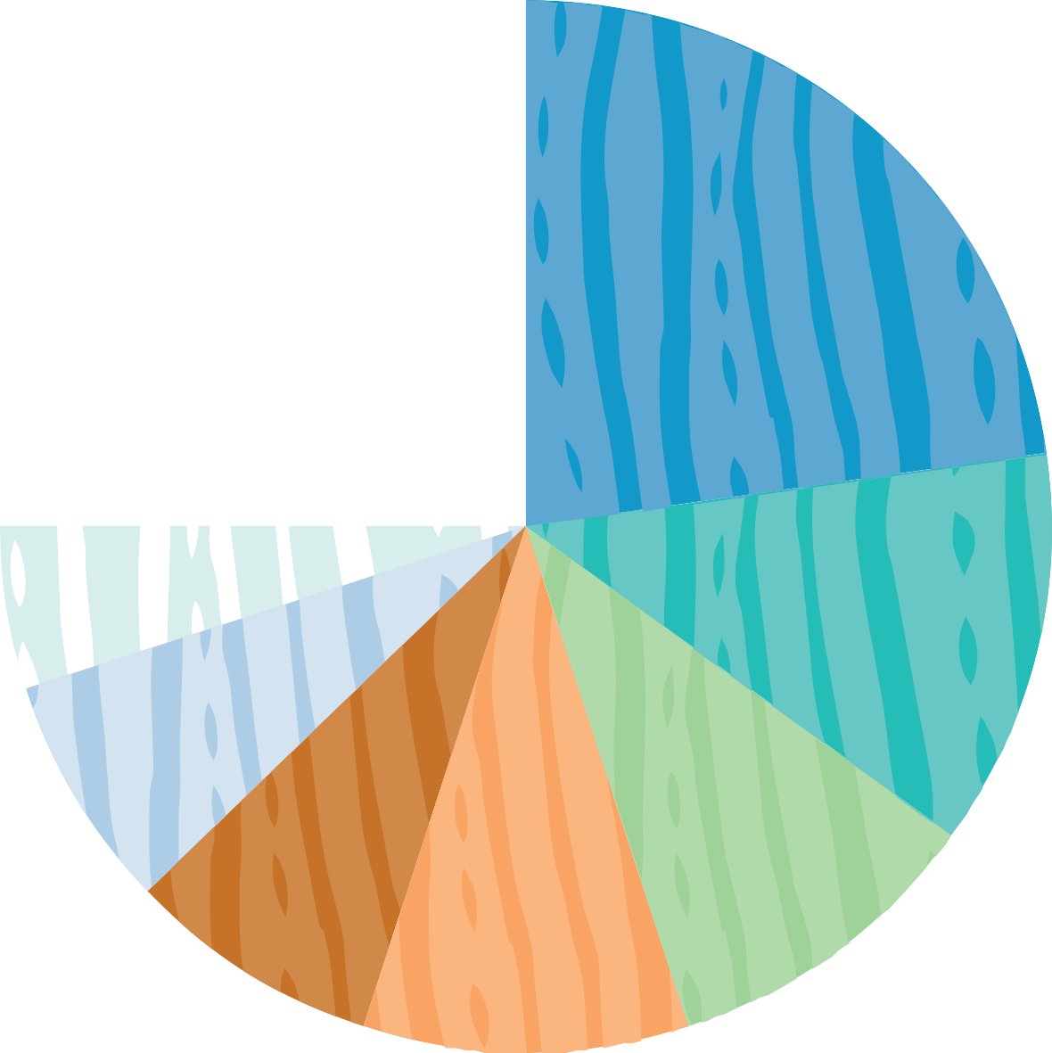
Burden of disease
among Aboriginal and Torres Strait Islander people
Contribution (%) of disease groups to total burden (DALY₂) among Aboriginal and Torres Strait Islander people, 2018
Contribution of disease groups to
total burden
Other
15
Mental/substance use
23
Each disease group made a different contribution to overall burden for Aboriginal and Torres Strait Islander people. The leading contributors were mental and substance use disorders and injuries ^{[1]}.
Gastrointestinal
3
Endocrine
3
4
5
Neurological
Infant/congenital
12
Injuries
7
Respiratory
8
10
10
Cancer
Cardiovascular
Findings from the burden of disease study selected for inclusion in this Summary differ slightly from those included in the Overview of Aboriginal and Torres Strait Islander health status 2021.
For definition of DALY, see Statistical terms on slide 4.
Musculoskeletal

Slide 22
Burden of disease
among Aboriginal and Torres Strait Islander people
Leading specific causes of total burden (based on age-standardised DALY rate) among Aboriginal and Torres Strait Islander people, 2018
Leading specific causes of total burden
Ischaemic heart disease
29
Chronic obstructive pulmonary disease
19
Anxiety disorders
17
Ischaemic heart disease, chronic obstructive pulmonary disease and anxiety disorders were the leading specific causes of total burden among Aboriginal and Torres Strait Islander people ^{[1]}.
Type 2 diabetes
15
Alcohol use disorders
14
14
Depressive disorders
Chronic kidney disease
13
13
13
13
Dementia
Suicide and self-inflicted injuries
Lung cancer
Asthma
11
11
Back pain and problems
Hearing loss
8.9
Chronic liver disease
8.2
8.0
Rheumatoid arthritis
Stroke
7.9
Age-standardised DALY rate per 1,000 people
0
5
10
15 20 25 30

Slide 23
Burden of disease
among Aboriginal and Torres Strait Islander people
Leading risk factors contributing to total burden
The study calculated the contribution made by modifiable risk factors to the total burden of disease among Aboriginal and Torres Strait Islander people. It found that almost half (49%) of total burden could have been prevented by avoiding modifiable risk factors. Tobacco use was the risk factor that contributed the most burden ^{[1]}.
Proportion (%) of total burden attributable to the leading five risk factors among Aboriginal and Torres Strait Islander people, 2018
Tobacco use
Alcohol use Overweight including obesity
Illicit drug use All dietary factors
12
11
9.7
6.9
6.2
0 2 4 6 8 10 12 (%)
Note: Risk factor contributions in this graph can not be added together to estimate totals, due to interactions between factors.

Slide 24


Impact of COVID-19
in Aboriginal and Torres Strait Islander people and communities
Australia is generally considered to have responded well to reduce the impact COVID-19 ^{[1, 2]}.
Mortality rates in comparable developed nations around the world have been estimated at 100 times greater than Australia^{[3].} Aboriginal and Torres Strait Islander people and communities were identified as a vulnerable population due to persistent social, economic and health inequalities ^{[4-7]}.
The response to the pandemic by the Aboriginal Community Controlled Health Sector with national leadership by NACCHO has been praised as instrumental to mitigating the impact of COVID-19 ^{[2,3]}.
The infection rate in non-Indigenous populations was 5.9 times higher than for First Nations people ^{[5]}.
The resilience of Aboriginal and Torres Strait Islander people and communities has also been highlighted ^{[7]}.
The impact of COVID-19 on mental health and the potential exposure to increased racism are important factors to be aware of ^{[6]}.
In Australia in June 2021 there were 910 deaths with none reported in Aboriginal and Torres Strait Islander communities ^{[1, 8]}.
In 2019-20, 1.2% of hospitalisations were for Aboriginal and Torres Strait Islander people ^{[9]}. Of these, the highest number of separations were in NSW followed by Qld, Vic, SA, WA and Tas.
There were no separations in this period for the ACT or the NT.

Slide 25
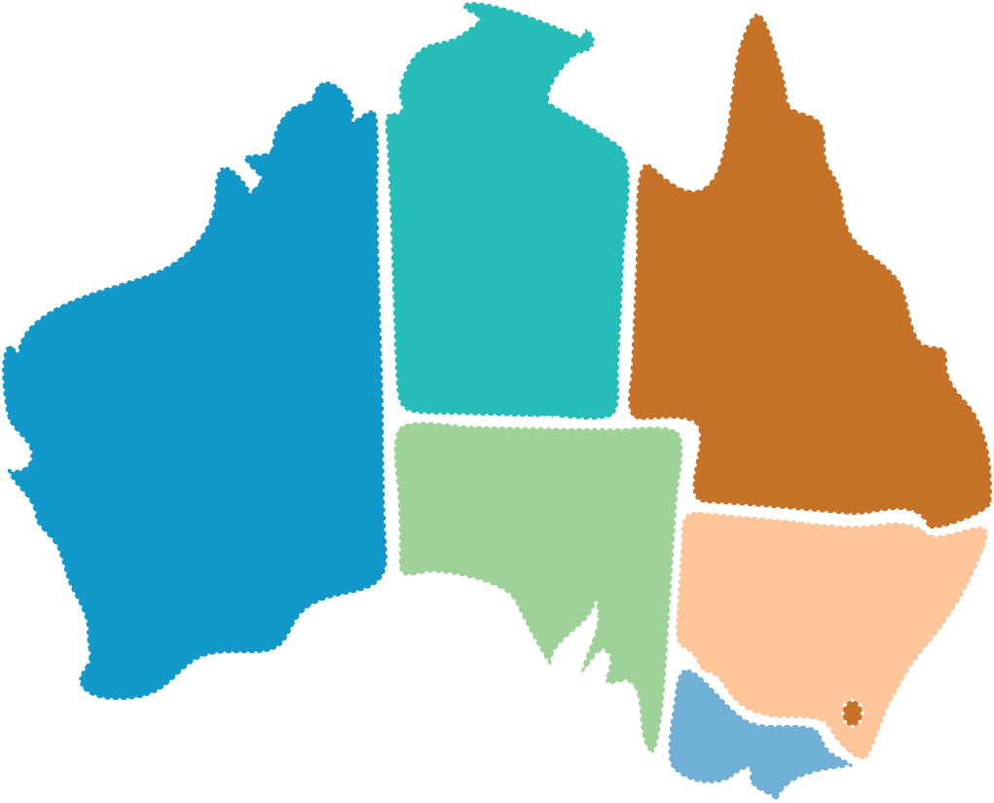


Impact of COVID-19
in Aboriginal and Torres Strait Islander people and communities
NT
0
As at December 2021, there had been ^{[10]}:
QLD
10
8,807 cases of COVID-19
WA
1
reported for Aboriginal and Torres Strait Islander people
SA
2
42%
NSW
13
ACT
living in a regional or remote area
VIC 5
0
20
2019-20 COVID-19 hospital separations for Aboriginal and Torres Strait Islander people^{[9]}.
deaths were reported from June to December 2021.
TAS
1

Slide 26
Impact of COVID-19
in Aboriginal and Torres Strait Islander people and communities
COVID-19 vaccine rollout rates for Indigenous people, by state and territory Local Government Areas (LGSs), 2021
Vaccination
Vaccination rates for a large number of Aboriginal and Torres Strait Islander people remain lower than the general Australian population ^{[11]}.
COVID-19 vaccine rollout rates varied across Australia ^{[12]}.
State | Indigenous individuals received dose 1 (%) | Indigenous individuals received dose 2 (%)
ACT | 91 | 87
NSW | 68 - 94 | 63 - 93
NT | 66* - 94 * | 48* - 85*
Qld | 58 - 93* | 39* - 90*
SA | 62 – 97* | 50* – 94*
Tas | 80 – 94* | 70 – 92*
Vic | 84 - 96 | 79 - 92
WA | 48 - > 99* | 31* - >99
Other Territories | 89* | 93*
Notes:
*Denotes LGAs with very large ‘very remote’ and ‘remote’ areas where geocoding addresses is difficult, often leading to artificially low counts.
Ranges indicate the highest to lowest LGA.
Source: Derived from Australian Government Department of Health, 2022 ^{[12]}.

Slide 27
Impact of COVID-19
in Aboriginal and Torres Strait Islander people and communities
Low vaccine rates in Aboriginal and Torres Strait Islander communities may be due to:
access to vaccination ^{[5, 13]}
perceived racism in mainstream services leading to high levels of mistrust ^{[5, 9]}
campaigns of misinformation and conspiracy theories ^{[14]}
Vaccine hesitancy has also become a more important health challenge with the appearance of the Delta strain and then the Omicron variant, together with nationwide plans to ‘open the borders’ in most Australian states and territories in early 2022. There will be a knock-on effect as the requirement for booster shots to further control COVID-19 outbreaks is rolled out.
To combat low vaccination rates programs have been implemented to enhance quality and impact of COVID-19 messaging. For example:
media personality Ernie Dingo is returning to his Country as part of the Vax the Outback program ^{[15]}
the Victorian Aboriginal Community Controlled Health Organisation (VACCHO) have sent Vaccine Vans out into their communities ^{[16]}
the Northern Land Council have released a series of short videos using local personalities called Get the Jab ^{[17]}.
NACCHO continues to provide strong leadership and support throughout Australia.

Slide 28
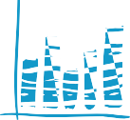

Cardiovascular health
among Aboriginal and Torres Strait Islander people
Cardiovascular disease (CVD) is the common term for all of the diseases and conditions that affect the heart and blood vessels ^{[1]}. These include ^{[1, 2]}:
ischaemic heart disease (IHD)
heart failure
peripheral vascular disease
cerebrovascular disease (including stroke) which affects blood vessels in the brain
rheumatic heart disease (RHD).
The term also includes high blood pressure which is associated with CVD ^{[2]}. CVD is a serious problem for the Aboriginal and Torres Strait Islander population ^{[3]}. Many people report having CVD, and it is a leading cause of both hospitalisation and death.
Prevalence
In the National Aboriginal and Torres Strait Islander Health Survey (NATSIHS) 2018-19 ^{[4]}:
14%
17%
the prevalence of CVD increased with age
15%
from 1.9 56
% %
of participants reported having CVD
among those
CVD was reported more frequently by females than by males
among those aged
aged 55 years and over
0-14 years to

Slide 29

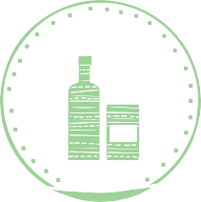

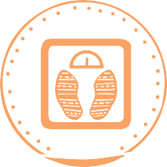
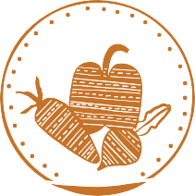



Cardiovascular health
among Aboriginal and Torres Strait Islander people
Risk factors
Risk factors for CVD include ^{[5-7]}:
smoking
drinking alcohol at risky levels
lack of physical activity
unhealthy weight
depression and social isolation
unhealthy diet
high blood pressure
high cholesterol
In 2018-19, about one quarter of Aboriginal and Torres Strait Islander adults had high blood pressure ^{[4]}.
Other health conditions like diabetes and chronic kidney disease can also increase the risk of developing CVD ^{[7]}.
Due to the high prevalence of CVD among Aboriginal and Torres Strait Islander people, it is now recommended for all adults to participate in regular screening for CVD risk factors from the age of 18 years ^{[7]}.

Slide 30

Cardiovascular health
among Aboriginal and Torres Strait Islander people
Hospitalisations
There were 16,360
hospitalisations for CVD in 2019-20 ^{[8]}:
Although rates of CVD are highest among older people, CVD is recognised as having a substantial impact on younger Aboriginal and Torres Strait Islander people ^{[10]}.
%
_{5.4} of all Aboriginal and Torres Strait Islander
hospitalisations (excluding dialysis)
In 2015-17 the rate of hospitalisations for CVD in Aboriginal and Torres Strait Islander people aged 35-44 years was
22
The crude rate of hospitalisations in 2018-1919 ^{[9]}: 19 per 1,000
per 1,000
Deaths
23
IHD was the leading cause of deaths in 2020 ^{[11]}:
About one quarter of all deaths were caused by CVD in 2014-2018 ^{[10]}:
The rates of death due to IHD increased with age, however, concerningly, it was the 2nd leading cause of death among the 35-44 year age group and the 4th leading cause of death among the 25-34 year age group in 2016-2020 ^{[11]}.
%
146
84
males
females
per 100,000

Slide 31
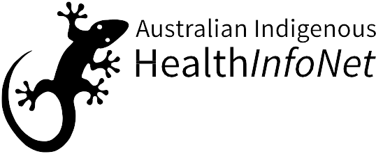




Cardiovascular health
among Aboriginal and Torres Strait Islander people
Acute rheumatic fever (ARF) and rheumatic heart disease (RHD)
ARF and RHD are preventable health problems that affect many Aboriginal and Torres Strait Islander people and communities ^{[12]}. RHD occurs when ARF, a sickness caused by the germ Streptococcus, leads to permanent damage to the heart valves. Risk factors for ARF include overcrowding and poor sanitation ^{[12, 13]}.
In Qld, WA, SA and the NT in 2015-2019, among Aboriginal and Torres Strait Islander people, there were ^{[14]}:
2,128
60of episodes were in the NT
nearly half these episodes were in the 5–14 age-group
%
episodes of ARF
1,325
the rate for females was nearly double the rate for males
x2
new diagnoses of RHD
A roadmap for ending RHD in Australia by 2031 was released in 2020 ^{[12]}.

Slide 32

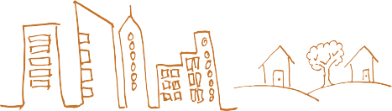



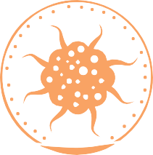
Cancer
among Aboriginal and Torres Strait Islander people
Cancer is the term used for a number of related diseases that cause damage to healthy body cells causing them to grow abnormally ^{[1]}. Cancer can start almost anywhere in the body ^{[1]} and there are more than 200 types of cancer ^{[2]}. The location in the body where the cancer cells begin forming is known as the primary site. For example, lung cancer begins in the lungs.
When cancer cells spread to other parts of the body it is known as ‘metastasis’. ‘Neoplasms’ is sometimes used to describe conditions associated with abnormal growth of new tissue (tumour) ^{[3]}. Neoplasms can be benign (not cancerous) or malignant (cancerous).
Incidence and prevalence
In the 2018-19 NATSIHS ^{[4]}, 1.1% of Aboriginal and Torres Strait Islander people reported having cancer (malignant neoplasm):
1.3%
1.2% 1.1%
males females
non-remote areas
0.7%
remote areas
In 2012-2016, 8,326 new cases were diagnosed, an average of 1,665 new cases per year ^{[5]}.

Slide 33






Cancer
among Aboriginal and Torres Strait Islander people
0
200
400
600
800
1,000
1,200
1,400
New cases of the most common cancers:
Lung Breast Bowel Prostate Head & Neck
Liver
Uterine Melanoma (skin)
1,220
1,030
742
703
523
295
269
264
Risk factors
AIHW ^{[5]}
Different types of cancer have different risk factors and sometimes cancers can develop for no known reason ^{[6]}. Risk factors for the common types of cancer include ^{[7]}:
smoking and passive smoking
alcohol consumption
overweight or obesity
infectious diseases
environmental family history factors and
radiation
poor diet
The patterns of incidence and mortality of some types of cancer among Aboriginal and Torres Strait Islander people can be partly explained by the higher level of risk factors, most notably smoking ^{[8]}. This is the main contributing factor to the high incidence of lung cancer.

Slide 34
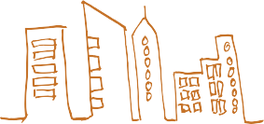

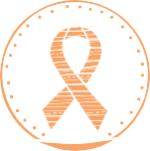





Cancer
among Aboriginal and Torres Strait Islander people
Survival
For the period 2007-2016, the likelihood of surviving five years after a cancer diagnosis was 47% ^{[5]}. Observed survival decreased with remoteness:
The highest observed survival rates were found in breast cancer (females) and melanoma (skin), while cancer of unknown primary site had the lowest ^{[5]}:
53%
38%
major cities
remote/very remote areas
76%
breast cancer (females)
76%
melanoma (skin)
5.8%
unknown primary site
Hospitalisations
In 2019-20, there were 10,073 hospitalisations for neoplasms, representing 3.3% of all hospitalisations ^{[9]}.
In 2015-17, there were 10,323 hospitalisations for cancer as the
principal diagnosis, at a rate of 12 per 1,000 ^{[10]}:
14 10
46%
36%
regional locations
major cities
males
females
17%
per 1,000
remote/very remote areas

Slide 35


Cancer
among Aboriginal and Torres Strait Islander people
Deaths
There were 3,576 deaths due to cancer in 2015-2019, at a rate of 230 per 100,000 ^{[5]}:
1,939 males
276 per 100,000
Cancers of the trachea, bronchus and lung combined were the
4th highest overall cause of death in 2020 ^{[11]}.
0 200 400 600 800
1000
Lung Bowel
Liver Pancreas
942
276
1,637 females
267
Number of deaths for selected cancers 2015-2019 ^{[5]}:
AIHW ^{[5]}
240
232
219
Unknown primary site
Head & neck
194 per 100,000
Factors contributing to cancer incidence and deaths ^{[12-14]}: having the types of cancers that are more likely to
be fatal
being diagnosed with cancer at a later stage
no treatment, or inadequate treatment
not participating in national cancer screening programs.
being more likely to present with co-morbidities (other chronic conditions)

Slide 36





Diabetes
among Aboriginal and Torres Strait Islander people
Diabetes (diabetes mellitus) is a chronic condition where the body cannot properly process glucose (sugar) from food ^{[1]}. Diabetes is treatable but can lead to life-threatening health complications if left untreated or not managed well ^{[2]}.
There are different types of diabetes with the three most common being:
type 1 diabetes
type 2 diabetes
gestational diabetes mellitus (GDM)
(a type of diabetes that occurs in pregnancy).
Diabetes is a serious problem for the Aboriginal and Torres Strait Islander population ^{[2]}. The most common form is type 2 diabetes, which occurs at earlier ages for Aboriginal and Torres
Strait Islander people than for non-Indigenous people and is often undetected and untreated.
Incidence and prevalence
In the 2018-19 NATSIHS 7.9% of people self-reported diabetes ^{[3]}:
7.6% 8.2%
males females
12% 7.0%
remote areas
non-remote areas

Slide 37





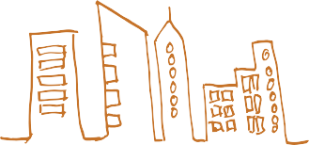



Diabetes
among Aboriginal and Torres Strait Islander people
WA and the NT had the highest levels of diabetes
(both 11%)
Diabetes increased with age:
35% of people 55 years + had diabetes.
High sugar levels (HSL) are a pre-cursor to diabetes. In the 2018-19 NATSIHS, 13% of adults reported
having HSL and/or diabetes ^{[4]}:
13% 14%
males females
19%
12%
remote areas
non-remote areas
In 2019, the incidence rate for type 1 diabetes
was 13 per 100,000 ^{[5]}:
16
⁹females^{.8}
males
per 100,000
In 2017-18, there were 1,715 new cases of GDM among Aboriginal and Torres Strait Islander
females aged 15-49 years ^{[6]}.

Slide 38


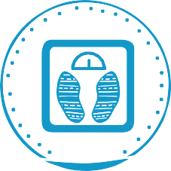
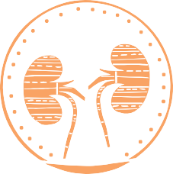
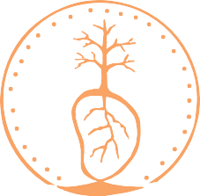
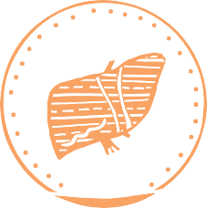
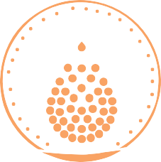


Diabetes
among Aboriginal and Torres Strait Islander people
Risk factors
Risk factors for diabetes
include ^{[1, 7]}:
Smoking
Family history
Obesity
Other chronic conditions such as kidney disease, cardiovascular disease, liver disease and anaemia.
Hospitalisations
Hospital services are usually required to treat the advanced stages of complications of diabetes or acute episodes ^{[2]}.
In 2018-19, there were 4,786 hospitalisations for diabetes as a main diagnosis ^{[8]}:
7.2
per 1,000
3.7
85
In 2017-18, there were 1,016 hospitalisations for type 1 diabetes as a main diagnosis ^{[9]}:
There were 2,504 hospitalisations for
type 2 diabetes as a main diagnosis:
3.8
3.7
The crude rate as a main or additional diagnosis was
per 1,000
males
females
The crude rate as a main or additional diagnosis was ^{[6]}
per 1,000
71
99
males
females

Slide 39















Diabetes
among Aboriginal and Torres Strait Islander people
Hospitalisations for those living in remote and very remote areas were 2.3x higher
(8.4 per 1,000) than for those living in major cities (3.6 per 1,000) ^{[9]}.
In 2017-18, there were 589 hospitalisations for diabetes as the main diagnosis during pregnancy (GDM) ^{[9]}.
The rate of GDM was more than 5x higher for those living in remote and very remote areas (119 per 1,000) than for those living in major cities (22 per 1,000).
Deaths
266 deaths, 7.4%of all deaths
Diabetes was the second leading cause of death
for Aboriginal and Torres Strait Islander people in 2020 ^{[10]}:
122 144
males females
4th leading cause of death 2nd leading cause of death
The NT had the highest rate of deaths due to diabetes (160 per 100,000).

Slide 40

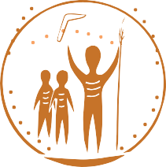
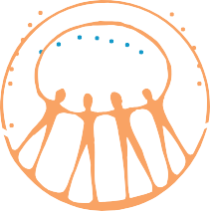
Social and emotional wellbeing
(including mental health) among Aboriginal and Torres Strait Islander people
For many Aboriginal and Torres Strait Islander people, social and emotional wellbeing (SEWB) includes mental health and also:
connection to Country
culture
spirituality
Factors that have been found to support wellbeing include ^{[2,3]}:
the body and emotions
ancestry, family and
community ^{[1, 2]}.
cultural continuity
self- determination
supporting Indigenous knowledge systems
maintaining family networks
strong community governance
COVID-19 has been found to have an impact on SEWB and mental health:
higher levels of stress
uncertainty
loss of control
isolation ^{[4, 5]}.

Slide 41







Social and emotional wellbeing
(including mental health) among Aboriginal and Torres Strait Islander people
Prevalence
In the 2018-19 NATSIHS, 31% of Aboriginal and Torres Strait Islander respondents aged 18 years and over reported high or very high levels of psychological distress ^{[6]}:
31% 23%
of Aboriginal people of Torres Strait Islander people
More females reported high or very high levels of psychological distress compared with males:
35% 26% 28%
females males remote areas
31%
non-remote areas

Slide 42



Social and emotional wellbeing
(including mental health) among Aboriginal and Torres Strait Islander people
In the 2018-19 NATSIS there were some encouraging and positive indicators ^{[6]}. For Aboriginal and Torres Strait Islander males over 18 years of age:
80% reported feeling calm
87% felt happy all/most of the time
and peaceful all/most of the time
For females over 18 years of age:
78% reporting feeling calm
%
and peaceful all/most of the time
88 felt happy all/most of the time
The proportion of people reporting positive indicators increased with remoteness:
Feeling calm and peaceful all/most of the time: 78% in non-remote areas (major cities and regional areas) 83% in remote areas (remote and very remote)
Happiness:
87% in non-remote areas
90% in remote areas

Slide 43
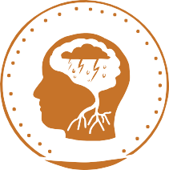



Social and emotional wellbeing
(including mental health) among Aboriginal and Torres Strait Islander people
Mental health conditions
In the 2018-19 NATSIHS ^{[6]}:
25% of Aboriginal people and 17% of Torres Strait Islander people aged two years and over were reported as having a mental and/or behavioural condition.
17
%
13
%
Anxiety was the
Depression was the
most common mental and behavioural condition reported.
second most common mental and behavioural condition reported.
Mental and behavioural conditions were more likely to be reported by people living in non-remote areas compared with remote areas.
Hospitalisations
9.8 remote areas 28
%
%
non-remote areas
There were 26,228 hospitalisations of Aboriginal and Torres Strait Islander people for mental and behavioural disorders.
8.6%
In 2019-20 ^{[7]}:
of all hospitalisations
0.5%
Intentional self-harm₁ was responsible for 3,094 hospitalisations.
of all hospitalisations
Intentional self-harm as a principal diagnosis for external causes of injury or poisoning for Aboriginal and Torres Strait Islander people.

Slide 44




Social and emotional wellbeing
(including mental health) among Aboriginal and Torres Strait Islander people
Deaths
In 2020, 197 people died from intentional self-harm (suicide) ^{[8]}.
Suicide was the 5th leading cause of death overall in 2020 for Aboriginal and Torres Strait islander people.
x3 more likely to be a cause of death for males as for females.
Suicide was:
For 2016-2020, the age groups with the highest rate of death by suicide were:
74per 100,000
26 per 100,000
males 35-44 years
WA consistently records the
highest death rates for suicide.
females 15-24 years

Slide 45







Kidney health
among Aboriginal and Torres Strait Islander people
Keeping the kidneys healthy is important because they help the body by removing waste and extra water, and keeping the blood clean and chemically balanced ^{[1]}. If the kidneys stop working properly, waste can build up in the blood and damage the body ^{[2]}. Many people are unaware that they have kidney disease as up to 90% of kidney function can be lost before symptoms appear.
Incidence and prevalence
For the 2012-13 AATSIHS, 18% of Aboriginal and Torres Strait Islander adults had biomedical signs of CKD^{[3]}.
For the 2018-19 NATSIHS, 1.8% of Aboriginal and Torres Strait Islander people reported kidney disease as a long-term health condition ^{[4]}.
1.9% 0.4%
1.2% 2.3%
males females
Aboriginal people
Torres Strait Islander people
Prevalence increased with age
7.6%
3.4%
remote areas
1.4%
non-remote areas
for people aged 55 years +

Slide 46





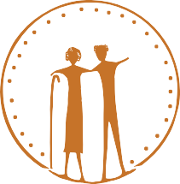
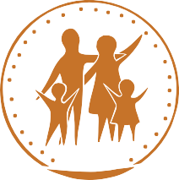
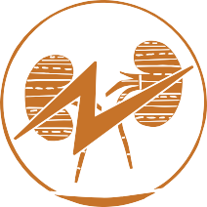
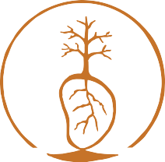
Kidney health
among Aboriginal and Torres Strait Islander people
For 2016-2020, the incidence rate of ESKD for Aboriginal and Torres Strait Islander people was:
616
per 1,000,000 population
(Derived from [5-8])
NT highest
NSW lowest
1,723
per 1,000,000
201
For ESKD, 55% of people were aged less than 55 years.
Risk factors
Risk factors for kidney disease which can be changed or controlled include ^{[2, 9]}:
overweight or obesity
high blood pressure
high blood glucose (sugar)
smoking
Risk factors for Aboriginal and Torres Strait Islander people that cannot be changed or controlled include ^{[10]}:
age (30yrs+)
family history of CKD
history of acute kidney injury
vascular disease

Slide 47





Kidney health
among Aboriginal and Torres Strait Islander people
Hospitalisations
In 2017-18, the crude rate of CKD hospitalisation was _{33 per 1,000 [2]:}
27
39
per 1,000
males
females
In 2018-19, there were 242,274 hospitalisations for ESKD at a crude hospitalisation rate of 289 per 1,000 ^{[11]}.
In 2016-18, the crude rate of ESKD hospitalisation was 278 per 1,000:
241
316
per 1,000
males
females
In 2016-18, the rate for people living in remote and very remote locations (681 per 1,000) was 5x higher than for those living in major cities (137 per 1,000) ^{[11]}.

Slide 48

























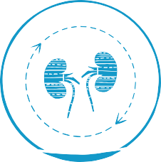
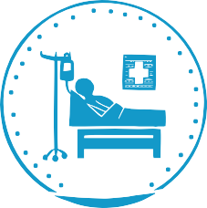
Kidney health
among Aboriginal and Torres Strait Islander people
Managing kidney disease may require dialysis, which involves artificially filtering the blood. This often requires the patient being admitted ^{[2]} to hospital, although in some circumstances the treatment can be performed at home. If kidney disease is left untreated a kidney transplant may be required ^{[2]}. Kidney disease impacts a patient’s quality of life as well as those who care for them ^{[12-14]}. Treatments can be expensive and require frequent travel to medical facilities ^{[15]}.
Dialysis:
Dialysis is the most common reason Aboriginal and Torres Strait Islander people are hospitalised ^{[16]}.
In 2017-18, the rate of hospitalisation for regular dialysis was 284 _{per 1,000} [2].
In 2020, 314 people commenced dialysis, down from 383 in 2019 ^{[17]}.
In 2020, 2,098 people were receiving dialysis: haemodialysis 93% and peritoneal dialysis 7% ^{[17]}.
Kidney transplants:
In 2019, there were 55 transplant operations^{[18]}.

Slide 49


Kidney health
among Aboriginal and Torres Strait Islander people
Deaths
In 2020, there were 110 deaths due to diseases of the urinary system (including disorders of the bladder and urethra, as well as disease of the kidneys and ureters). It was the 7th underlying cause of death for females and the 10th underlying cause of death for males ^{[19]}.
In 2015-2019, the death rate for kidney disease (major cause) was 19 per 100,000 ^{[20]}.
For 2016-2018, the crude death rate for CKD as an underlying or associated cause of death was:
72 deaths
64
80
per 100,000
per 100,000 ^{[2]}
males
females
In 2020, 236 Aboriginal and Torres Strait Islander people who were receiving dialysis died ^{[17]}.
The most common causes of death for the dialysis patients were CVD (78 deaths) and withdrawal from treatment (49 deaths).

Slide 50




Respiratory health
among Aboriginal and Torres Strait Islander people
Respiratory health can include a number of conditions that affect the airways and other parts of the lung ^{[1]}, and affect breathing ^{[2]}. They range from those that come on quickly or do not last long (acute respiratory conditions), to those that last a long time (chronic respiratory conditions) ^{[3]}.
Prevalence
In the 2018-19 NATSIHS, 29% of Aboriginal and Torres Strait Islander people reported
having a long-term respiratory condition ^{[4]}. Other specific long-term respiratory diseases reported included:
asthma 16% and chronic obstructive pulmonary disease (COPD) 3.4%
The level of respiratory disease among Aboriginal and Torres Strait Islander females was approximately 1.2x higher than for males.
26% 32%
males females

Slide 51


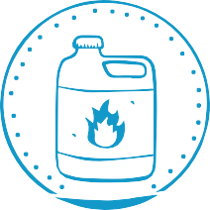

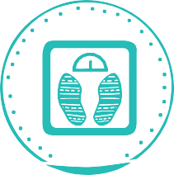
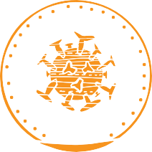



Respiratory health
among Aboriginal and Torres Strait Islander people
Risk factors
The main risk factors for respiratory disease include ^{[3,5]}:
tobacco smoking
environmental conditions
occupational exposures and hazards
family history
obesity
infectious diseases
Risk factors for infants and children include ^{[6,7]}:
exposure to second-hand tobacco smoke
poor living conditions
poor nutrition
limited access to medical care

Slide 52
Respiratory health
among Aboriginal and Torres Strait Islander people
Hospitalisations
In 2018-19, crude hospitalisation rates were highest for Aboriginal and Torres Strait Islander people with ^{[8]}:
influenza and pneumonia (9.2 per 1,000)
COPD (6.7 per 1,000)
acute upper respiratory infections (4.6 per 1,000)
asthma (2.7 per 1,000)
Deaths
In 2020, chronic lower respiratory disease (which includes asthma, bronchitis, emphysema, and COPD) was the 3rd leading cause of death for Aboriginal and Torres Strait Islander people, responsible for 245 deaths ^{[9]}.
There were no deaths of Aboriginal and Torres Strait Islander people from COVID-19 in 2020 ^{[9]}.

Slide 53

Sexually transmissible infections
among Aboriginal and Torres Strait Islander people
Sexually transmissible infections (STIs) are spread through sexual contact and include:
bacterial infections such as chlamydia, gonorrhoea and syphilis
viral infections such as human papillomavirus (HPV) and genital herpes
parasitic infections such as trichomoniasis.
Most STIs are treatable although early detection is important ^{[1]}. Safe sex practices, such as using condoms, are recommended to prevent exposure and the spread of STIs.
Incidence and prevalence of some notifiable₁ STIs
In 2019, there were ^{[2]}:
7,647 notifications of chlamydia 1,216
4,042 notifications of gonorrhoea 586
1,021 notifications of syphilis 119
rate per 100,000
© 2022 Australian Indigenous HealthInfoNet
For more information about STIs and other aspects of sexual health visit the Australian Indigenous HealthInfoNet’s new online sexual health portal [healthinfonet.ecu.edu.]
healthinfonet.ecu.edu.au
53

Slide 54


Sexually transmissible infections
among Aboriginal and Torres Strait Islander people
In 2019 ^{[2]}:
Females were 1.9x more likely to be diagnosed with chlamydia than males.
Females were 1.2x more likely to be diagnosed with gonorrhoea than males.
Males and females were diagnosed with syphilis at similar rates.
In 2019 ^{[2]}:
Chlamydia notification rates were highest in the NT, followed by WA and Qld. Gonorrhoea notification rates were highest in the NT, followed by SA and WA. Syphilis notification rates were highest in the NT, followed by WA and Qld.

Slide 55
Environmental health
among Aboriginal and Torres Strait Islander people
Environmental health refers to the physical, chemical and biological factors which impact a person’s health and wellbeing such as: housing conditions; drinking water; air quality; sanitation; disease control and food safety ^{[1, 2]}. Health conditions associated with poor environmental health include:
infectious diseases of the bowels (such as ‘gastro’)
skin infections (such as scabies, boils)
middle ear infections
chronic diseases (such as ARF)
respiratory issues (such as asthma)
some cancers (such as lung cancer) ^{[3, 4]}.
Aboriginal and Torres Strait Islander people are disproportionately affected by the diseases associated with environmental health due to:
the remoteness of some communities
lack of adequate housing
lack of cleaning, health and personal care equipment
poor infrastructure
lack of access to tradespeople and repairs
the cost of maintenance ^{[2-5]}.

Slide 56

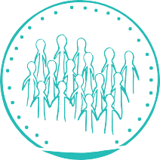

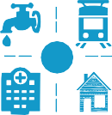


Environmental health
among Aboriginal and Torres Strait Islander people
Overcrowding
In 2016, 18% of Aboriginal and Torres Strait Islander people reported living in an overcrowded house ^{[6]}.
Infrastructure
In 2018-19 ^{[1]}:
80% of Aboriginal and Torres Strait Islander households reported living in housing of an acceptable₁ standard
33% of households reported major structural issues households with major structural issues increased with
remoteness
In 2018-19, overcrowding was:
reported highest in the NT (51%)
and lowest in the ACT (8%) ^{[1]}.
majority reported having access to household
washing people 97%
washing bedding and clothes 96%
preparing/storing food 91%
sewerage facilities 98%
Access to functioning facilities was lowest in the NT.
facilities for:

Slide 57


Environmental health
among Aboriginal and Torres Strait Islander people
Hospitalisations for diseases related to environmental health
influenza and pneumonia 9.2
4.6
acute upper respiratory infections
infectious diseases of bowels 9.0
crude rate per 1,000
hospitalisations
2.7
asthma
bacterial diseases _{8.0}
1.8
scabies
2018-19 ^{[1]}
Deaths related to poor environmental health
44
40
per 100,000
males
females
2014-2018 ^{[1]}
1. Housing of an ‘acceptable’ standard must have at least four working household facilities and not more than two major structural problems ^{[1]}.

Slide 58
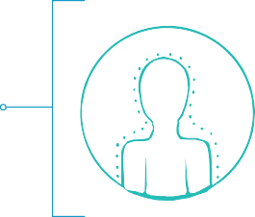





Tobacco use
among Aboriginal and Torres Strait Islander people
Tobacco smoking increases the risk of chronic disease, such as CVD, many forms of cancer and lung diseases, as well as being a risk factor associated with preterm birth and LBW ^{[1]}. Environmental tobacco smoke (passive smoking) can also make people sick, especially children. Passive smoking is a risk factor for children who are particularly susceptible to middle ear infections, asthma and increased risk of sudden infant death syndrome (SIDS).
Smoking among Aboriginal and Torres Strait Islander people
In the 2018-19 NATSIHS ^{[2]}:
the age-group with the highest proportion of current daily smokers was 35-44 years
37
% of people aged 15 years+
39 36
% %
47
%
reported they were current daily smokers
males females
people living in remote areas reported a higher proportion
of current daily smokers than those living in non-remote areas
49 remote
35 non-remote
%
%
areas
areas
Passive smoking reported in the 2014-15 NATSISS ^{[3]}
of Aboriginal and Torres Strait Islander
57
%
For those children living with a daily smoker,
children aged 0-14 years lived in households with a daily smoker.
13
%
were living in households where people smoked indoors.

Slide 59




Tobacco use
among Aboriginal and Torres Strait Islander people
Deaths
In 2018, around 800 deaths (23% of all deaths among Aboriginal and Torres Strait Islander people) were due to tobacco use ^{[4]}.
The proportion of young people starting to smoke has decreased, which will result in improved health outcomes over time.
Daily smoking rates reduced between the 2012-13 AATSIHS and the 2018-19 NATSIHS ^{[2]}:
15-17 year olds
decreasing from 18% to
9.7%
18-24 year olds
decreasing from 42% to
36%
25-34 year olds
decreasing from 52% to
44%
A 2021 study found that there was a 15%
lower prevalence of smoking inside the home in areas funded under the Tackling Indigenous Smoking (TIS) program
compared to non-TIS areas ^{[5]}.
The proportion of Aboriginal and Torres Strait
Islander mothers who reported smoking
during pregnancy has decreased from
50% in 2009 to 43% in 2019 ^{[6]}.

Slide 60
Alcohol use
among Aboriginal and Torres Strait Islander people
Drinking too much alcohol, both on single drinking occasions (binge drinking) and over a person’s lifetime can lead to health and social harms including:
chronic diseases
injury and transport accidents
mental health disorders
intergenerational trauma
violence
Alcohol use not only affects individuals, but also families and the wider community ^{[1, 2]}.
The 2020 National Health and Medical Research (NHMRC) Australian guidelines to reduce health risks from drinking alcohol provide recommendations on reducing the risk of alcohol-related harm for adults, young people, and women who are pregnant or breastfeeding ^{[3]}:
Guideline 1 recommends that to reduce the risk of alcohol-related disease or injury, men and women should drink no more than four standard drinks on any day or no more than 10 standard drinks in a week.
Guideline 2 recommends that to reduce the risk of alcohol-related harm and injury, children and people aged under 18 years should not drink alcohol.
Guideline 3 recommends that to prevent alcohol-related harm to an unborn child, women who are planning a pregnancy, or who are pregnant, should not drink alcohol. For women who are breastfeeding, not drinking alcohol is the safest option for their baby.
The 2018-19 NATSIHS assessed a person’s alcohol consumption for short-term and lifetime risk using the previous (2009) NHMRC alcohol guidelines.

Slide 61



Alcohol use
among Aboriginal and Torres Strait Islander people
Abstinence and alcohol consumption
The following information was self-reported by participants in the 2018-19 NATSIHS ^{[4]}:
Abstinence (or those who had never drunk alcohol) in the last 12 months:
26%
23
% of Torres Strait Islander people
aged 18 years or older
of Aboriginal people
The proportion of people who abstained was highest for those aged 55 years and older.
The proportion of people who abstained was higher
for people living in very remote areas:
43%
very remote areas
19%
major cities

Slide 62


Alcohol use
among Aboriginal and Torres Strait Islander people
Short-term risk (no more than four drinks on a single occasion):
18% of Aboriginal people and 22% of Torres Strait Islander people did not exceed the guidelines
54% of Aboriginal people reported exceeding the short-term risk guideline.
Males were 1.5x more likely to exceed the guideline compared with females:
65% 43%
males females
Young people were more likely to exceed the guideline compared with people aged 55 years and older:
65%
34%
aged 18-24 years
aged 55 years +

Slide 63




Alcohol use
among Aboriginal and Torres Strait Islander people
Lifetime risk (no more than two standard drinks on a single day):
26% of Aboriginal people and 21% of Torres Strait Islander people did not exceed the guidelines
20% of Aboriginal people and 24% of Torres Strait Islander people reported exceeding the guideline for lifetime risk.
Males were 3x more likely to exceed the guideline for lifetime risk compared with females:
30% 10%
males females
The proportion of people exceeding the guideline for lifetime risk was higher for people living in non-remote areas compared with remote and very remote areas:
non-remote areas
remote and
very remote areas
21% 17%

Slide 64





















Alcohol use
among Aboriginal and Torres Strait Islander people
Hospitalisations
In 2016-18 ^{[5]}, the crude alcohol-related
hospitalisation rate was 7.6 per 1,000
Deaths
For 2014-2018 ^{[5]}, the rate of death due to alcohol use was 20 per 100,000, 2.9x higher for males than for females.
8.4
6.8
per 1,000
males
females
31
11
per 100,000
males
females
The main cause of alcohol-related deaths was alcoholic liver disease.
Between 2010 and 2019 there was a reduction in the proportion of Aboriginal and Torres Strait Islander people aged 14 years and older exceeding the 2009 alcohol guidelines for lifetime risk ^{[2]}.
In 2018-19, 90% of mothers of Aboriginal
32% 19%
and Torres Strait Islander children (aged 0-3 years) had not drunk alcohol during their pregnancy ^{[6]}.
in 2010 in 2019

Slide 65



Illicit drug and volatile substance use
among Aboriginal and Torres Strait Islander people
Illicit drug use is the use of illegal drugs such as cannabis, heroin, cocaine and methamphetamine, as well as the use of prescribed drugs, such as painkillers, in ways in which they were not intended or prescribed ^{[1, 2]}. Illicit drug use is associated with an increased risk of mental illness, poisoning, self-harm, infection with blood borne viruses from unsafe injection practices, chronic disease and death ^{[3-5]}.
Most Aboriginal and Torres Strait Islander people surveyed do not use illicit drugs ^{[6-8]}.
Prevalence
In the 2019 National Drug Strategy Household Survey (NDSHS)^{[8]}:
77% 23%
of people aged 14 years + had
of people aged 14 years + reported they
had used illicit drugs
never used illicit drugs or had not done so in the previous 12 months
in the previous 12 months

Slide 66







Illicit drug and volatile substance use
among Aboriginal and Torres Strait Islander people
In the 2018-19 NATSIHS ^{[7]}, people aged 15 years + reported specific drug use in the previous 12 months:
₂₄% had used cannabis (marijuana)
had used other drugs₁ such
3.3
% had used amphetamines, ice
or speed
%
% reported taking ecstasy or
_{5.9} as heroin, cocaine, petrol
and kava
3.3 designer drugs
reported illicit use of
_{3.8} analgesics and sedatives
(sleeping pills)
%
Illicit drug use was 1.8x higher among males than females ^{[7]}:
37 21
In 2019-20, the most common principal illicit drugs of concern that Aboriginal and Torres Strait Islander people sought treatment for were amphetamines, cannabis and heroin ^{[9]}.
% %
males females

Slide 67





Illicit drug and volatile substance use
among Aboriginal and Torres Strait Islander people
Hospitalisations
The top two reasons for drug-related hospitalisations among Aboriginal and Torres Strait Islander people in 2018-19 were mental and behavioural disorders (crude rate of 4.7 per 1,000) and poisoning (crude rate of 3.0 per 1,000) ^{[10]}. The most common drugs to cause mental and behavioural disorders requiring hospitalisation in 2016-18 were ^{[10]}:
2.1 1.0
amphetamines ₂ cannabis
per 1,000
Hospitalisation rates due to drug use were higher in major cities than in inner and outer regional areas, and remote and
very remote areas ^{[10]}.
9.2 6.6 4.3
per 1,000
Deaths
major cities
regional areas
remote and very remote areas
In 2019 ^{[11]}:
The rate of unintentional deaths caused by drugs was ₂₀
per 100,000

Slide 68
Illicit drug and volatile substance use
among Aboriginal and Torres Strait Islander people
Volatile substance use
Volatile substance use (VSU) involves sniffing inhalants - substances that give off fumes such as petrol, paint, glue or deodorants ^{[12]}. Sniffing can have serious short and long-term health effects, including a condition known as sudden sniffing death which causes the heart to stop within minutes ^{[13]}.
In the 2014-15 NATSISS, 0.7% of Aboriginal and Torres Strait Islander people aged 15 years and over
reported using petrol and other inhalants in the 12 months prior to the survey ^{[14]}. Crude rates of hospitalisation caused by VSU for 2016-18 ^{[10]}:
Toxic effect of organic solvents (e.g. petrol) 0.05 Accidental poisoning from organic solvents 0.03 Mental/behavioural disorders from use of volatile substances 0.06
per 1,000
Overall, the number of people using volatile substances is small but the issue of VSU is still a concern in some communities ^{[15]}. Positively, one study reported a 95% reduction of VSU between 2006 and 2018, attributed to the replacement of regular unleaded petrol with low aromatic fuel.

Slide 69

References
Please refer to the
Summary of Aboriginal and Torres Strait Islander health status – selected topics 2021
for a full list of the references to accompany these PowerPoints.

