Slide 1
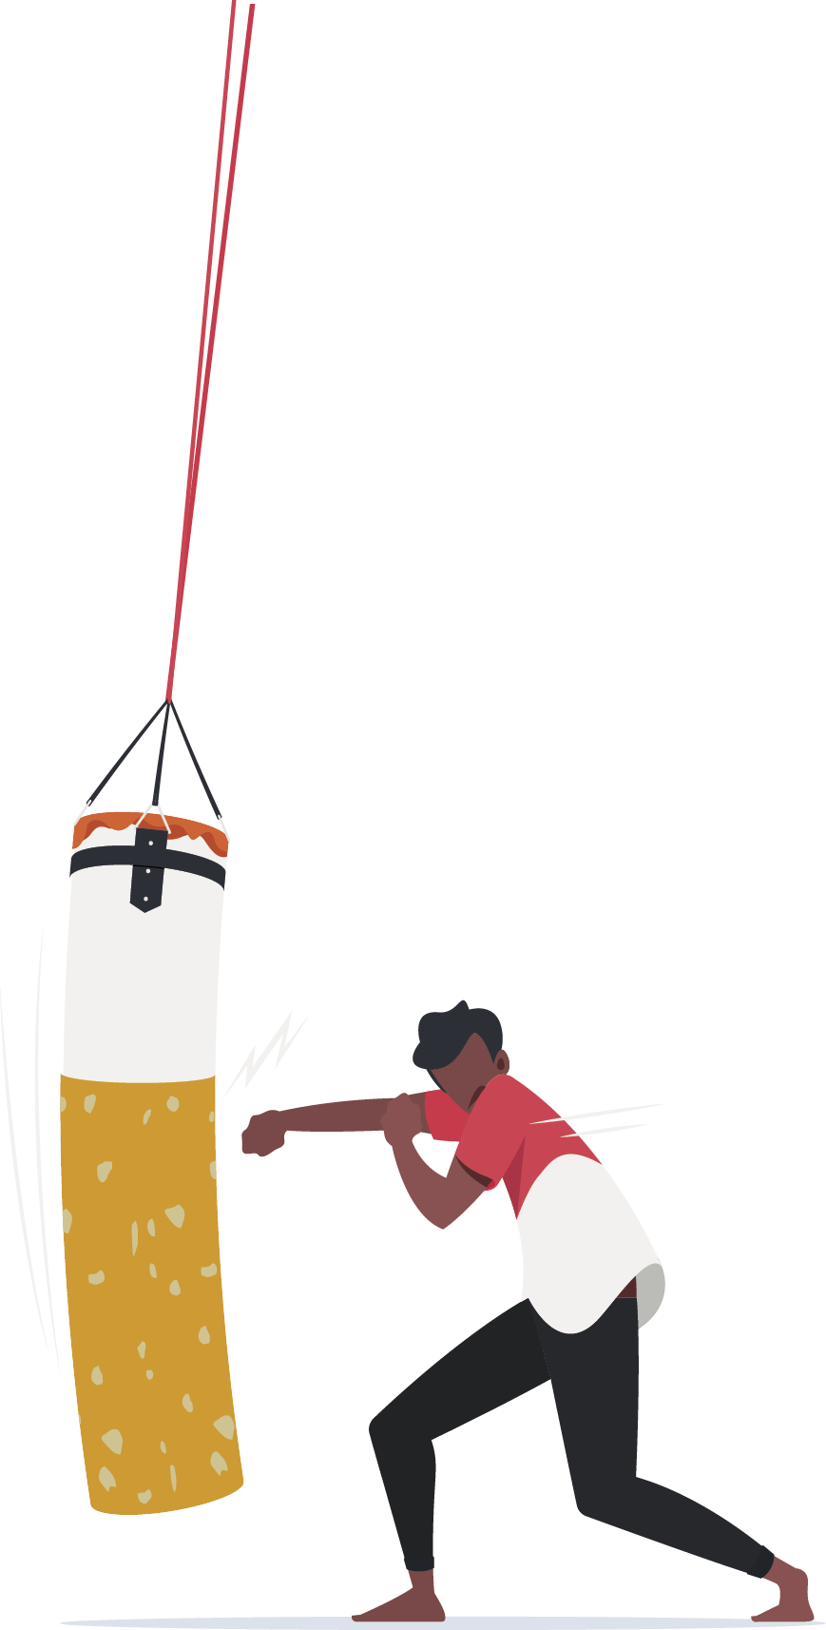
KEEP OUR PLACE A SMOKE AND VAPE FREE SPACE
Why every workplace needs a smoke and vape free policy

Slide 2
Acknowledgement
We acknowledge and respect the traditional custodians whose ancestral lands we are meeting upon here today. We pay our respects to Elders past, present and emerging. We acknowledge the deep feelings of attachment and relationship of Aboriginal and Torres Strait Islander peoples to Country. We also pay respects to the cultural authority of Aboriginal and Torres Strait Islander people visiting/attending from other areas of Australia present here.

Slide 3
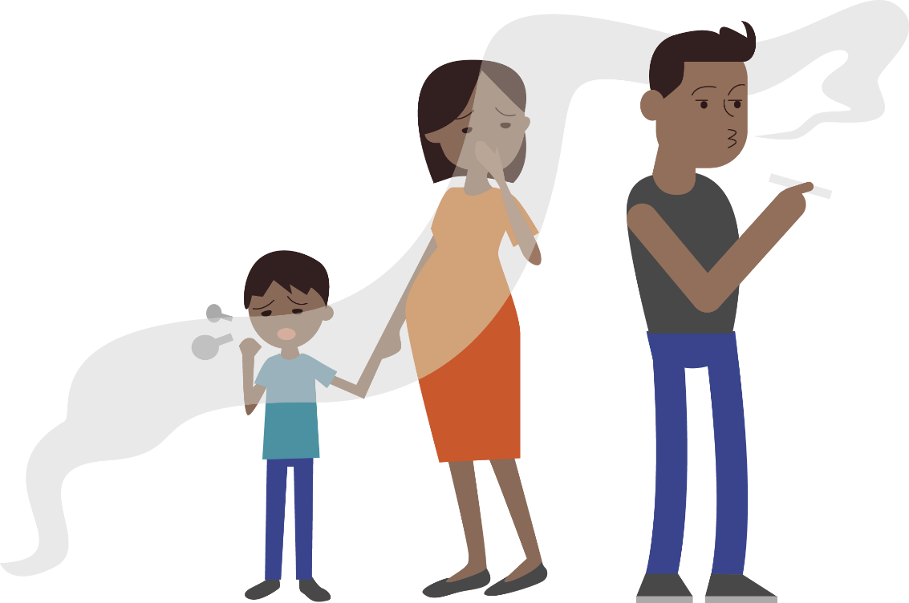

Why should our workplace have a smoke and vape free policy ?
A smoke and vape free workplace ensures you are following the legislation.
More importantly, it sends a strong message to the community we are committed to providing a healthy, supportive working environment for all staff, contractors and visitors.

Slide 4

Benefits of a smoke and vape free Workplace
Creates an environment that:
de-normalises smoking/vaping
is more supportive for people trying to quit
encourages those who do smoke or vape to make a quit attempt
improves health and safety for everyone, including people who don’t smoke/vape.
A smoke and vape free workplace is a space where
more people achieve long-term cessation.

Slide 5
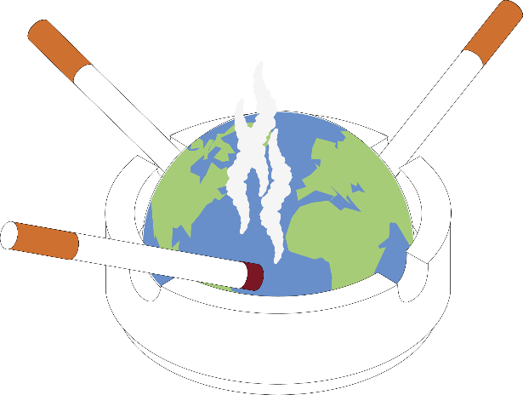
The Effects of Smoking
Smoking, and exposure to second-hand smoke, increases the risk of cancer, heart disease and stroke and can make some chronic illnesses worse (e.g., asthma and diabetes);
People who smoke are more likely to have illness-related time off work than those who don’t;
Workplaces may also experience reduced productivity due to long or frequent smoke breaks;
Smoking also affects the environment: cigarette butts are the most abundant form of plastic waste in the world.

Slide 6
The Effects of Vaping
  Vaping and exposure to second hand vape aerosol can cause shortness of breath, coughing, sore throat and eye irritation in the short term. Exposure to harmful chemicals could have long term effects on health.
  Workplaces may also experience reduced productivity due to long or frequent vape breaks;
  Vaping also affects the environment: e-cigarettes create waste in the form of single-use plastics, tech waste such as lithium batteries and toxic chemicals when discarded.

Slide 7
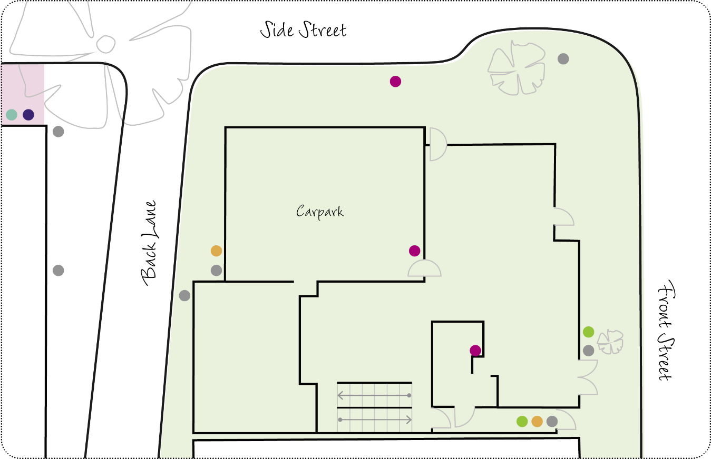
What we can do
Work together to develop/update our smoke and vape free workplace policy
Support policy implementation by:
  undertaking an environmental scan
  consulting with staff
  delivering educational workshops
  providing culturally sensitive and tailored resources.

Slide 8
Activity: our workplace and smoking/vaping
Do we have a smoke and vape free workplace policy?
If yes, how effective is it?
Are there any barriers to creating a smoke and vape free workplace for our organisation?
What would help us to successfully implement a smoke and vape free policy in our organisation?

Slide 9
Next Steps
Engagement
Work together to develop a plan and timeline
Environmental Scan
Check the local and organisational tobacco control context
Consultation and education
Run a change workshop with staff
Implementation
Put the new policy into action
Review
Review and update the policy annually

Slide 10

To finish, here’s a funny video created by Tackling Indigenous Smoking team Bega Garnbirringu with Ngarrindjeri comedian Kevin Kropinyeri to showcase the positives of a smoke and vape free life.

Slide 11
Thank you for participating today.
Any questions or comments?
?

