Slide 1
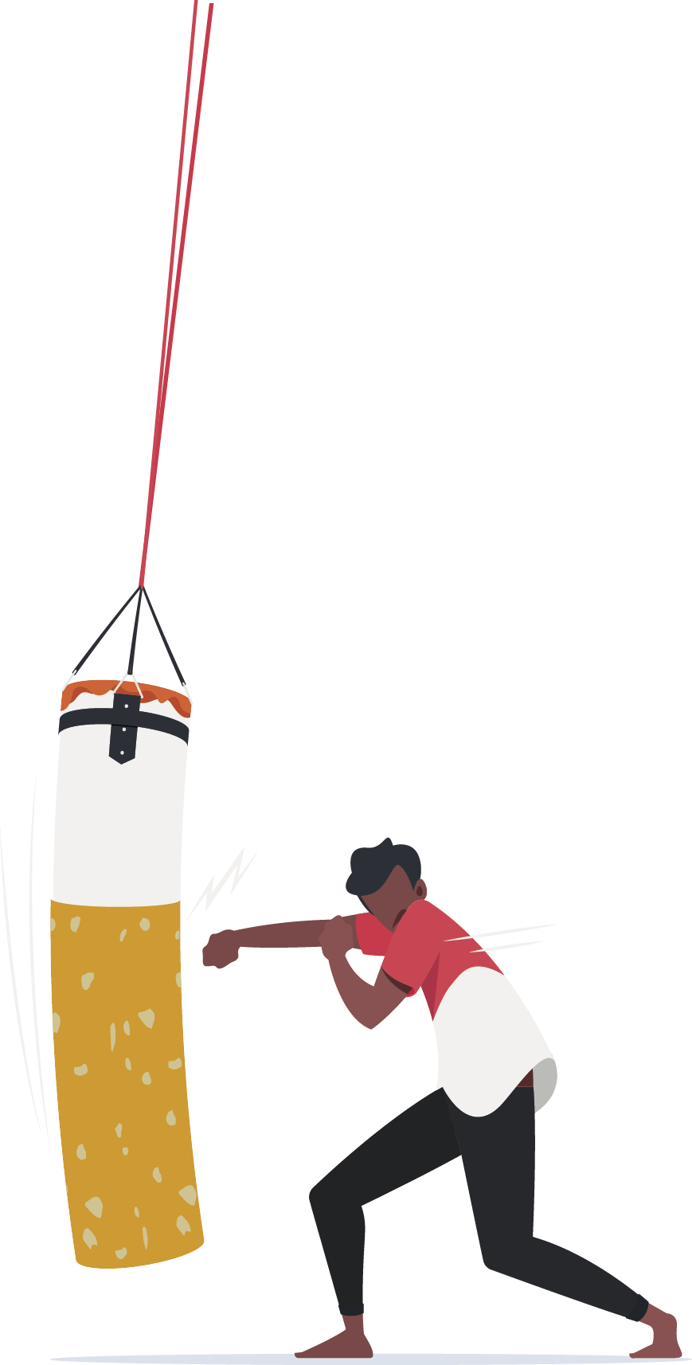
KEEP OUR PLACE A SMOKE AND VAPE FREE SPACE
Why every workplace needs a smoke and vape free policy

Slide 2
Acknowledgement
We acknowledge and respect the traditional custodians whose ancestral lands we are meeting upon here today. We pay our respects to Elders past, present and emerging. We acknowledge the deep feelings of attachment and relationship of Aboriginal and Torres Strait Islander peoples to Country. We also pay respects to the cultural authority of Aboriginal and Torres Strait Islander people visiting/attending from other areas of Australia present here.

Slide 3
Workshop agenda:
What are the benefits of a smoke and vape free workplace?
What is our current workplace policy?
What are the harms of second-hand smoke/vape?
How will our new policy look?
How to be smoke and vape free at work.

Slide 4
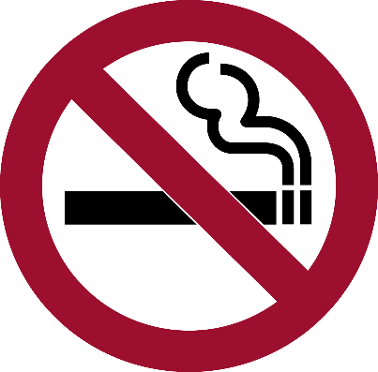
What are the benefits of a smoke and vape free workplace?

Slide 5
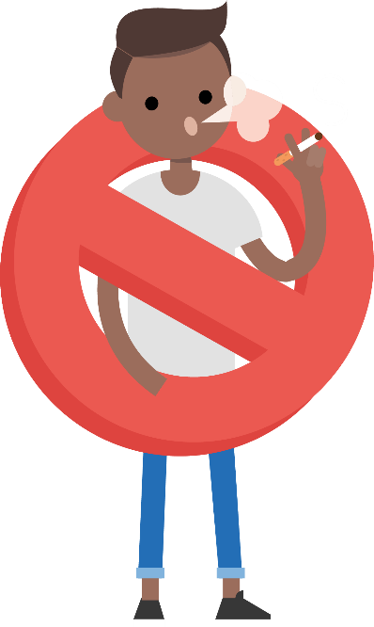
Why should our workplace have a smoke and vape free Policy?
Each state has legislation outlining where people can and can’t smoke/vape in the workplace. Having a policy in place ensures we are following the legislation.
But more importantly it sends a strong message to the community that our workplace is committed to providing a healthy, supportive working environment for all staff, contractors and visitors.
Everyone has a part to play in keeping the workplace
safe, and that is the focus of today’s workshop.

Slide 6

Benefits of a smoke and vape free Workplace
Creates an environment that:
de-normalises smoking and vaping
is more supportive for people trying to quit
encourages those who smoke/vape to make a quit attempt
improves health and safety for everyone, including people who don’t smoke/vape.
A smoke and vape free workplace is a space where
more people achieve long-term cessation.

Slide 7

What is our current smoke and vape free workplace policy?

Slide 8
Group Discussion
What do you know about our existing policy?
Are there many people who smoke or vape in our workplace? Where do they go to smoke/vape?
Are there designated smoking/vaping areas? If so, what is the visibility like (any signage)?
Do people follow the current policy (why/why not)?
Notes:
Have copies of the current policy available to share with the group. Focus on the policy angle and being smoke and vape free at work. The aim of the workshop is not about telling people who smoke to quit, and it is important that anyone who does smoke feels supported

Slide 9
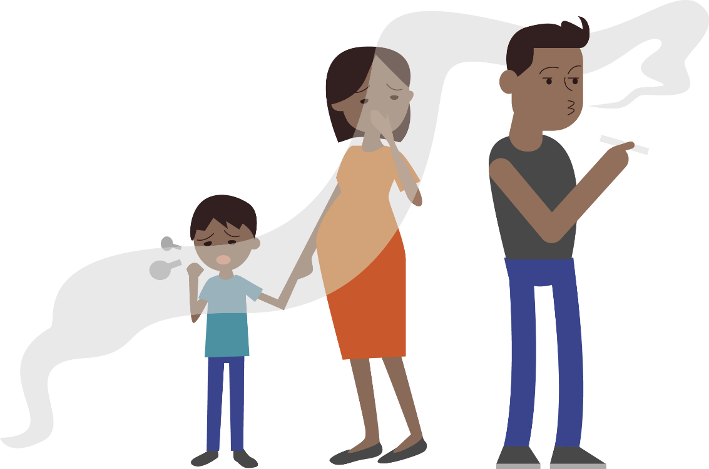
What are the effects of second-hand smoke?

Slide 10

What is second-hand smoke?
Second-hand smoke is made up of:
  smoke exhaled by a person who is smoking
  smoke from the lit end of a cigarette
The chemicals from second-hand smoke:
  stay in the air for many hours after a cigarette is put out.
  settle in clothing, furniture, car seats and carpets.
This ‘thirdhand smoke’ is resistant to general cleaning methods and can remain for weeks, months or even years.

Slide 11
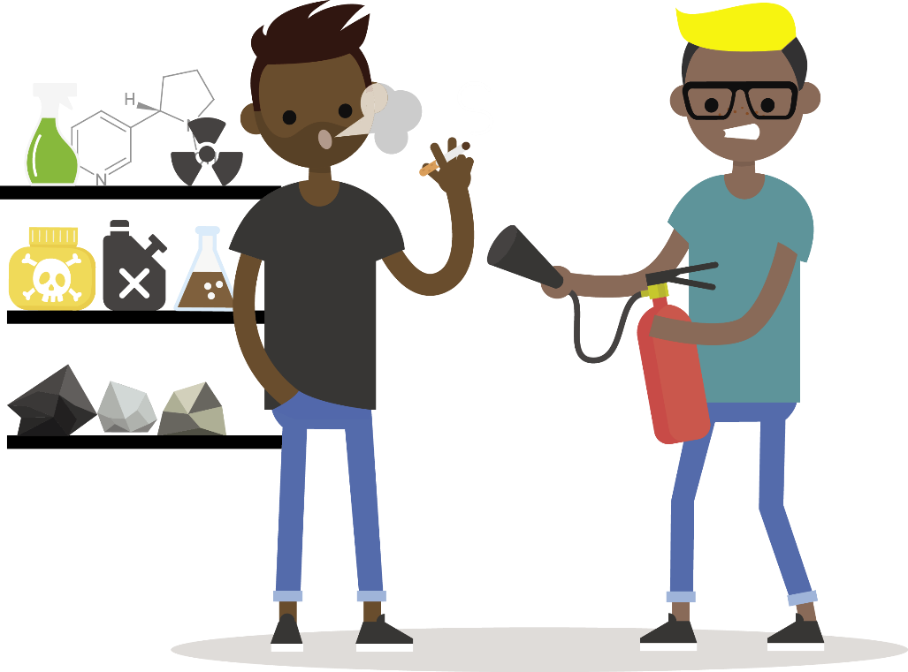
What’s in second-hand smoke?
Second-hand smoke contains hundreds of toxic chemicals including about 70 known to cause cancer:
  Carbon monoxide (also found in vehicle exhaust fumes)
  Hydrogen cyanide (used in US death row gas chambers)
  Benzene (also found in petrol, causes cancer)
  Heavy metals including lead (known to cause brain damage)
  Formaldehyde (used to preserve dead bodies)
  Acetone (used as a paint stripper)
  Arsenic (often used to poison rats)
  Butane (used in lighter fluids)

Slide 12

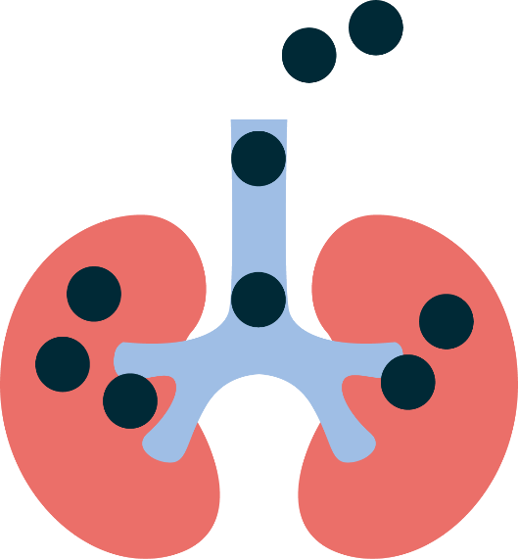



What does second-hand smoke do to your body?
Second- and third-hand smoke can expose people to many health risks including:
  Heart disease
  Lung cancer
  Asthma and other breathing problems
  Stroke
  Clogged arteries
  Reduced healing
  Poor blood circulation

Slide 13

What level of second-hand smoke is harmful?
There is no safe level of ‘passive’ smoking. It only takes 5 minutes of breathing in second-hand smoke to cause harm.
  After 5 minutes: Arteries becomes less flexible, just as they do in a person smoking a cigarette.
  After 20-30 minutes: Blood starts clotting, and fat deposits in blood vessels increase the risk of heart attack and stroke.
  After two hours: An irregular heartbeat can develop,
  triggering a heart attack or other serious cardiac problems.
A smoke free workplace can provide protection from this harm.

Slide 14
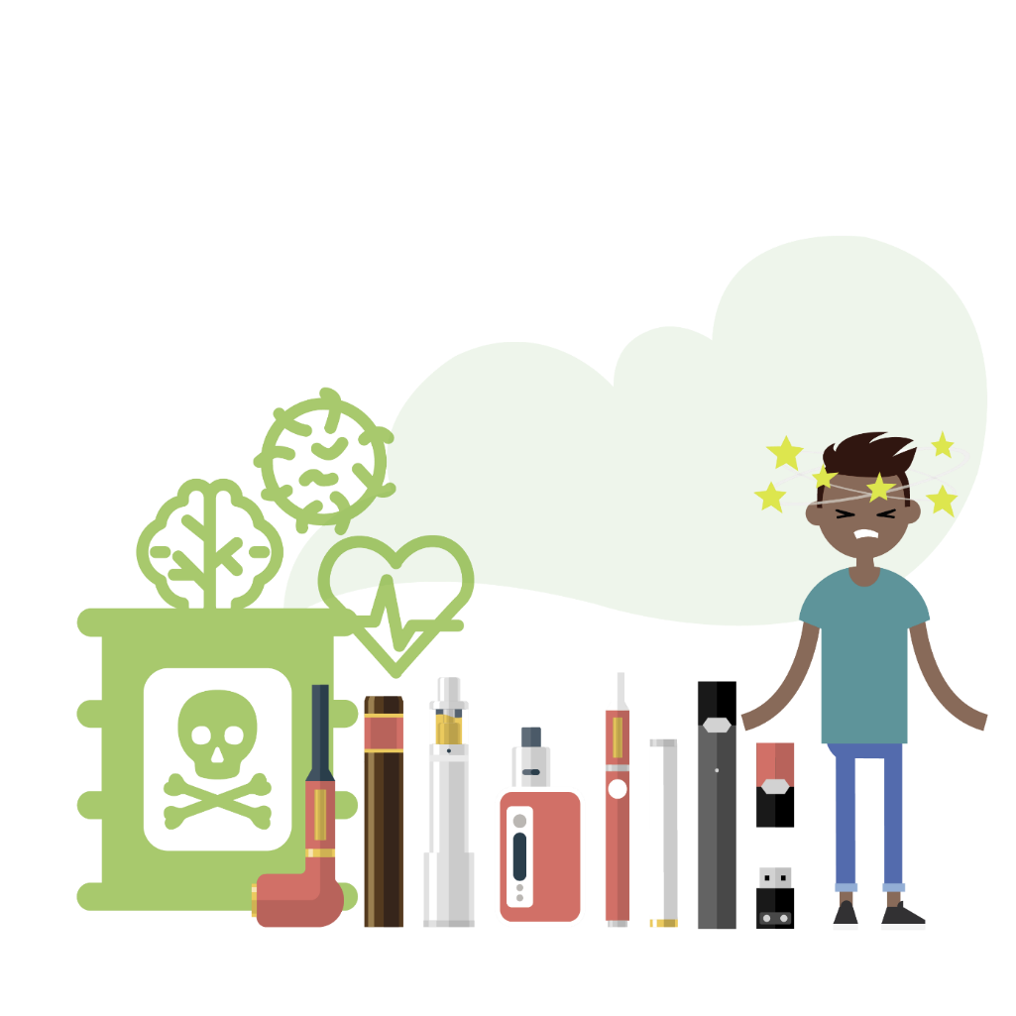
What about vaping?
The evidence does not support vaping as a way to stop smoking. Here are five vaping facts:
  Short-term side-effects include nausea, vomiting, mouth and airway irritation, chest pain and heart palpitations.
  Studies show vaping is linked to lung disease.
  Vapes produce toxic chemicals.
  Vaping exposes you to heavy metals such as chromium, nickel and lead that are linked to heart disease,
  brain damage and cancer.

Slide 15
What about second-hand vape aerosol?
Whilst evidence is constantly evolving around vaping and second-hand vape aerosol, here is what we do know:
Second-hand vape aerosol can cause shortness of breath, coughing, sore throat and eye irritation.
It exposes people to harmful chemicals such as nicotine, diacetyl (e-cigarette flavouring) and heavy metals which could have long term effects.
Third-hand vape aerosol exposure is also a concern. Chemicals and particles from vape aerosol can settle on surfaces and build up over time, resulting to exposure through touching surfaces or breathing in the chemicals.

Slide 16
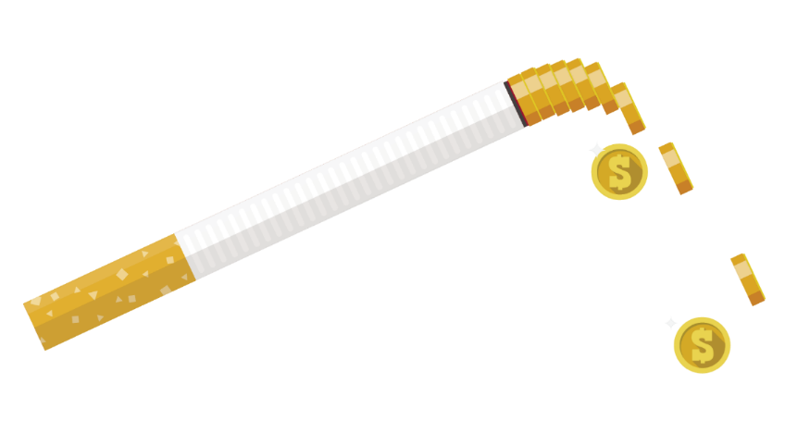
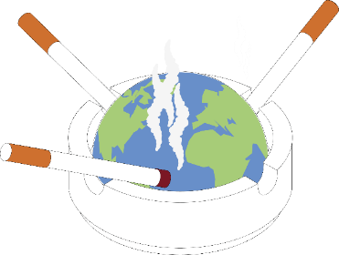
Other benefits of being smoke and vape free:
Being smoke and vape free in the workplace is also good for your wallet and the environment. Did you know:
  The world’s most littered plastic item is cigarette butts. Trillions are thrown into the environment every year.
  Butts pollute the environment with poisons and microplastics.
  E-cigarettes also create waste in the form of
  single-use plastics, tech waste such as lithium batteries
  and toxic chemicals when discarded
  Someone who smokes 20 cigarettes/day spends at least $350 a week.
  In six months, a person who used to
  smoke could save almost $10,000.

Slide 17
Group Discussion
Were you surprised by any of this information?
Has it changed how you think about smoking/vaping?

Slide 18
How will our new policy look?

Slide 19
Group Discussion
Are there any possible challenges with implementing this policy?
If yes, can you come up with workable solutions?
Is anything missing from the policy, anything that doesn’t make sense, or anything you would change or add?
Notes:
Share a copy of the draft policy developed with the organisation management. Go through the policy together and get feedback from staff.
Explain how you arrived at this draft, including the findings of your environmental scan.
Discuss and agree any feedback to management about the draft policy.

Slide 20
How to be smoke and vape free at work

Slide 21
How can we work together to implement the policy?
A workplace champion as a point of contact for staff and management
A buddy system so team members support each other
Contacting the local TIS team for support
Any other ideas?
Notes:
Discuss what the workplace champion might do and if the workers think this will be useful;
Identify someone to be the smoke and vape free Workplace Champion
Introduce the wall chart
Get team to identify ways they can support each other before introducing the 5Ds

Slide 22

How can people who smoke or vape manage cravings?
  Use the 5 ‘Deadly Ds’
Deep breaths - use mindfulness, relaxation, or yoga
Drink water
Distract - replace smoke break with a different activity, e.g., go for a walk
Delay - cravings only last 5 minutes. Use the ‘Keep our place a smoke and vape free space’ resources to keep your hands busy until the urge to smoke/vape passes
Dial 137 848 – call Aboriginal Quitline for support.
Notes:
EXPLAINED
Deep Breaths
Breathe in and breathe out slowly, as if you were smoking a cigarette. When you do deep breathing, inhale deeply, hold it for a couple seconds, and then release it slowly. Deep breathing will help you relax and make the craving dissipate.
Drink Water
Drink lots of water all day long, especially during a craving. Drinking water helps flush the toxins out of your system, and it will help keep your hands and mouth busy if that's something you miss from smoking. Some ex-smokers prefer to drink through a straw, which also helps with the oral fixation.
Distract/Do something else
Distract yourself by getting up and making yourself active. Go for a brisk walk. Go out and meet with a friend. If you choose to stay indoors, go into a different room. Grab a carrot stick and munch on it elsewhere. Put on some music. Open a book or browse through a magazine. Call up a friend. Many smokers have said that when they get an urge to smoke and then make the effort to change their surrounding environment, they do get distracted and actually forget that they wanted to smoke.
Delay
Most smokers falsely assume that each craving lasts a long time - maybe 45 minutes or so. Time yourself to learn the truth. Cravings come and go quickly. The average craving really only lasts about 5 to 10 minutes. No matter how strong the craving is, convince yourself that you can wait 10 minutes. To help those 10 minutes go by, practice the other Ds.

Slide 23
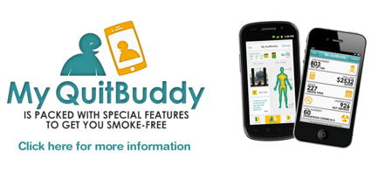
Where to get support
Aboriginal Health Workers, nurses or doctors at your local clinic at your local clinic
Call Aboriginal Quitline on 137 848
Use the ‘Keep our place a smoke and vape free space’ journal to track your progress and for tips and tricks to staying smoke and vape free
Download the MyQuit Buddy app.

Slide 24

?
Thank you for participating today
Any questions or comments?
Please complete the evaluation survey.

