Slide 1

KEEP OUR PLACE A SMOKE-FREE SPACE
Why every workplace needs a smoke-free policy

Slide 2
Acknowledgement
We acknowledge and respect the traditional custodians whose ancestral lands we are meeting upon here today. We pay our respects to Elders past, present and emerging. We acknowledge the deep feelings of attachment and relationship of Aboriginal and Torres Strait Islander peoples to Country. We also pay respects to the cultural authority of Aboriginal and Torres Strait Islander people visiting/attending from other areas of Australia present here.

Slide 3
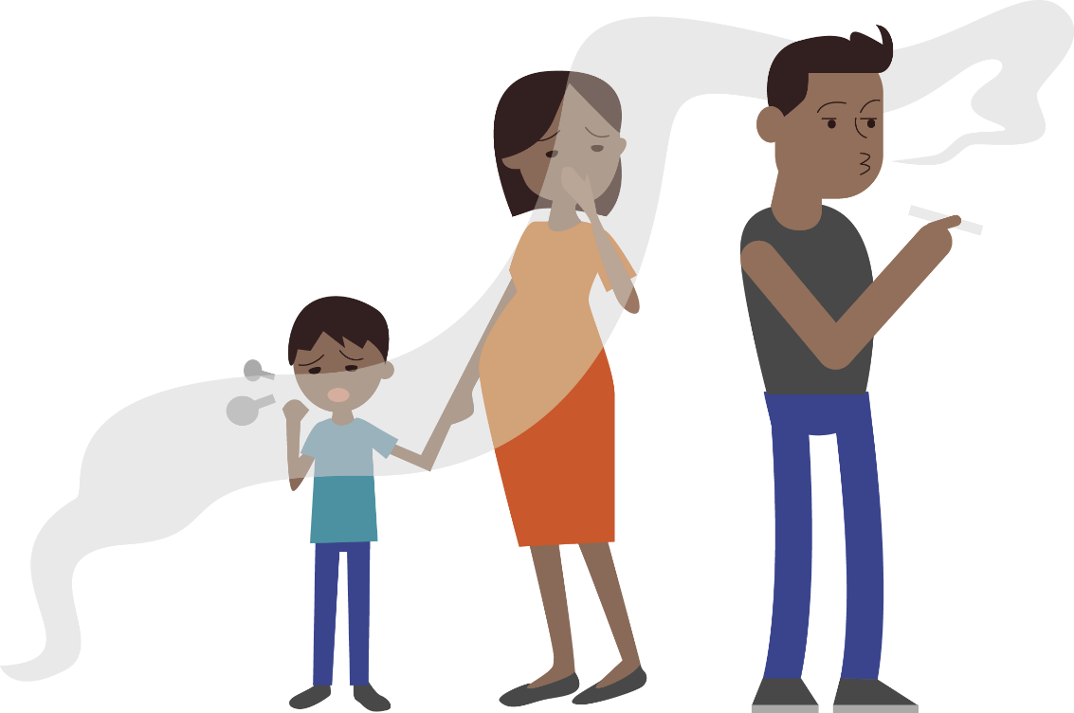

Why should your workplace have a smoke-free policy ?
A smoke-free workplace ensures you are following the legislation.
More importantly, it sends a strong message to the community you are committed to providing a healthy, supportive working environment for all staff, contractors and visitors.

Slide 4

Benefits of a Smoke-Free Workplace
Creates an environment that:
de-normalises smoking
is more supportive for people trying to quit
encourages those who do smoke to make a quit attempt
improves health and safety for everyone, including people who don’t smoke.
A smoke-free workplace is a space where
more people achieve long-term smoking cessation.

Slide 5
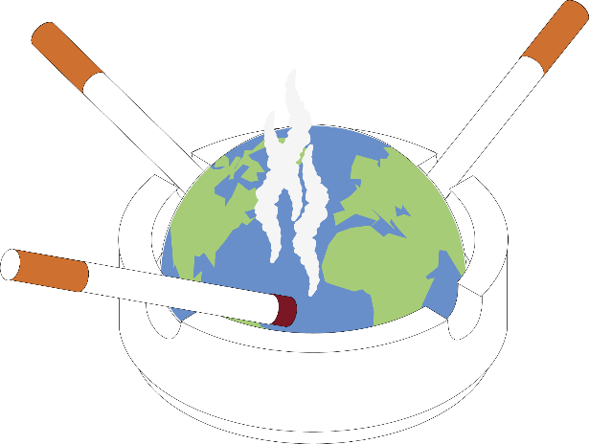
The Effects of Smoking
Smoking, and exposure to second-hand smoke, increases the risk of cancer, heart disease and stroke and can make some chronic illnesses worse (e.g., asthma and diabetes);
People who smoke are more likely to have illness-related time off work than those who don’t;
Workplaces may also experience reduced productivity due to long or frequent smoke breaks;
Smoking also affects the environment: cigarette butts are the most abundant form of plastic waste in the world.

Slide 6
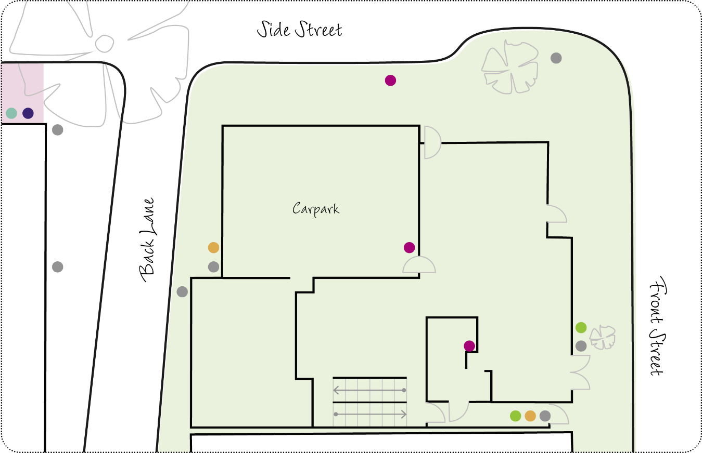
What we do
Work with you to develop/update your smoke-free workplace policy
Support you to implement the policy by:
  undertaking an environmental scan
  consulting with staff
  delivering educational workshops
  providing culturally sensitive and tailored resources.

Slide 7
Activity: your workplace and smoking
Do you have a smoke-free workplace policy?
If yes, how effective is it?
Are there any barriers to creating a smoke-free workplace for your organisation?
What would help you to successfully implement a smoke-free policy in your organisation?

Slide 8
Next Steps
Engagement
Work together to develop a plan and timeline
Environmental Scan
Check the local and organisational tobacco control context
Consultation and education
Run a change workshop with staff
Implementation
Put the new policy into action
Review
Review and update the policy annually

Slide 9

To finish, here’s a funny video created by Tackling Indigenous Smoking team Bega Garnbirringu with Ngarrindjeri comedian Kevin Kropinyeri to showcase the positives of a smoke-free life.

Slide 10
Thank you for participating today.
Any questions or comments?
?

