Slide 1
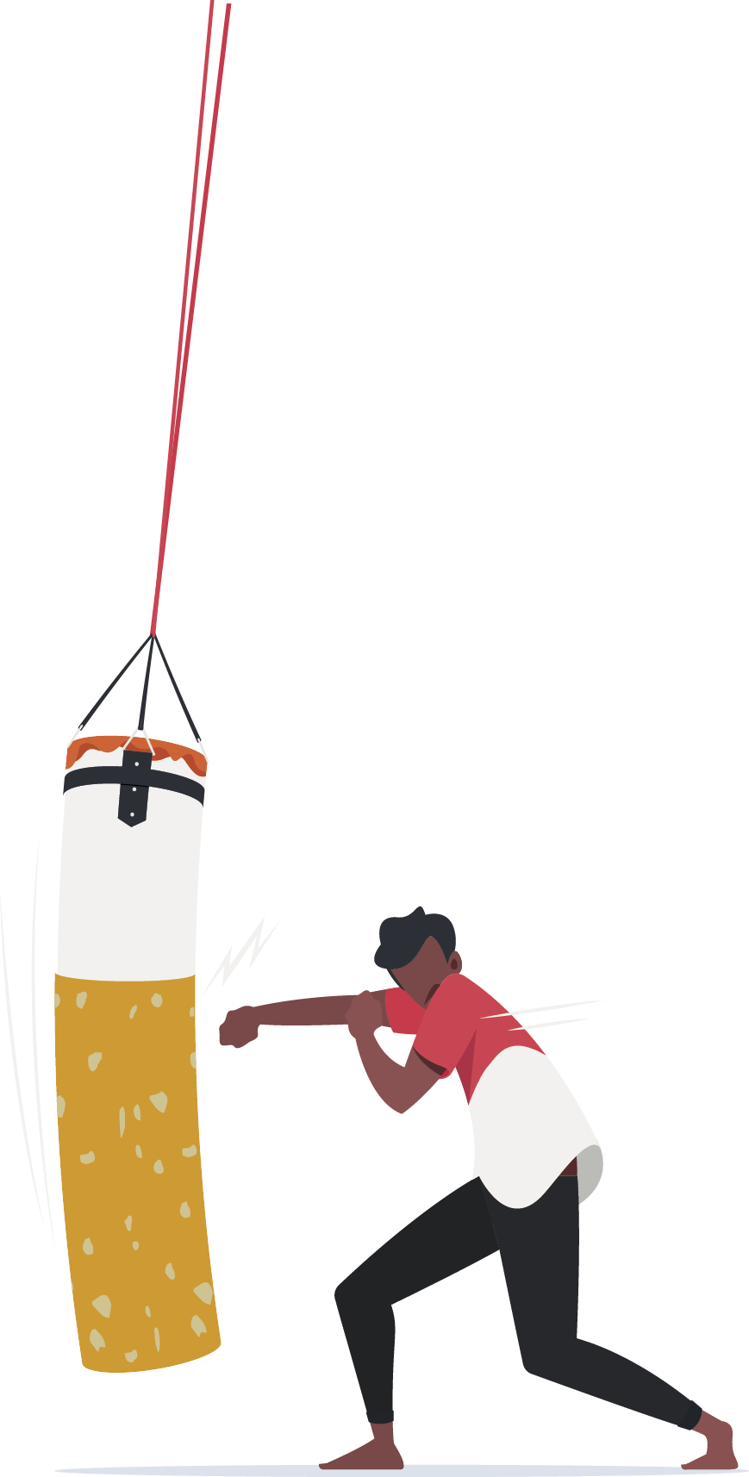
KEEP OUR PLACE A SMOKE-FREE SPACE
Why every workplace needs a smoke-free policy

Slide 2
Acknowledgement
We acknowledge and respect the traditional custodians whose ancestral lands we are meeting upon here today. We pay our respects to Elders past, present and emerging. We acknowledge the deep feelings of attachment and relationship of Aboriginal and Torres Strait Islander peoples to Country. We also pay respects to the cultural authority of Aboriginal and Torres Strait Islander people visiting/attending from other areas of Australia present here.

Slide 3
Workshop agenda:
What are the benefits of a smoke-free workplace?
What is your current smoke-free workplace policy?
What are the harms of second-hand smoke?
How will your new policy look?
How to be smoke-free at work.

Slide 4

What are the benefits of a smoke-free workplace?

Slide 5

Why should your workplace have a Smoke-free Policy?
Each state has legislation outlining where people can and can’t smoke in the workplace. Having a policy in place ensures you are following the legislation.
But more importantly it sends a strong message to the community that your workplace is committed to providing a healthy, supportive working environment for all staff, contractors and visitors.
Everyone has a part to play in keeping the workplace safe, and that is the focus of today’s workshop.

Slide 6

Benefits of a Smoke-Free Workplace
Creates an environment that:
de-normalises smoking
is more supportive for people trying to quit
encourages those who smoke to make a quit attempt
improves health and safety for everyone, including people who don’t smoke.
A smoke-free workplace is a space where more people achieve long-term smoking cessation.

Slide 7

What is your current smoke-free workplace policy?

Slide 8
Group Discussion
What do you know about your existing policy?
Are there many people who smoke in your workplace? Where do they go to smoke?
Are there designated smoking areas? If so, what is the visibility like (any signage)?
How does your organisation deal with vaping?
Do people follow the current policy (why/why not)?
Notes:
Have copies of the current policy available to share with the group. Focus on the policy angle and being smoke-free at work. The aim of the workshop is not about telling people who smoke to quit, and it is important that anyone who does smoke feels supported

Slide 9
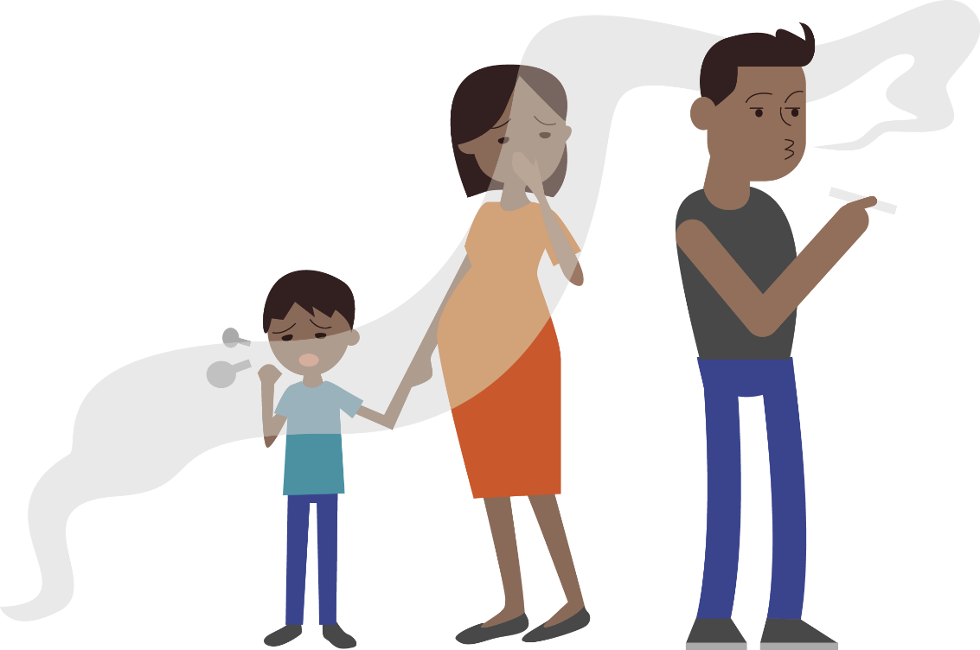
What are the effects of second-hand smoke?

Slide 10

What is second-hand smoke?
Second-hand smoke is made up of:
smoke exhaled by a person who is smoking
smoke from the lit end of a cigarette
The chemicals from second-hand smoke:
stay in the air for many hours after a cigarette is put out.
settle in clothing, furniture, car seats and carpets.
This ‘thirdhand smoke’ is resistant to general cleaning methods and can remain for weeks, months or even years.

Slide 11

What’s in second-hand smoke?
Second-hand smoke contains hundreds of toxic chemicals including about 70 known to cause cancer:
Carbon monoxide (also found in vehicle exhaust fumes)
Hydrogen cyanide (used in US death row gas chambers)
Benzene (also found in petrol, causes cancer)
Heavy metals including lead (known to cause brain damage)
Formaldehyde (used to preserve dead bodies)
Acetone (used as a paint stripper)
Arsenic (often used to poison rats)
Butane (used in lighter fluids)

Slide 12





What does second-hand smoke do to your body?
Second- and third-hand smoke can expose people to many health risks including:
Heart disease
Lung cancer
Asthma and other breathing problems
Stroke
Clogged arteries
Reduced healing
Poor blood circulation

Slide 13

What level of second-hand smoke is harmful?
There is no safe level of ‘passive’ smoking. It only takes 5 minutes of breathing in second-hand smoke to cause harm.
After 5 minutes: Arteries becomes less flexible, just as they do in a person smoking a cigarette.
After 20-30 minutes: Blood starts clotting, and fat deposits in blood vessels increase the risk of heart attack and stroke.
After two hours: An irregular heartbeat can develop, triggering a heart attack or other serious cardiac problems.
A smoke-free workplace can provide protection from this harm.

Slide 14
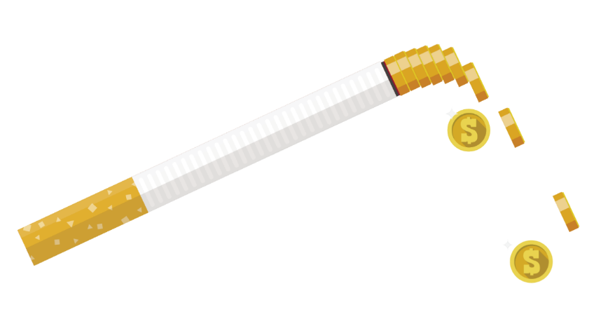
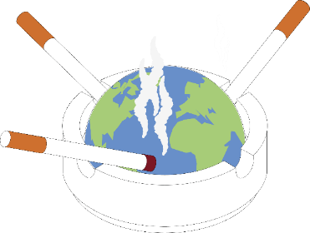
Other benefits of being smoke-free:
Being smoke-free in the workplace is also good for your wallet and the environment. Did you know:
The world’s most littered plastic item is cigarette butts. Trillions are thrown into the environment every year.
Butts pollute the environment with poisons and microplastics.
Someone who smokes 30 cigarettes/day spends at least $350 a week.
In six months, a person who used to smoke could save almost $10,000.

Slide 15

What about vaping?
The evidence does not support vaping as the best way to stop smoking. Here are five vaping facts:
Short-term side-effects include nausea, vomiting, mouth and airway irritation, chest pain and heart palpitations.
Studies show vaping is linked to lung disease.
Vapes produce toxic chemicals.
Vaping increases the chance of having a heart attack or stroke.
Vaping exposes you to heavy metals such as chromium, nickel and lead that are linked to heart disease, brain damage and cancer.

Slide 16
Group Discussion
Were you surprised by any of this information?
Has it changed how you think about smoking/vaping?

Slide 17
How will your new policy look?

Slide 18
Group Discussion
Are there any possible challenges with implementing this policy?
If yes, can you come up with workable solutions?
Is anything missing from the policy, anything that doesn’t make sense, or anything you would change or add?
Notes:
Share a copy of the draft policy developed with the organisation management. Go through the policy together and get feedback from staff.
Explain how you arrived at this draft, including the findings of your environmental scan.
Discuss and agree any feedback to management about the draft policy.

Slide 19
How to be smoke-free at work

Slide 20
How can we work together to implement the policy?
A workplace champion as a point of contact for staff, management and the TIS team
A buddy system so team members support each other
Any other ideas?
Notes:
Discuss what the workplace champion might do and if the workers think this will be useful;
Identify someone to be the Smoke-free Workplace Champion
Introduce the wall chart
Get team to identify ways they can support each other before introducing the 5Ds

Slide 21

How can people who smoke manage cravings?
Use the 5 ‘Deadly Ds’
Deep breaths - use mindfulness, relaxation, or yoga
Drink water
Distract - replace smoke break with a different activity, e.g., go for a walk
Delay - cravings only last 5 minutes. Use the ‘Keep our place a smoke-free space’ resources to keep your hands busy until the urge to smoke passes
Dial 137 848 – call the Quitline for support.
Notes:
EXPLAINED
Deep Breaths
Breathe in and breathe out slowly, as if you were smoking a cigarette. When you do deep breathing, inhale deeply, hold it for a couple seconds, and then release it slowly. Deep breathing will help you relax and make the craving dissipate.
Drink Water
Drink lots of water all day long, especially during a craving. Drinking water helps flush the toxins out of your system, and it will help keep your hands and mouth busy if that's something you miss from smoking. Some ex-smokers prefer to drink through a straw, which also helps with the oral fixation.
Distract/Do something else
Distract yourself by getting up and making yourself active. Go for a brisk walk. Go out and meet with a friend. If you choose to stay indoors, go into a different room. Grab a carrot stick and munch on it elsewhere. Put on some music. Open a book or browse through a magazine. Call up a friend. Many smokers have said that when they get an urge to smoke and then make the effort to change their surrounding environment, they do get distracted and actually forget that they wanted to smoke.
Delay
Most smokers falsely assume that each craving lasts a long time - maybe 45 minutes or so. Time yourself to learn the truth. Cravings come and go quickly. The average craving really only lasts about 5 to 10 minutes. No matter how strong the craving is, convince yourself that you can wait 10 minutes. To help those 10 minutes go by, practice the other Ds.

Slide 22
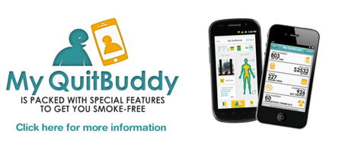
Where to get support
Aboriginal Health Workers, nurses or doctors at your local clinic at your local clinic
Call Aboriginal Quitline on 137 848
Use the ‘Keep our place a smoke-free space’ journal to track your progress and for tips and tricks to staying smoke-free
Download the MyQuit Buddy app.

Slide 23

?
Thank you for participating today
Any questions or comments?
Please complete the evaluation survey.

