Slide 1
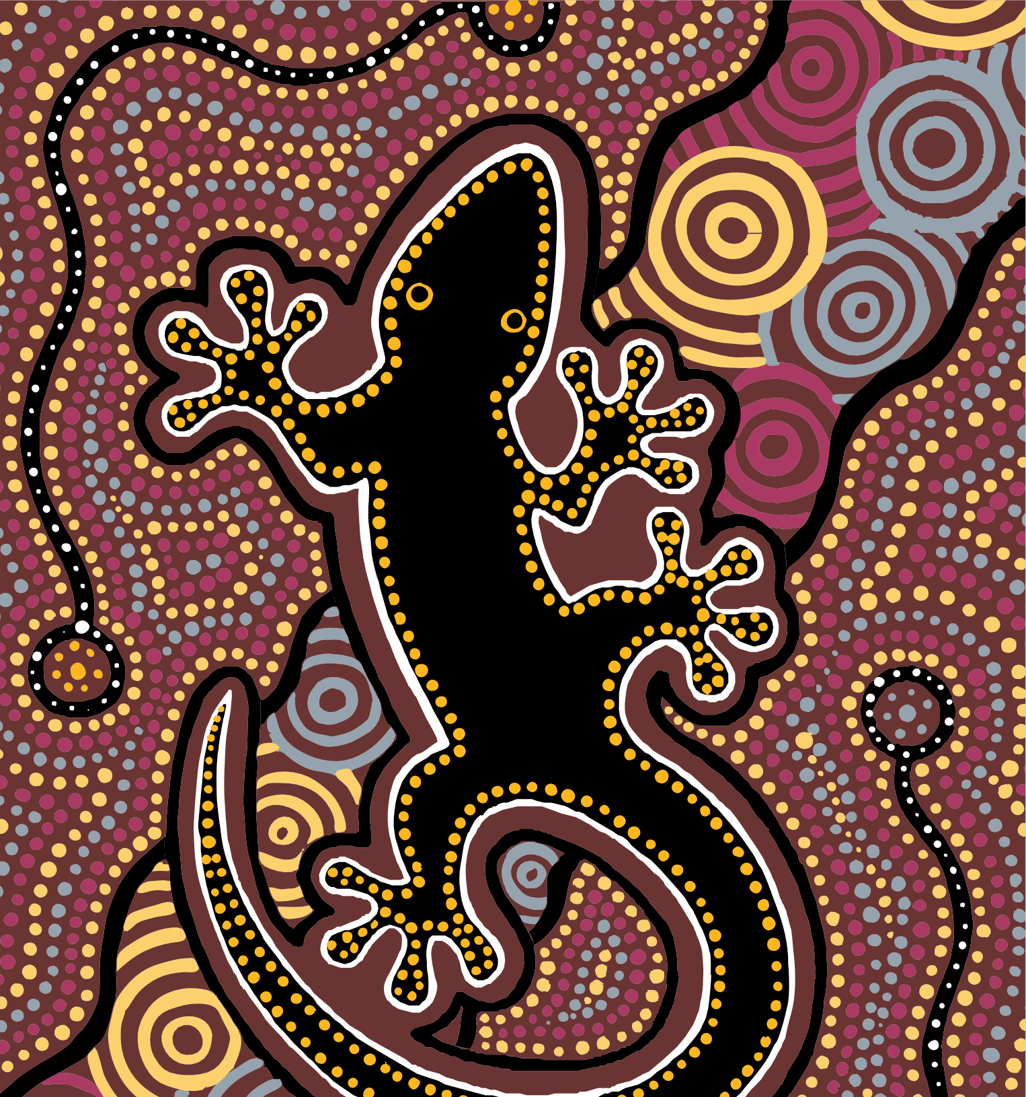



Overview of Aboriginal and
Torres Strait Islander health status 2025
Key facts and tables

Slide 2
Australian Indigenous HealthInfoNet
The mandate of the Australian Indigenous HealthInfoNet (HealthInfoNet) is to contribute to improvements in Aboriginal and Torres Strait Islander health by making relevant, high-quality knowledge and information easily accessible to policy makers, health service providers, program managers, clinicians and other health professionals (including Aboriginal and Torres Strait Islander Health Workers and Health Practitioners) and researchers.
The HealthInfoNet also provides easy-to-read and summarised material for students and the general community.
The HealthInfoNet achieves its commitment by compiling and disseminating the results (and other relevant knowledge and information) about various Aboriginal and Torres Strait Islander health topics, mainly via HealthInfoNet websites (https://healthinfonet.ecu.edu.au), the Alcohol and Other Drugs Knowledge Centre (https://aodknowledgecentre.ecu.edu.au), Tackling Indigenous Smoking (https://tacklingsmoking.org.au) and WellMob (https://wellmob.org.au).
The research involves analysis and synthesis of data and other information obtained from academic, professional, government and other sources. The HealthInfoNet’s work in knowledge exchange aims to facilitate the transfer of pure and applied research into policy and practice to address the needs of a wide range of users.
We acknowledge and pay our deepest respects to Elders past, present and emerging throughout the country. In particular, we pay our respects to the Whadjuk Noongar peoples of Western Australia on whose Country our offices are located (https://healthinfonet.ecu.edu.au/acknowledging-country).

Slide 3

Social, Political and Environmental Determinants of Health
 | CTG Outcome 3: Children are engaged in high quality, culturally appropriate early childhood education in their early years CTG Outcome 5: Students achieve their full learning potential CTG Outcome 6: Students reach their full potential through further education pathways CTG Outcome 7: Youth are engaged in employment or education CTG Outcome 8: Strong economic participation and development of people and their communities CTG Outcome 9: People can secure appropriate, affordable housing that is aligned with their priorities and need
In 2022, 60% of Aboriginal and Torres Strait Islander people aged 18 years and over reported having experienced at least one form of racial prejudice in the past six months.
In 2022–23, 67% of Aboriginal and Torres Strait Islander people aged 15–64 years were in the labour force. Of these, 36% were employed full-time and 21% were employed part-time.
In 2022–23, 82% of Aboriginal and Torres Strait Islander households reported living in houses of an acceptable standard.

Slide 4
Social, Political and Environmental Determinants of Health
Average proportion (%) of Aboriginal and Torres Strait Islander students across all NAPLAN domains, by proficiency level and year level, 2025
 | Needs additional support | Developing | Strong | Exceeding
Year 3 | 34 | 30 | 30 | 2.8
Year 5 | 31 | 30 | 32 | 3.6
Year 7 | 32 | 29 | 31 | 4.5
Year 9 | 33 | 32 | 28 | 4.0
Note:
This table shows the average proportion of Aboriginal and Torres Strait Islander students across all domains who were assessed as being in each proficiency level in 2025. About one-third of students achieved results that were classified as strong or exceeding, combined.
Proportions are rounded; totals may not equal 100.
Source: Australian Curriculum Assessment and Reporting Authority, 2025 (Derived from [32])

Slide 5
Population
In 2025, the estimated Aboriginal and Torres Strait Islander population was 1,059,185.
In 2025, NSW had the largest Aboriginal and Torres Strait Islander population, with an estimated 364,450 people representing 34% of the national Aboriginal and Torres Strait Islander population.
In 2025, the NT had the highest proportion of Aboriginal and Torres Strait Islander people, compromising 30% of its population.

Slide 6
Population
Estimated Aboriginal and Torres Strait Islander (Indigenous) population, by jurisdiction, Australia, 2025
Jurisdiction | Indigenous population (number) | Proportion of Australian Indigenous population (%) | Proportion of total jurisdiction population (%)
NSW | 364,450 | 34 | 4.2
Vic | 85,500 | 8.1 | 1.2
Qld | 299,450 | 28 | 5.3
WA | 55,490 | 5.2 | 2.9
SA | 129,117 | 12 | 4.2
Tas | 35,712 | 3.4 | 6.2
NT | 78,785 | 7.4 | 30
ACT | 10,432 | 1.0 | 2.2
Australia | 1,059,185 | 100 | 3.8
Note: The Australian population includes Jervis Bay Territory, the Cocos (Keeling) Islands, Christmas Island and Norfolk Island.
Source: Derived from ABS, 2025 [44], ABS, 2024 [43]

Slide 7
Connection to Culture
 | CTG Outcome 16: Cultures and languages are strong, supported and flourishing
In 2021, 9.5% of Aboriginal or Torres Strait Islander people in the Census reported using or speaking an Aboriginal or Torres Strait Islander language at home.
In 2021, there were 167 Aboriginal and Torres Strait Islander languages being actively spoken in Australia.
In 2022–23, 66% of Aboriginal and Torres Strait Islander people identified with a tribal group, language, clan, mission or regional group.
Based on 2018–2020 data from the national Mayi Kuwayu study, 29% of Aboriginal and Torres Strait Islander adults aged 16 years and over spend a moderate to high amount of time participating in cultural practices.

Slide 8
Connection to Country
 | CTG Outcome 15: Aboriginal and Torres Strait Islander people maintain a distinctive cultural, spiritual, physical and economic relationship with their land and waters
50% of Aboriginal and Torres Strait Islander people aged 16 years and over in the Mayi Kuwayu study spent at least a little bit of time on their Country.
19% of Aboriginal and Torres Strait Islander people aged 16 years and over in the Mayi Kuwayu study had cultural responsibilities for their mother’s Country and 14% for their father’s Country.
Indigenous Rangers are 1.3 times as likely to report very high life satisfaction than non-Rangers.
In 2024, 56% of Australia’s total land mass was subject to Aboriginal and Torres Strait Islander people’s legal rights and interests.

Slide 9
Births and pregnancy outcomes
 | CTG Outcome 2: Children are born healthy and strong
In 2024, there were 25,049 births registered in Australia with one or both parents identified as Aboriginal and/or Torres Strait Islander (8.6% of all births registered).
In 2024, the median age of Aboriginal and Torres Strait Islander mothers who gave birth was 27.0 years.
In 2024, the total fertility rate was 2.1 babies per Aboriginal and Torres Strait Islander woman.

Slide 10
Cardiovascular health
 | CTG Outcome 1: Everyone enjoys long and healthy lives
In 2022-23, 14% of Aboriginal and Torres Strait Islander people reported having cardiovascular disease (CVD).
In 2024, in NSW, Qld, WA, SA and the NT combined, there were 472 notifications of acute rheumatic fever (ARF) for Aboriginal and Torres Strait Islander people.
In 2023-24, there were 20,169 hospital separations for CVD among Aboriginal and Torres Strait Islander people, representing 5.2% of all Aboriginal and Torres Strait Islander hospital separations (excluding dialysis).
In 2024, ischaemic heart disease (IHD) was the leading specific cause of death for Aboriginal and Torres Strait Islander people living in NSW, Qld, WA, SA and the NT.

Slide 11
Cancer
 | CTG Outcome 1: Everyone enjoys long and healthy lives
In 2022–23, 1.1% of Aboriginal and Torres Strait Islander people reported having neoplasms (including malignant, benign, in situ and of an uncertain nature) as a long-term health condition.
In 2023–24, there were 14,111 hospital separations with neoplasms (including all types of cancer) as the principal diagnosis, representing 3.7% of all separations (excluding dialysis) among Aboriginal and Torres Strait Islander people.
In 2024, cancers of the trachea, bronchus and lung combined were the fourth leading cause of death for Aboriginal and Torres Strait Islander people living in NSW, Qld, WA, SA and the NT, being responsible for 329 deaths.
In 2018, cancer accounted for 9.9% of the total burden of disease among Aboriginal and Torres Strait Islander people.

Slide 12
Diabetes
 | CTG Outcome 1: Everyone enjoys long and healthy lives
In 2024, diabetes was the third leading specific cause of death for Aboriginal and Torres Strait Islander people in NSW, Qld, SA, WA and the NT.
In 2022-23, 7.4% of Aboriginal and Torres Strait Islander people reported having diabetes.
In 2021-22, there were 4,850 potentially preventable hospitalisations of Aboriginal and Torres Strait Islander people for a principal diagnosis of diabetes.

Slide 13
Kidney health
 | CTG Outcome 1: Everyone enjoys long and healthy lives
In 2022-23, 1.4% of Aboriginal and Torres Strait Islander people reported kidney disease as a long-term health condition.
In 2024, there were 2,249 prevalent dialysis patients in Australia who identified as Aboriginal and/or Torres Strait Islander people.
In 2024, 362 Aboriginal and Torres Strait Islander people commenced dialysis.
In 2024, 64 Aboriginal and Torres Strait Islander people received a kidney transplant.

Slide 14
Respiratory health
 | CTG Outcome 1: Everyone enjoys long and healthy lives CTG Outcome 2: Children are born healthy and strong
In 2022-23, 31% of Aboriginal and Torres Strait Islander people reported having a long-term respiratory condition.
In 2021, 13% of Aboriginal and Torres Strait Islander people reported having asthma and 2.2% chronic obstructive pulmonary disease (COPD).
In 2023-24, 9.2% of all Aboriginal and Torres Strait Islander hospital separations (excluding those for dialysis) were for respiratory disease.
In 2024, chronic lower respiratory disease was the second leading cause of death overall for Aboriginal and Torres Strait Islander people living in NSW, Qld, WA, SA and the NT.

Slide 15
Eye health
 | CTG Outcome 1: Everyone enjoys long and healthy lives
In 2022-2025, the prevalence of vision impairment in both eyes among Aboriginal and Torres Strait Islander adults aged 50 years and over was 11%.
In 2022-23, eye and sight problems were reported by 41% of Aboriginal people and 38% of Torres Strait Islander people.
In 2024, the estimated overall prevalence of trachoma in at-risk communities in WA, SA and the NT combined was 1.5%.
In 2023-24, hospitalisations for diseases of the eye and adnexa accounted for 2.1% of all Aboriginal and Torres Strait Islander hospital separations (excluding dialysis).

Slide 16
Ear health and hearing
 | CTG Outcome 1: Everyone enjoys long and healthy lives
In 2022-2025, the prevalence of hearing impairment in both ears among Aboriginal and Torres Strait Islander adults aged 50 years and over was 49%.
In 2022-23, 13% of Aboriginal and Torres Strait Islander people reported ear and hearing problems.
In 2023-24, ear-related hospitalisations accounted for 1.2% of all Aboriginal and Torres Strait Islander hospital separations (excluding dialysis).

Slide 17
Oral health
 | CTG Outcome 1: Everyone enjoys long and healthy lives
In 2012-2014, 61% of Aboriginal and Torres Strait Islander children aged 5-10 years had experienced tooth decay in their baby teeth, and 36% of Aboriginal and Torres Strait Islander children aged 6-14 years had experienced tooth decay in their permanent teeth.
In 2017-18, 7.1% of Aboriginal and Torres Strait Islander people aged 15 years and over had complete tooth loss.
In 2023-24, there were 5,679 potentially preventable hospitalisations for dental conditions

Slide 18
Disability
 | CTG Outcome 1: Everyone enjoys long and healthy lives
In 2022-23, 38% of Aboriginal people and 29% of Torres Strait Islander people reported having a disability or restrictive long-term health condition.
In 2022-23, 7.0% of Aboriginal people and 5.9% of Torres Strait Islander people reported a profound or severe disability.
In 2022, 71% of Aboriginal and Torres Strait Islander people with disability, aged 5 years and over, reported having a schooling or employment restriction.
In the 2021 Census, 8.2% of Aboriginal and Torres Strait Islander people reported a need for assistance with either self-care, mobility or communication.

Slide 19
Nutrition, physical activity and bodyweight
 | CTG Outcome 1: Everyone enjoys long and healthy lives
In the 2022–23 NATSIHS, 35% of Aboriginal and Torres Strait Islander people aged 15 years and over met the recommended fruit intake guidelines, and 5.3% met the recommended vegetable intake guidelines.
In the 2018–19 NATSIHS, 87% of Aboriginal and Torres Strait Islander children aged 0–2 years had been breastfed.
In the 2022–23 NATSIHS, 17% of people aged 15 years and over in non-remote areas met the recommended guidelines for weekly physical activity.
In the 2022–23 NATSIHS, 68% of people aged 15 years and over were overweight or obese.

Slide 20
Tobacco and e-cigarette use
 | CTG Outcome 1: Everyone enjoys long and healthy lives CTG Outcome 2: Children are born healthy and strong
In 2022-23, 29% of Aboriginal and Torres Strait Islander people aged 15 years and over reported they smoked daily, a reduction from levels reported in 2018-19 (37%).
In 2023, 38% of Aboriginal and Torres Strait Islander mothers reported smoking during pregnancy.
In 2018, tobacco use was the leading risk factor contributing to the burden of disease among Aboriginal and Torres Strait Islander people, responsible for 12% of the total burden of disease.
In 2022-23, 24% of Aboriginal and Torres Strait Islander people aged 15 years and over had ever used an e-cigarette and 8.3% currently used an e-cigarette.

Slide 21
Alcohol use
 | CTG Outcome 1: Everyone enjoys long and healthy lives
In 2022-23, 62% of Aboriginal and Torres Strait Islander adults did not exceed the 2020 Australian adult alcohol guideline.
In 2022-23, 36% of Aboriginal and Torres Strait Islander adults exceeded the 2020 Australian adult alcohol guideline.
In 2023, 86% of pregnant Aboriginal and Torres Strait Islander people self-reported not consuming alcohol during the first 20 weeks of pregnancy, increasing to 90% after 20 weeks.
In 2023-24, alcohol was the main drug of concern for 36% of Aboriginal and Torres Strait Islander people who sought treatment for their own alcohol and other drugs (AOD) use.

Slide 22
Illicit drug and volatile substance use
 | CTG Outcome 1: Everyone enjoys long and healthy lives
In 2022–23, 27% of Aboriginal and Torres Strait Islander people aged 15 years and over reported they had used an illicit substance in the previous 12 months.
In 2018, illicit drug use contributed to 6.9% of the total burden of disease among Aboriginal and Torres Strait Islander people.
In 2023–24, 0.8% of Aboriginal and Torres Strait Islander people aged 10 years and over identified volatile solvents as the main drug they sought treatment for in publicly funded AOD services.
In 2022–23, the majority (94%) of Aboriginal and Torres Strait Islander people aged 14 years and over reported they had never used inhalants.

Slide 23
Sexual health
In 2024, there were 9,885 notified chlamydia infections among Aboriginal and Torres Strait Islander people.
In 2024, there were 5,934 notified gonorrhoea infections among Aboriginal and Torres Strait Islander people.
In 2024, there were 989 notified infectious syphilis for Aboriginal and Torres Strait Islander people.

Slide 24
Communicable disease
In 2024, there were 23 notifications of human immunodeficiency virus (HIV) infection for Aboriginal and Torres Strait Islander people.
In 2024, there were 1,527 notified hepatitis C virus (HCV) infections for Aboriginal and Torres Strait Islander people.
In 2024, there were 144 notified hepatitis B virus (HBV) infections for Aboriginal and Torres Strait Islander people.
In 2020–2024, there were 1,418 notifications for invasive pneumococcal disease (IPD) for Aboriginal and Torres Strait Islander people.

Slide 25
Skin health
In 2022-23, 4.0% of Aboriginal and Torres Strait Islander people reported having a disease of the skin or subcutaneous tissue.
In 2023–24, 3.8% of hospital separations among Aboriginal and Torres Strait Islander people (excluding dialysis) were for diseases of the skin and subcutaneous tissue.

Slide 26
Immunisation
 | CTG Outcome 1: Everyone enjoys long and healthy lives
As of 30 September 2025, 94.3% of Aboriginal and Torres Strait Islander five-year-old children were fully immunised against the recommended vaccine preventable diseases.

Slide 27
Immunisation
Percentage (%) of Aboriginal and Torres Strait Islander children assessed as fully immunised, by age, as of 30 September 2025
Age (years) | 1 | 2 | 5
Percentage assessed as fully immunised | 89.8% | 87.4% | 94.3%
Note: Proportion expressed as percentages rounded to one decimal point.
Source: Australian Government Department of Health, 2025 [238]

Slide 28
Immunisation
Influenza vaccination coverage percentage (%) for Aboriginal and Torres Strait Islander people, by age, as of 31 August 2025
Age (years) | Australia (%)
6 months - <5 | 18
5 - <15 | 12
15 - <50 | 18
50 - <65 | 37
≥65 | 60
Note:
Proportion expressed as percentages rounded to one decimal point.
Coverage calculated using doses given 1 March–31 Aug 2025 using AIR data as of 7 September 2025.
Source: National Centre for Immunisation Research and Surveillance, 2025 [242]

Slide 29
Connection to Mind and Emotions
 | CTG Outcome 14: People enjoy high levels of social and emotional wellbeing
In 2022-23, 30% of Aboriginal people and 31% of Torres Strait Islander people aged 18 years and over reported high or very high levels of psychological distress.
In 2022-23, anxiety was the most common mental or behavioural condition reported by Aboriginal and Torres Strait Islander people aged two years and over (21%), followed by depression (16%).
In 2023-24, there were 29,289 hospital separations of Aboriginal and Torres Strait Islander people with a principal diagnosis of ‘Mental and behavioural disorders’.
In 2024, 271 Aboriginal and Torres Strait Islander people living in NSW, Qld, WA, SA and the NT died from intentional self-harm.

Slide 30
Connection to Community
 | CTG Outcome 1: Everyone enjoys long and healthy lives CTG Outcome 13: Families and households are safe CTG Outcome 14: People enjoy high levels of social and emotional wellbeing
The Mayi Kuwayu study reported that 21% of respondents felt that where they live, local Mob makes community decisions ‘a lot’.
In 2024–25, there were 146 National Aboriginal Community Controlled Health Organisation (NACCHO)-affiliated Aboriginal Community Controlled Health Organisations across Australia, operating across more than 550 sites.
In the Mayi Kuwayu study, 48% of Aboriginal and Torres Strait Islander adults reported preferring an Aboriginal Medical Service (AMS) as a source of non-urgent care, while 33% reported using an AMS.
In 2023–24, assault accounted for 17% of injury-related hospitalisations among Aboriginal and Torres Strait Islander people.

Slide 31
Connection to Family and Kinship
 | CTG Outcome 13: Families and households are safe CTG Outcome 16: Cultures and languages are strong, supported and flourishing
In 2024, there were 19,987 Aboriginal children in out-of-home care (OOHC).
In 2023–24, there were 4,415 Aboriginal and Torres Strait Islander children admitted to OOHC, with an admission rate of 11 per 1,000.
In 2023–24, there were 4,433 family violence hospitalisations among Aboriginal and Torres Strait Islander people.
In 2022–23, low or moderate distress was reported by 74% of Aboriginal and Torres Strait Islander respondents with no family removal history, compared with 60% of those with a removal history.

Slide 32
Mortality
 | CTG Outcome 1: Everyone enjoys long and healthy lives
In 2024, the age-standardised death rate for Aboriginal and Torres Strait Islander people living in NSW, Qld, WA, SA and the NT was 9.9 per 1,000.
For Aboriginal and Torres Strait Islander people born in 2020-2022, life expectancy was estimated to be 71.9 years for males and 75.6 years for females.
In 2024, the leading causes of death among Aboriginal and Torres Strait Islander people living in NSW, Qld, WA, SA and the NT were ischaemic heart disease (IHD), intentional self-harm (suicide), cancer of the trachea, bronchus and lung, chronic lower respiratory diseases, and diabetes.

Slide 33
Mortality
Number of deaths and age-standardised death rates, Aboriginal and Torres Strait Islander people, NSW, Qld, WA, SA and the NT, 2024
Jurisdiction | Numbers | Aboriginal and Torres Strait Islander people
NSW | 1,904 | 9.3
Qld | 1,466 | 8.8
WA | 704 | 11
SA | 310 | 11
NT | 529 | 14
Total for the selected jurisdictions | 4,913 | 9.9
Note:
Rates are per 1,000 population.
Rates are based on three-year averages; for Aboriginal and Torres Strait Islander data, rates are calculated for each calendar year and then averaged to reduce variability in annual rates.
Source: ABS, 2024 (Derived from [258])

Slide 34
Mortality
Median age at death (in years), Aboriginal and Torres Strait Islander people, by sex, NSW, Qld, WA, SA and the NT, 2024
Jurisdiction | Aboriginal and Torres Strait Islander people
 | Males | Females | Persons
NSW | 63.5 | 69.0 | 65.7
Qld | 60.9 | 66.6 | 63.7
WA | 56.6 | 63.6 | 60.0
SA | 60.2 | 64.1 | 61.8
NT | 56.8 | 61.2 | 58.7
Total for the selected jurisdictions | 60.8 | 66.0 | 63.2
Notes:
Information is not available for the other jurisdictions because of the relatively small numbers of deaths recorded.
Median age at death is the age below which 50% of deaths occur.
Source: ABS, 2024 [258]

Slide 35
Hospitalisation
In 2023–24, 5.5% of all hospital separations were for Aboriginal and Torres Strait Islander people.
In 2023–24, the age-standardised hospital separation rate for Aboriginal and Torres Strait Islander people was 900 per 1,000 population, with the highest rate in the NT of 2,166 per 1,000.
In 2023–24, the main cause of hospitalisation for Aboriginal and Torres Strait Islander people was for ‘Factors influencing health status and contact with health services’ (mostly for care involving dialysis), responsible for 44% of all Aboriginal and Torres Strait Islander hospital separations.
In 2023–24, the age-standardised rate of potentially preventable hospitalisations for Aboriginal and Torres Strait Islander people was 69 per 1,000 population.

Slide 36
Hospitalisation
Numbers of hospital separations and age-standardised hospital separation rates for Aboriginal and Torres Strait Islander people, by jurisdiction, 2023-24
Jurisdiction | Number | Rate
NSW | 136,893 | 502
Vic | 47,539 | 762
Qld | 200,777 | 943
WA | 117,979 | 1,344
SA | 40,055 | 1,017
Tas | n.p. | 401
ACT | n.p. | 726
NT | n.p. | 2,166
Australia | 690,953 | 900
Note:
Age-standardised rates per 1,000 population.
Rates for Tas, the ACT and the NT are for public hospitals only; data for private hospitals in Tas, the ACT and the NT are included in the Australia row.
Source: AIHW, 2025 [83]

Slide 37
Hospitalisation
Numbers, proportions (%), and age-standardised hospitalisation rates for leading causes of hospital separations among Aboriginal and Torres Strait Islander people, Australia, 2023–24
Principal diagnosis (ICD) | Number of separations | Proportion of separations (%) | Age-standardised separation rate (per 1,000 population)
Injury, poisoning and certain other consequences of external causes | 46,233 | 6.7 | 52
Symptoms, signs and abnormal clinical and laboratory findings, not elsewhere classified | 42,715 | 6.2 | 52
Diseases of the digestive system | 38,944 | 5.6 | 47
Pregnancy, childbirth and the puerperium | 36,201 | 5.2 | 33
Diseases of the respiratory system | 35,352 | 5.1 | 40
Mental and behavioural disorders | 29,289 | 4.2 | 34
Diseases of the genitourinary system | 20,714 | 3.0 | 26
Diseases of the musculoskeletal system and connective tissue | 20,695 | 3.0 | 29
Diseases of the circulatory system | 20,169 | 2.9 | 30
Endocrine, nutritional and metabolic diseases | 14,694 | 2.1 | 19
Diseases of the skin and subcutaneous tissue | 14,646 | 2.1 | 17
Neoplasms | 14,111 | 2.0 | 21
Diseases of the nervous system | 11,696 | 1.7 | 14
Certain infectious and parasitic diseases | 11,514 | 1.7 | 13
Factors influencing health status and contact with health services | 305,127 | 44 | 448
All causes | 690,953 | 100 | 907
Note: 1. Age-standardised rates per 1,000 population. 2. Some principal diagnoses have been excluded.
Source: AIHW, 2025 [83]

Slide 38
Hospitalisation
Age-standardised hospital separation rates for selected potentially preventable hospitalisations for Aboriginal and Torres Strait Islander people, by condition type, by jurisdiction, all hospitals, 2023–24
 | NSW | Vic | Qld | WA | SA | Tas | ACT | NT | Australia
Vaccine preventable conditions | 5.1 | 6.7 | 8.2 | 15 | 12 | 1.9 | 7.0 | 47 | 11
Acute conditions | 19 | 24 | 33 | 38 | 28 | 14 | 27 | 51 | 29
Chronic conditions | 21 | 33 | 34 | 38 | 35 | 16 | 29 | 54 | 31
Total | 44 | 62 | 73 | 88 | 72 | 31 | 63 | 144 | 69
Note: Rates are age-standardised and per 1,000 population.
Source: AIHW, 2025 [83]

Slide 39
Hospitalisation
Age-standardised hospital separation rates for potentially preventable hospitalisations for Aboriginal and Torres Strait Islander people, by condition type, by remoteness, 2023–24
 | Vaccine preventable conditions | Acute conditions | Chronic conditions | Total
Major cities | 6.1 | 24 | 24 | 53
Regional | 7.1 | 25 | 29 | 60
Remote | 32 | 50 | 50 | 126
Total | 11 | 29 | 31 | 69
Note: Age-standardised rates are per 1,000 population.
Source: AIHW, 2025 [83]

Slide 40
Citation and contact details
Australian Indigenous HealthInfoNet (2026) Overview of Australian Aboriginal and Torres Strait Islander health status, 2025 (PowerPoint slides). Perth, WA: Australian Indigenous HealthInfoNet
For a complete list of references, see:
Australian Indigenous HealthInfoNet (2026) Overview of Australian Aboriginal and Torres Strait Islander health status, 2025. Perth, WA: Australian Indigenous HealthInfoNet
https://healthinfonet.ecu.edu.au/learn/health-facts/overview-aboriginal-torres-strait-islander-health-status
Contact:
Australian Indigenous HealthInfoNet
Edith Cowan University
270 Joondalup Drive, Joondalup,
Western Australia 6027
P: (08) 9370 6336
E: healthinfonet@ecu.edu.au
W: healthinfonet.ecu.edu.au

